Slide 1
Real-World Biologic Use Patterns in Severe Asthma, 2015–2021: the CLEAR Study
Trung N. Tran, Stephanie Chen, Benjamin Emmanuel, Alan Altraja, Arnaud Bourdin, Chau-Chyun Sheu, Ming-Ju Tsai, Flavia C. L. Hoyte, Anna Quinton, Bill Cook, Lakmini Bulathsinhala, William Henley, Celine Y. Y. Goh, Yang Liu, Cono Ariti, Victoria Carter, and David B. Price, on behalf of the CLEAR Study Working Group
Tran TN. et al., Real-World Biologic Use Patterns in Severe Asthma, 2015–2021: the CLEAR Study. Pragmat Obs Res. In press

Slide 2
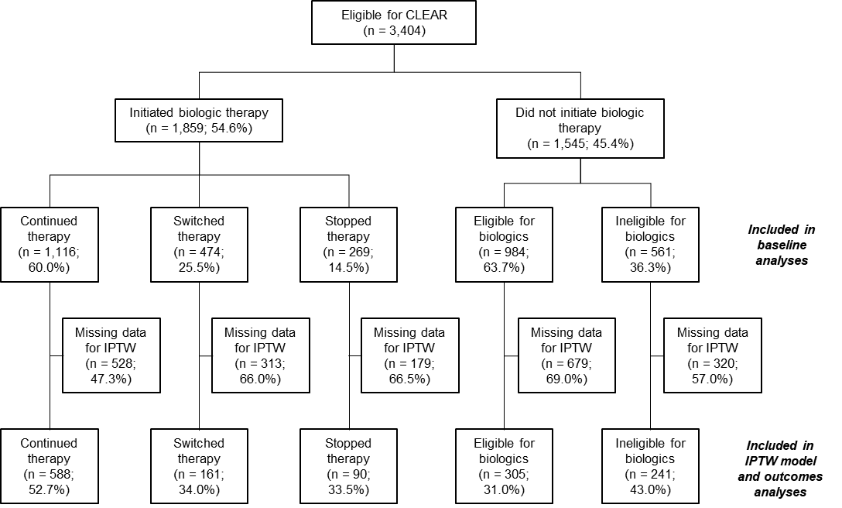
Aim and Methods
Background
Biologics are effective in severe asthma, however individual patients’ responses may be suboptimal, leading to therapy switching or stopping
Patients and patterns of biologic use
Aim
Assess real-world biologic use patterns and associated clinical outcomes in patients receiving care for severe asthma
Methods
Multicenter, observational study that included adults (≥18 years old) from 23 ISAR countries between December 2015 and August 2021
Biologic initiators were categorized as:
Continuing the initial biologic for 6 months
Switching to another biologic within 6 months
Stopping biologic treatment within 6 months
Outcomes were assessed using the closest available data to 12 months after biologic initiation, using propensity score-weighted multivariable regression models
IPTW = Inverse probability of treatment weighting; ISAR = International Severe Asthma Registry
Tran TN. et al., Real-World Biologic Use Patterns in Severe Asthma, 2015–2021: the CLEAR Study. Pragmat Obs Res. In press

Slide 3
Biologic initiators (pre-biologic initiation) were more likely to have uncontrolled asthma, and had more exacerbations and higher biomarker levels than non-initiators (within 12 months before the index date)
Characteristics of initiators (before biologic initiation) and non-initiators (within 12 months before the index date), % of patients
Biomarkers of initiators (before biologic initiation) and non-initiators (within 12 months before the index date)
Biomarker | Initiators | Non-initiators | P value
BEC, median (IQR), cells/µL | N=1671 300 (480) | N=1216 200 (260) | <0.001
FeNO, median (IQR), ppb | N=1159 35 (49) | N=544 22 (32) | <0.001
Serum total IgE, median (IQR), IU/mL | N=1476 191 (428) | N=893 63 (229) | <0.001
P<0.001
P<0.001
P<0.001
P<0.001
BEC = Blood eosinophil count; FeNO = Fractional exhaled nitric oxide; IgE = Immunoglobulin E; IQR = Interquartile range; LTOCS = Long-term oral corticosteroids
Tran TN. et al., Real-World Biologic Use Patterns in Severe Asthma, 2015–2021: the CLEAR Study. Pragmat Obs Res. In press

Slide 4
Pre-biologic initiation, continuers were more likely than switchers or stoppers to have uncontrolled asthma; switchers had higher FeNO levels and were less likely to be receiving LTOCS than continuers or stoppers
Characteristics of continuers, switchers and stoppers before biologic initiation, % of patients
Biomarkers of continuers, switchers and stoppers before biologic initiation
Biomarker | Continuers | Switchers | Stoppers | P value
BEC, median (IQR), cells/µL | N=1005 340 (480) | N=433 300 (510) | N=233 300 (400) | 0.007
FeNO, median (IQR), ppb | N=691 33 (44) | N=313 42 (53) | N=155 30 (53) | 0.001
Serum total IgE, median (IQR), IU/mL | N=904 185 (411) | N=367 197 (519) | N=205 238 (390) | 0.105
P<0.001
P<0.001
BEC = Blood eosinophil count; FeNO = Fractional exhaled nitric oxide; IgE = Immunoglobulin E; IQR = Interquartile range; LTOCS = Long-term oral corticosteroids
Tran TN. et al., Real-World Biologic Use Patterns in Severe Asthma, 2015–2021: the CLEAR Study. Pragmat Obs Res. In press

Slide 5
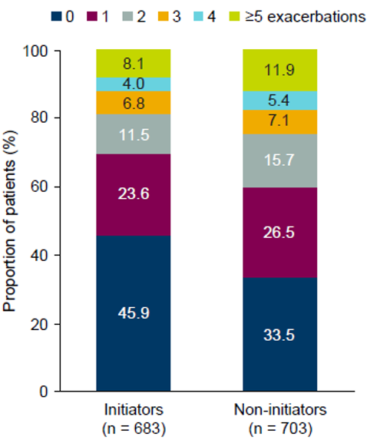
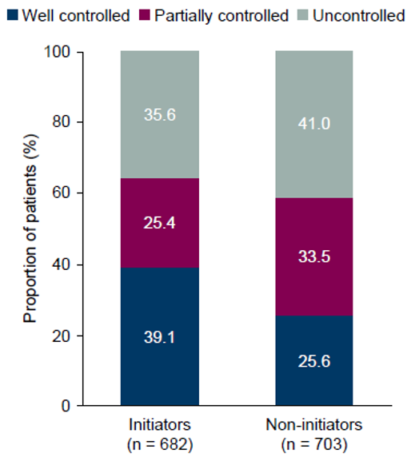
Biologic initiators had fewer exacerbations, were less likely to have uncontrolled asthma and had a greater reduction in daily LTOCS dose than non-initiators during the follow-up period*
Exacerbations at follow-up*
Asthma control at follow-up*
Initiators had a lower AAER than non-initiators (adjusted IRR: 0.76 [95% CI: 0.65, 0.88]), with a mean (SD) AAER of 1.6 (2.9) for initiators and 2.1 (3.5) for non-initiators.
Initiators had a longer time to first exacerbation than non-initiators (HR: 0.39 [95% CI: 0.33, 0.47]).
Initiators were less likely to have uncontrolled asthma than non-initiators (adjusted odds ratio: 0.76 [95% CI: 0.55, 1.06]).
LTOCS dose at follow-up*
The mean (SD) daily LTOCS dose was 7.8 (10.0) mg for initiators and 9.5 (8.8) mg for non-initiators.
Initiators had a greater reduction in daily LTOCS dose than non-initiators (adjusted β: −2.73 mg [95% CI: −4.77, −0.68]).
*After inverse probability of treatment weighting. Exacerbations are annualized numbers. Asthma control is the last available assessment. Outcomes were assessed at follow-up (after biologic initiation for initiators) using the closest available data to 12 months after the index date. The index date was the date of biologic initiation for initiators and ISAR enrolment for non-initiators.
AAER: Annualized asthma exacerbation rate; CI: Confidence interval; HR: Hazard ratio; IRR: Incidence rate ratio; LTOCS: Long-term oral corticosteroids; SD: Standard deviation
Tran TN. et al., Real-World Biologic Use Patterns in Severe Asthma, 2015–2021: the CLEAR Study. Pragmat Obs Res. In press

Slide 6
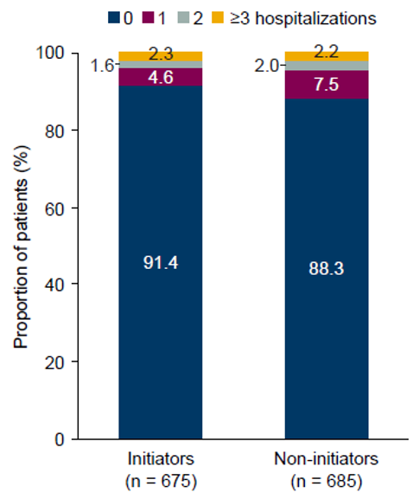
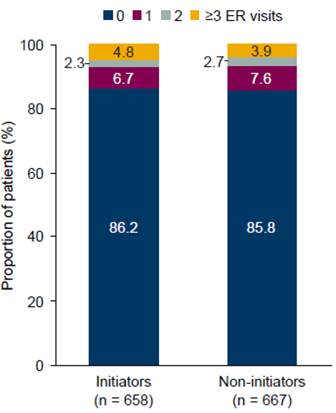
There were no substantive differences between biologic initiators and non-initiators in rates of healthcare resource utilization during the follow-up period*
Hospitalizations at follow-up*
ER visits at follow-up*
The annualized mean (SD) number of hospitalizations was 0.2 (0.9) for initiators and 0.2 (0.6) for non-initiators.
The annualized mean (SD) number of ER visits was 0.4 (2.1) for initiators and 0.3 (1.2) for non-initiators.
*After inverse probability of treatment weighting. Hospitalizations and emergency room visits are annualized numbers. Outcomes were assessed at follow-up (after biologic initiation for initiators) using the closest available data to 12 months after the index date. The index date was the date of biologic initiation for initiators and ISAR enrolment for non-initiators.
ER: Emergency room; SD: Standard deviation
Tran TN. et al., Real-World Biologic Use Patterns in Severe Asthma, 2015–2021: the CLEAR Study. Pragmat Obs Res. In press

Slide 7
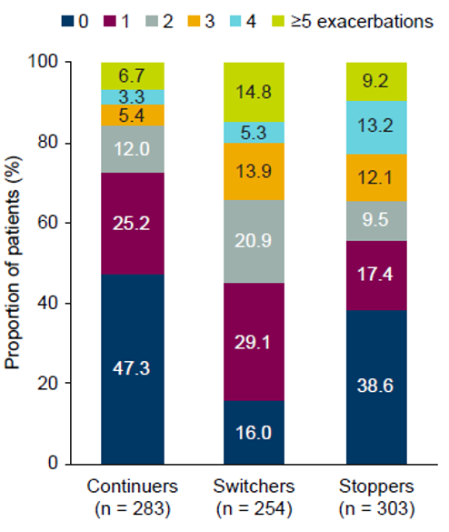
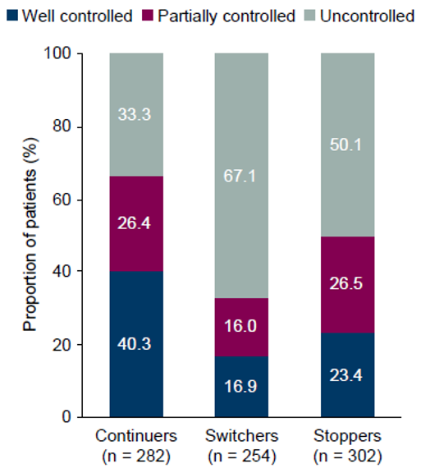
After biologic initiation, continuers had fewer exacerbations, lower LTOCS use and were less likely to have uncontrolled asthma than switchers or stoppers at follow-up*
Exacerbations at follow-up*
Asthma control at follow-up*
The mean (SD) AAER was 1.4 (2.7) for continuers, 2.5 (2.9) for switchers and 2.0 (2.4) for stoppers.
Compared with continuers, both switchers (HR: 2.59 [95% CI: 1.57, 4.27]) and stoppers (HR: 2.12 [95% CI: 1.11, 4.04]) had a shorter time to first exacerbation.
>50% of continuers still had ≥1 exacerbation.
Switchers and stoppers were more likely to have uncontrolled asthma than continuers (switchers versus continuers adjusted OR: 5.40 [95% CI: 3.12, 9.33]; stoppers versus continuers adjusted OR: 4.02 [95% CI: 2.32, 6.98]).
One-third of continuers still had uncontrolled asthma.
LTOCS dose at follow-up*
The mean (SD) daily LTOCS dose during the follow-up period was 6.2 (8.7) mg for continuers, 11.1 (11.4) mg for switchers and 10.8 (12.5) mg for stoppers.
The reduction in daily LTOCS dose was smaller for switchers and stoppers than for continuers (adjusted β: 3.77 mg [95% CI: 1.71, 4.37] and 3.09 mg [95% CI: −0.27, 6.45] for switchers and stoppers, respectively, versus continuers).
*After inverse probability of treatment weighting. Exacerbations are annualized numbers. Asthma control is the last available assessment. Outcomes were assessed at follow-up (after biologic initiation for initiators) using the closest available data to 12 months after the index date. The index date was the date of biologic initiation for initiators and ISAR enrolment for non-initiators.
AAER: Annualized asthma exacerbation rate; CI: Confidence interval; HR: Hazard ratio; OR: Odds ratio; LTOCS: Long-term oral corticosteroids; SD: Standard deviation
Tran TN. et al., Real-World Biologic Use Patterns in Severe Asthma, 2015–2021: the CLEAR Study. Pragmat Obs Res. In press

Slide 8
After biologic initiation, continuers had lower rates of healthcare resource utilization than switchers at follow-up*
Hospitalizations at follow-up*
ER visits at follow-up*
Switchers had a higher rate of hospitalizations than continuers (adjusted IRR [95% CI]: 2.58 [1.52, 4.37]; there was no substantive difference between stoppers and continuers (adjusted IRR [95% CI]: 1.20 [0.59, 2.42]).
The annualized mean (SD) number of hospitalizations was 0.1 (0.5) for continuers, 0.5 (1.6) for switchers and 0.3 (1.1) for stoppers.
Switchers had a higher rate of ER visits than continuers (adjusted IRR [95% CI]: 2.12 [1.39, 3.24]; there was no substantive difference between stoppers and continuers (adjusted IRR [95% CI]: 1.10 [0.60, 2.01]).
The annualized mean (SD) number of ER visits was 0.3 (1.1) for continuers, 1.3 (3.9) for switchers and 0.4 (1.7) for stoppers.
*After inverse probability of treatment weighting. Hospitalizations and emergency room visits are annualized numbers. Outcomes were assessed at follow-up (after biologic initiation for initiators) using the closest available data to 12 months after the index date. The index date was the date of biologic initiation for initiators and ISAR enrolment for non-initiators.
ER: Emergency room; SD: Standard deviation
Tran TN. et al., Real-World Biologic Use Patterns in Severe Asthma, 2015–2021: the CLEAR Study. Pragmat Obs Res. In press

Slide 9
Summary: Among biologic initiators, switching or stopping biologic therapy was associated with worse clinical outcomes than continuing the initial therapy
Key findings
Practice change needed
Biologic initiators had fewer exacerbations, lower LTOCS use and were less likely to have uncontrolled asthma than non-initiators during the follow-up period.
After biologic initiation, continuers had fewer exacerbations, lower LTOCS use and were less likely to have uncontrolled asthma than switchers or stoppers.
There remained a high unmet need among biologic continuers: >50% had ≥1 exacerbation and one-third had uncontrolled asthma during the follow-up period.
There is a need for regulators to increase and standardize access to biologics (e.g., reimbursement and availability of biomarker tests for phenotyping).
Selecting the right initial biologic for continual therapy, accurate phenotyping and the optimal management of comorbidities are essential. Further research on how to predict patient response to biologic treatment is needed.
Earlier initiation of biologic therapy or switching to alternatives may benefit patients who experience lack of clinical effectiveness with their initial biologic.
LTOCS = Long-term oral corticosteroids
Tran TN. et al., Real-World Biologic Use Patterns in Severe Asthma, 2015–2021: the CLEAR Study. Pragmat Obs Res. In press

