Slide 1
International Variation in Severe Exacerbation Rates in Patients with Severe Asthma
Tae Yoon Lee, MSc, David Price, FRCGP, Chandra Prakash Yadav, PhD, Rupsa Roy, MSc, Laura Lim Huey Mien, MSc, Eileen Wang, MD, PhD, Michael E. Wechsler, MD, David J. Jackson, MBBS, MRCP (UK), PhD, John Busby, PhD, Liam G. Heaney, MD, Paul E. Pfeffer, MRCP(UK), PhD, Bassam Mahboub, MD, Diahn- Warng Perng (Steve), MD, PhD, Borja G. Cosio, MD, PhD, Luis Perez-de-Llano,MD, PhD, Riyad Al-Lehebi, MD, FRCPC, Désirée Larenas-Linnemann, MD, FAAAAI, Dist.Intl.FACAAI, Mona Al-Ahmad, MD, FRCPC, Chin Kook Rhee, MD, PhD, Takashi Iwanaga, MD, PhD, Enrico Heffler, MD, PhD, Giorgio Walter Canonica, MD, Richard Costello, MB, MD, FRCPI, Nikolaos G. Papadopoulos, MD, PhD, FRCP, Andriana I. Papaioannou, MD, PhD, Celeste M. Porsbjerg, MD, PhD, Carlos A. Torres-Duque, MD, George C. Christoff, MD, PhD, MPH, Todor A. Popov, MD, PhD, Mark Hew, MBBS, PhD, FRACP, Matthew Peters, MD, PhD, Peter G. Gibson, MBBS, FRACP, Jorge Maspero, PhD, Celine Bergeron, MD, FRCPC, MSc, Saraid Cerda, MD, Elvia Angelica Contreras Contreras, MD, Wenjia Chen, PhD, Mohsen Sadatsafavi, MD, PhD

Slide 2
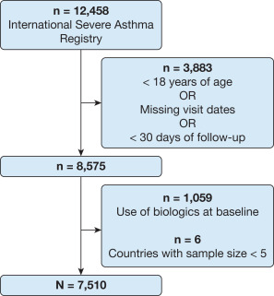
Aim and Methods
Rationale
Exacerbation frequency strongly influences treatment choices in patients with severe asthma, but the rate of exacerbations varies across countries.
Aim
To examine the extent of the variability of exacerbations rate across countries and its implications in disease management.
Methods
Data source: The International Severe Asthma Registry (ISAR).
Study population: Patients ≥ 18 years of age who did not initiate any biologics before baseline visit.
Statistical analyses: Negative binomial models to estimate country-specific severe exacerbation rates during 365 days of follow-up in naïve and adjusted models.
Flow diagram of the International Severe Asthma Registry cohort

Slide 3
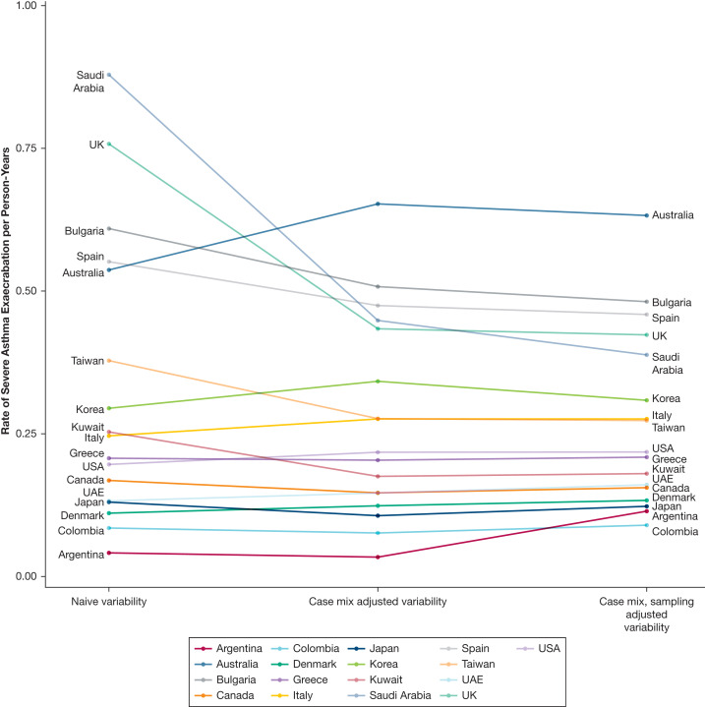
Large between-country variations of severe asthma exacerbation rates
Estimates of country-specific severe asthma exacerbation rates (per person-years) using the average marginal effect framework for naïve, case mix adjusted (fixed-effect), and case mix and sampling adjusted (random-effects) models.
Findings
Large between-country variation in observed severe exacerbation rate (minimum, 0.04 [Argentina]; maximum, 0.88 [Saudi Arabia]; interquartile range, 0.13-0.54).
Remained substantial after adjusting for patient characteristics and sampling variability (interquartile range, 0.16-0.39).
UAE = United Arab Emirates; UK = United Kingdom; USA = United States.

Slide 4
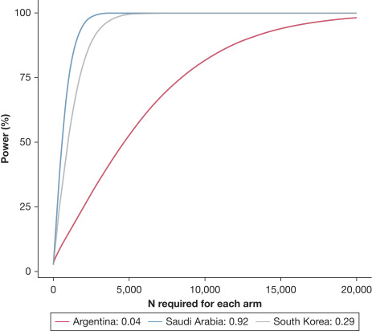
Design of future severe asthma trials (desired sample sizes)
Power analysis for the lowest, median, and highest severe exacerbation rates (per person-years) observed in the International Severe Asthma Registry to detect a reduction of 20% in severe exacerbation rates from the comparator.
Findings
To detect a 20% reduction in severe exacerbation rate with 90% power
12,699 patients per arm required in Argentina;
2,503 patients in South Korea;
1,432 patients in Saudi Arabia
International clinical studies recruiting patients from specialty care should balance trial design’s efficiency and representativeness of countries and regions.

Slide 5
Conclusions
Considerable heterogeneity in severe exacerbation rates in patients with severe asthma across countries.
Unidentified patient-specific factors and/or systemic intricacies contributing to the observed variations.
Each country or jurisdiction should adapt clinical recommendations for severe asthma to their setting for optimal treatment escalation strategies.
Risk prediction models calibrated for each jurisdiction will be needed to optimize treatment strategies.

