Slide 1
Characterization of Severe Asthma Worldwide: Data From the International Severe Asthma Registry
Eileen Wang et al, CHEST 2020;157(4):790-804.

Slide 2
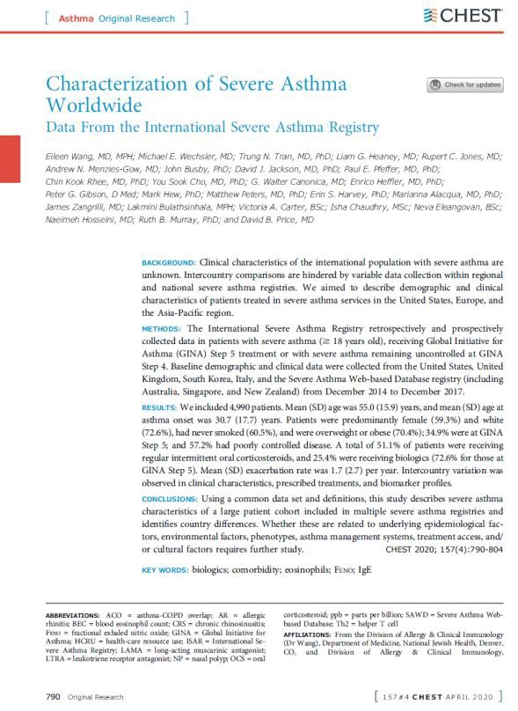
Background and aims
Background
Clinical characteristics of the international population with severe asthma are unknown, and intercountry comparisons are hindered by variable data collection within regional and national severe asthma registries.
Aim
To describe baseline demographic and clinical characteristics of patients treated in severe asthma services in the United States, Europe, and the Asia-Pacific region.
Full Text available here.
ISAR: International Severe Asthma Registry

Slide 3
Methods: A historical, registry study
ISAR acts as a data custodian by including patient-level data from other existing and newly-created
registries into the ISAR database at regular intervals.
Participating countries retain ownership of their own data but have agreed to provide access to anonymous patient-level data for approved research purposes.
Before making the countrywide data available to ISAR, each country lead is responsible for overseeing
data collection and combining data from any satellite sites.
This allows for the creation of a locally hosted central registry for the country’s combined data, which can be used to
enhance local- and international-level research.
You may find ISAR’s mission statement which fully describes how ISAR may improve our understanding
of severe asthma here, and we described the protocol for registry development and management here.
ISAR: International Severe Asthma Registry

Slide 4
Methods: Patient eligibility criteria
Eligibility criteria were chosen to reflect patients with severe asthma in the real-world setting
and to broaden the scope to include patients with uncontrolled moderate to severe asthma.
Additional information on definitions of severe asthma for registries participating in the ISAR Inclusion criteria can be found in the Online Supplement here.
18 years or older
Received treatment at Global Initiative for Asthma (GINA) Step 5
Had uncontrolled asthma at GINA Step 4 (at inclusion)
Provided consent for their data to be included
– Except in the United States, where consent was not required because data were deidentified
Smokers and patients with asthma-COPD overlap (ACO) were NOT excluded
GINA: Global Initiative for Asthma; ACO: Asthma-COPD overlap

Slide 5
Methods: Data collection
Data were collected from the following registries from December 2014 to December 30, 2017:
National Jewish Health Electronic Medical Record (NJH EMR) Severe Asthma Cohort
– United States, from all regions [predominantly Colorado and Wyoming] and a small proportion from other countries)
UK Severe Asthma Registry (four sites)
Korean Academy of Asthma, Allergy and Clinical Immunology (KAAACI; 15 sites)
Severe Asthma Network Italy (SANI; 61 sites)
Australasian Severe Asthma Registry (ASAR) hosted by the Thoracic Society of Australia and New Zealand (TSANZ)
– i.e. Severe Asthma Web-based Database [SAWD], including patient data from Australia, Singapore, and New Zealand: 23 sites

Slide 6
Methods: Data collection
ISAR captures 95 core variables that were agreed through a modified Delphi process.
– You may find our Delphi study which fully describes the process of reaching consensus on which core variables to collect in ISAR here.
Data collected | Definition
Number of exacerbations | The number requiring rescue systemic corticosteroids in the past 12 months; The United States used duration of OCS as a proxy for exacerbation (assuming one OCS course lasts ≥7 days), in line with GINA 2018 recommendations, previously published research, and based on discussion with the site investigator.
Prednisolone prescriptions | Most were for at least 7 days for short-term use
Number of hospitalization and ED admissions for asthma | The number in the past 12 months
Number of times invasive ventilation was used | The number of episodes before data extraction
Comorbidity | Based on a formal diagnosis or reliably inferred from relevant prescription data For the United States, comorbidity data were captured using International Classification of Diseases, Tenth Revision codes for active diagnosis of comorbidity Prescription data were used as a supplement to identify the comorbidity status of allergic rhinitis (AR) and eczema because their active diagnosis was underreported in the electronic medical records data.
Regular OCS use | ≥90 days of OCS use in a year
Intermittent OCS use | Prescription for repeated OCS use and/or ≥2 exacerbations in a 1-year period
Asthma control | Categorized as controlled, partly controlled, or uncontrolled according to GINA criteria determined using the Asthma Control Test questionnaire or the Asthma Control Questionnaire

Slide 7
Methods: Statistical analysis
Data were assessed using Stata version 14 (StataCorp) or SAS version 9.4 or 9.5 (SAS Institute)
according to a predefined data analysis plan to minimize bias.
Descriptive statistics were reported as categorical variables for all variables for the overall and country- specific patient populations.
Health-care resource use (HCRU), IgE count, blood eosinophil count (BEC), and comorbidities also were stratified by severe asthma status and sex for the overall population.
ISAR: International Severe Asthma Registry

Slide 8
Results: Patient demographics
ETHNICITY
2.6
SMOKING STATUS
4,990
ELIGIBLE PATIENTS
0.6
6.7
5.9
5.4
12
33.5
MEAN AGE OF MEAN AGE OF
55 30.7
60.6
72.6
YEARS
YEARS AT ASTHMA ONSET
White African Other
Asian Mixed Unknown
FEMALE (59.3%)
MALE (40.7%)
Current Smoker Ex-smoker Never smoked
Approximately ⅓ of individuals from the SAWD registry, SK, and the USA were ex- smokers.
70.4%
OVERWEIGHT/OBESE
51.1%
REGULAR INTERMITTENT ORAL CORTICOSTEROIDS
25.4%
RECEIVING BIOLOGICS
(72.6% for those at GINA Step 5)
1.7
MEAN EXACERBATION RATE PER YEAR
SK had the oldest patients, the lowest prevalence of patients who were overweight or obese, and the highest prevalence of current smokers.
USA: United States of America; SK: South Korea; SAWD: Severe Asthma Web-based Database

Slide 9
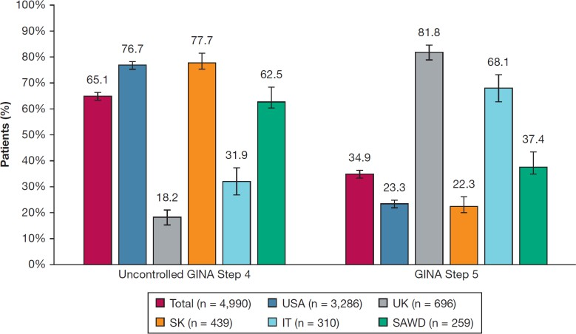
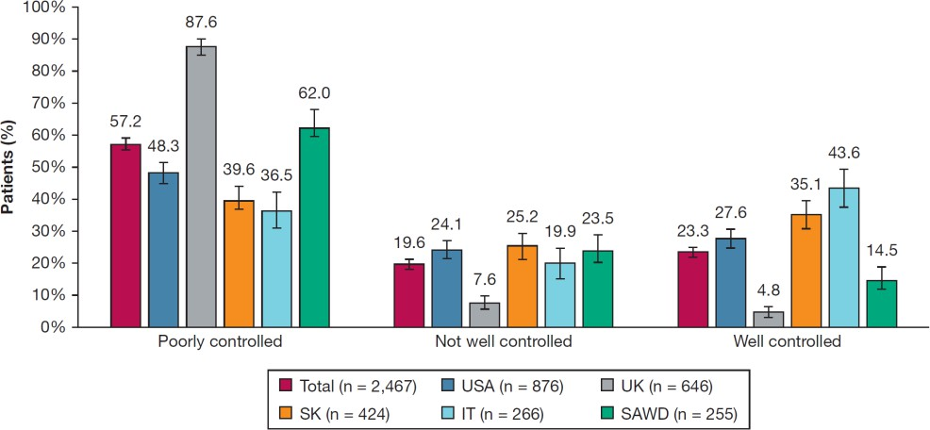
Results: Demographic characteristics
Asthma Control
34.9% were at GINA Step 5 and 57.2% had poorly controlled severe asthma,
USA: United States of America; UK: United Kingdom; SK: South Korea; IT: Italy; SAWD: Severe Asthma Web-based Database

Slide 10
Results: Clinical characteristics
Severity
Most patients had uncontrolled asthma at GINA Step 4, and there was a higher proportion of women among patients with uncontrolled asthma at GINA Step 4 and among patients with asthma at GINA Step 5.
Patients from the UK and IT tended to have more severe disease, and those from the USA and SK
tended to have the least severe compared with patients in other countries.
USA: United States of America; UK: United Kingdom; SK: South Korea; IT: Italy; SAWD: Severe Asthma Web-based Database

Slide 11
Results: Clinical characteristics
Lung Function
Percent predicted FEV₁ and FVC values appeared to be independent of severity, showed some
intercountry variability, and showed little postbronchodilator improvement.
Bronchoconstriction was considered irreversible for those in both severity groups and irrespective of smoking history. Some intercountry variability was also noted.
These findings not only justify the ISAR inclusion criteria for severe asthma, but also ratify the definition of severe asthma as outlined by the European Respiratory Society (ERS) and American Thoracic Society (ATS).
– Incidentally, those with low or limited reversibility are routinely excluded from asthma clinical trials.
ISAR’s inclusive nature and broad definition of severe asthma allowed for this population to be properly
studied and characterised.
USA: United States of America; UK: United Kingdom; SK: South Korea; IT: Italy; SAWD: Severe Asthma Web-based Database

Slide 12
Results: Clinical characteristics
Age at Onset
The mean (SD) age at onset was 30.7 (17.7) years.
77.5% of patients developed asthma after the age of 12 years, and 34.4% developed it after the age of 40 years.
Patients from the UK and the SAWD registry developed asthma slightly earlier than this, and those from South Korea and Italy slightly later.
USA: United States of America; UK: United Kingdom; SK: South Korea; IT: Italy; SAWD: Severe Asthma Web-based Database

Slide 13
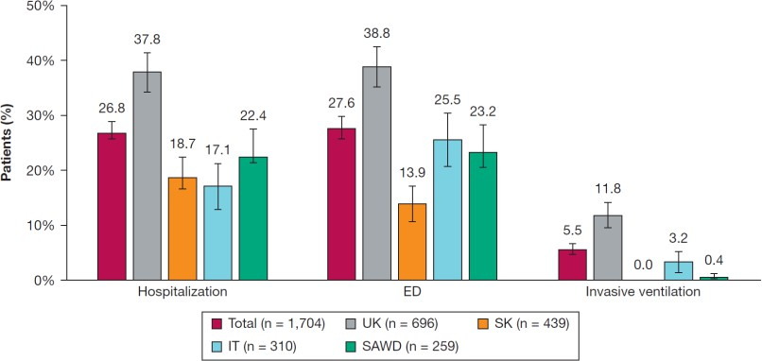
Results: Clinical characteristics
Asthma Control and Health-Care Resource Use (HCRU)
At entry to their national registry, 57.2% of patients had poorly controlled asthma.
This percentage was highest in the UK and the SAWD registry and lowest in IT and SK.
The proportions of patients with well- controlled, partly controlled, and uncontrolled asthma were similar in the GINA Step 4 (uncontrolled asthma at entry) and GINA Step 5 groups.
HCRU was high overall.
HCRU was highest in the UK, lowest in SK, and was slightly higher for patients at GINA Step 5.
USA: United States of America; UK: United Kingdom; SK: South Korea; IT: Italy; SAWD: Severe Asthma Web-based Database

Slide 14
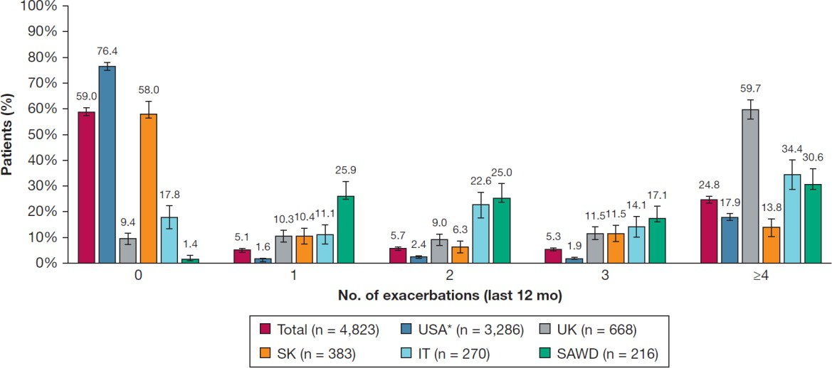
Results: Clinical characteristics
Exacerbations
The mean (SD) number of exacerbations (past 12 months) was 1.7 (2.7).
One quarter of patients reported ≥4 exacerbations.
The number of exacerbations was driven by severity, with most patients with uncontrolled asthma at GINA Step 4 (at inclusion) reporting 0 exacerbations (71.1%), whereas 42.5% of patients at GINA Step 5 reported ≥4 exacerbations.
The mean number of exacerbations was lowest in the United States and South Korea and highest in the United Kingdom.
USA: United States of America; UK: United Kingdom; SK: South Korea; IT: Italy; SAWD: Severe Asthma Web-based Database

Slide 15
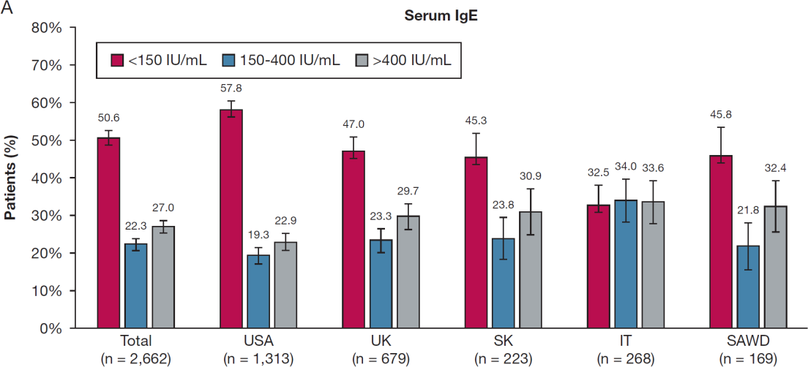
Results: Clinical characteristics
Immunoglobulin E (IgE) Concentration
Overall, one-half of the patient population with severe asthma had low IgE concentrations, and IgE profile varied according to severity.
Gender:
More women had low IgE concentrations, and more men had high IgE concentrations, irrespective of severity.
Asthma Control:
More patients with uncontrolled asthma at GINA Step 4 (vs GINA Step 5) had low IgE concentrations.
GINA:
More patients at GINA Step 5 (vs those with uncontrolled asthma at GINA Step 4) had high IgE concentrations.
Geographic location:
Most patients had low IgE serum concentrations.
An even distribution of patients across the IgE concentration categories was noted.
–
Patients showed a more even split between low
vs. intermediate or high IgE concentrations.
USA: United States of America; UK: United Kingdom; SK: South Korea; IT: Italy; SAWD: Severe Asthma Web-based Database

Slide 16
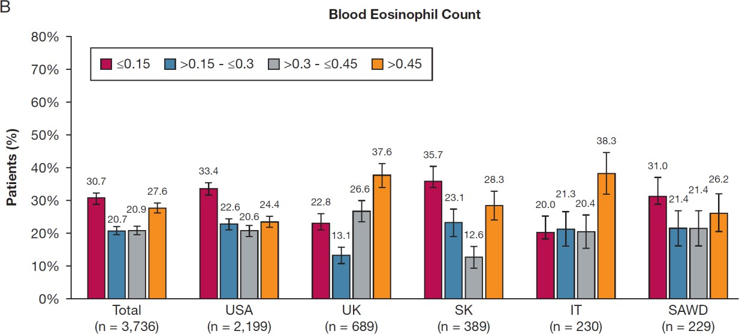
Results: Clinical characteristics
Blood Eosinophil Count (BEC)
48.5% of patients had a BEC > 0.3x10⁹/L.
– This comprises mostly patients from the UK and IT.
Most patients had a BEC ≤ 0.3x10⁹/L.
USA: United States of America; UK: United Kingdom; SK: South Korea; IT: Italy; SAWD: Severe Asthma Web-based Database

Slide 17
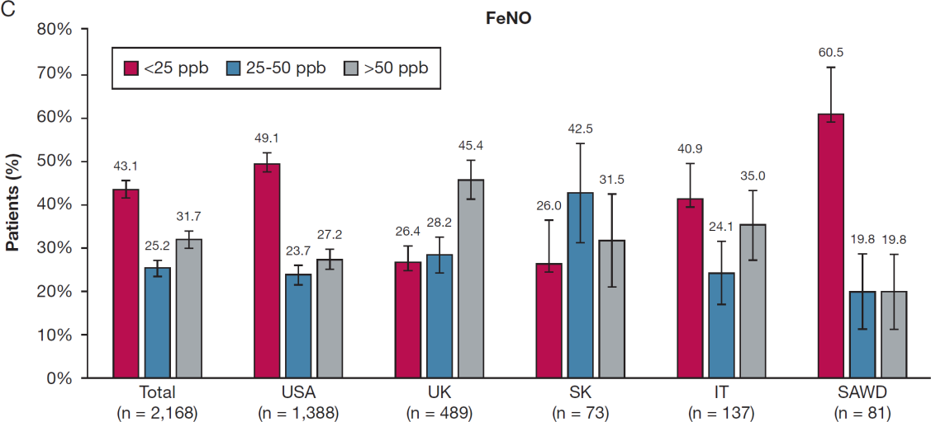
Results: Clinical characteristics
Fractional Exhaled Nitric Oxide (FeNO)
Overall, 43.1% of patients with severe asthma had fractional exhaled nitric oxide (FeNO) concentrations
<25 parts per billion (ppb), and 56.9% had a concentration ≥25 ppb.
A similar proportion of patients had FeNO concentrations <25ppb and ≥25 ppb.
Most patients had FeNO concentrations ≥25ppb.
Most patients had FeNO concentrations <25 ppb.
USA: United States of America; UK: United Kingdom; SK: South Korea; IT: Italy; SAWD: Severe Asthma Web-based Database

Slide 18
Results: Clinical characteristics
Comorbidities
Allergic rhinitis (AR) was the predominant comorbidity in the total population (49.4%), and in all countries.
– This is followed by chronic rhinosinusitis (CRS; 21.4%), eczema (9.6%), and nasal polyps (NP; 7.3%).
Highest prevalence of comorbid CRS (26.8%):
Highest eczema prevalence (20.5%):
Highest NP prevalence (22.3%):
USA: United States of America; UK: United Kingdom; SK: South Korea; IT: Italy; SAWD: Severe Asthma Web-based Database

Slide 19
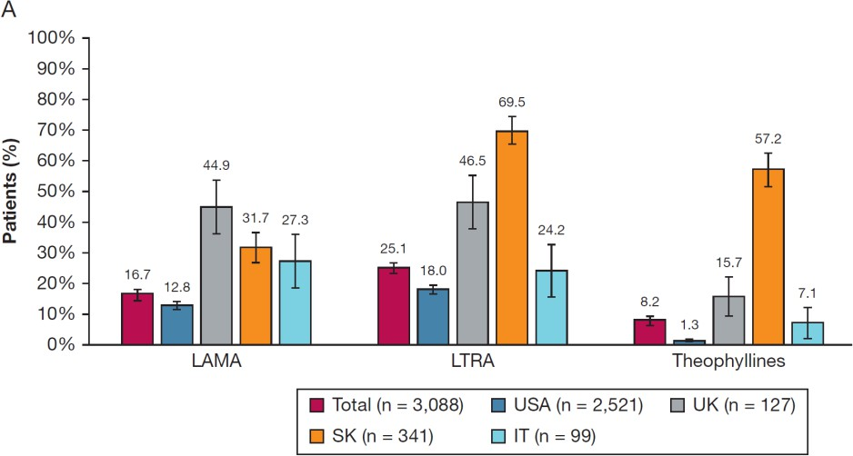
Results: Clinical characteristics
Treatment
Half of all patients at GINA Step 4 or Step 5 were
receiving repeated intermittent OCS.
Highest intermittent OCS use:
Lowest intermittent OCS use:
All patients with uncontrolled asthma at GINA Step 4 were receiving inhaled corticosteroid and long-acting B₂- agonist therapy.
The most common add-on to inhaled corticosteroid and long-acting B₂-agonist was leukotriene receptor antagonist (LTRA), followed by long-acting muscarinic receptor antagonist (LAMA) and theophylline.
The same pattern was noted in the US and UK registries.
Theophylline was used more commonly than was LAMA:
LAMA was used more commonly than was LTRA:
Highest proportion of patients receiving add-on LAMA:
Add-on therapy was used sparingly for patients with uncontrolled asthma at GINA Step 4 (at baseline).
USA: United States of America; UK: United Kingdom; SK: South Korea; IT: Italy; SAWD: Severe Asthma Web-based Database

Slide 20
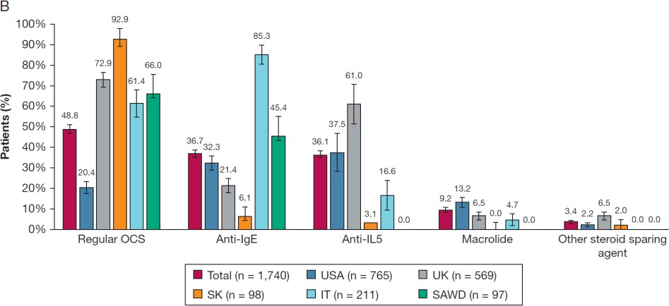
Results: Clinical characteristics
Treatment
Add-on regular OCS was used by almost one-half of the
patients at GINA Step 5.
A wide range of intercountry variability was noted for regular OCS use.
Anti-IgE and anti-IL-5 were each used by approximately one-third of patients, and macrolides were prescribed for a minority.
Overall, 72.6% of patients with severe asthma at GINA Step 5 were receiving therapeutic monoclonal antibody therapy (i.e. biologics).
Notably high rates in Italy and the United Kingdom, and a relatively low rate of use in South Korea.
Predominant biologics:
Anti-IgE in IT and anti-IL-5 in the UK.
In the USA, there is a fairly even split between anti-IgE and anti-IL-5, with the highest proportion of patients receiving macrolides.
USA: United States of America; UK: United Kingdom; SK: South Korea; IT: Italy; SAWD: Severe Asthma Web-based Database

Slide 21
Conclusions
This study provides the first description of an international population with managed severe asthma and identified differences in demographic and clinical characteristics both geographically and across health-care systems.
Initial country-specific biomarker profiles have been identified, and further studies are required to determine whether inter-counter differences are related to:
Underlying epidemiological factors
Environmental factors
Phenotypes
Asthma management systems
Treatment access
Cultural factors
Prospective data collection for the ISAR registry began in 2018 in Italy, the United States, South Korea, and the United Kingdom, and this ensures better standardisation of data fields, facilitating more accurate cross-country comparisons and reducing any data incongruence in upcoming ISAR data sets.
ISAR: International Severe Asthma Registry

