Slide 1
Exploring different composite definitions of responders and non-responders to biologic treatment for severe asthma (FULL BEAM response)
Exploring Definitions and Predictors of Severe Asthma Clinical Remission Post-Biologic in Adults (FULL BEAM remission)
ISAR FULL BEAM
Perez-de-Llano, L. et al., Am J Respir Crit Care Med 2024, https://doi.org/10.1164/rccm.202311-2192OC Scelo, G. et al., J Allergy Clin Immunol Pract. 2024 May 19:S2213-2198(24)00530-0. doi: 10.1016/j.jaip.2024.05.016. ​

Slide 2
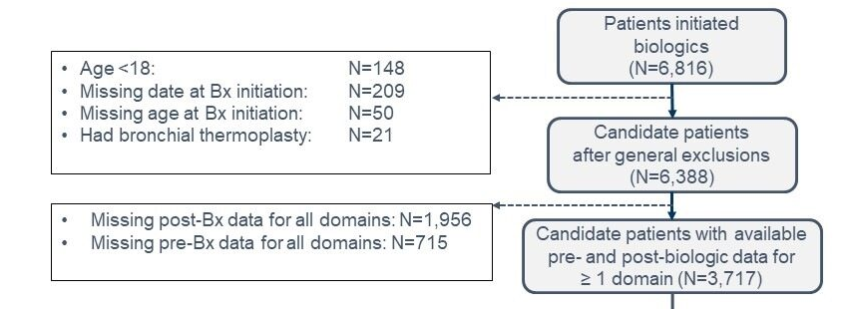
Aims and Methods
Rationale
There is little agreement on definitions of real-world responders to biologic treatments for asthma and the concept of remission in severe asthma remains to be explored.
Objective
To explore composite definitions of response and remission in adults with severe asthma.
Methods
Longitudinal cohort study across 22 countries participating in ISAR from May 2017 to
January 2023
Quantification of individual and composite definitions of response and remission at one year post-treatment using four asthma domains: exacerbation rate, asthma control, long-term oral corticosteroid (LTOCS) dose, and lung function
Comparison of patient characteristics between response and non-response groups, and between remission and non-remission group
bx: biologics ​
​
Perez-de-Llano, L. et al., Am J Respir Crit Care Med 2024, https://doi.org/10.1164/rccm.202311-2192OC Scelo, G. et al., J Allergy Clin Immunol Pract. 2024 May 19:S2213-2198(24)00530-0. doi: 10.1016/j.jaip.2024.05.016. ​
Notes:
There is little agreement on definitions of real-world responders to biologic treatments for asthma and the concept of remission in severe asthma remains to be explored.
FULL BEAM explores the definitions of response and remission in severe asthma.
The study spans across 22 countries, and data collected from between 2017 and 2023.
Individual and composite definitions of response and remission at one year post-treatment with biologics were measured. Four domains were assessed: exacerbation rate, asthma control, long-term OCS dose and lung function.

Slide 3
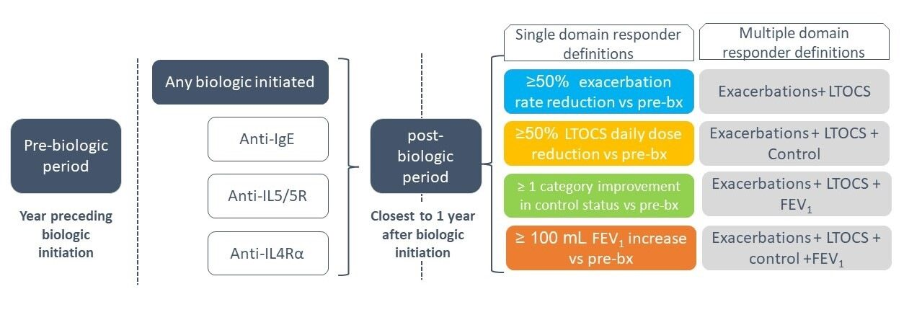
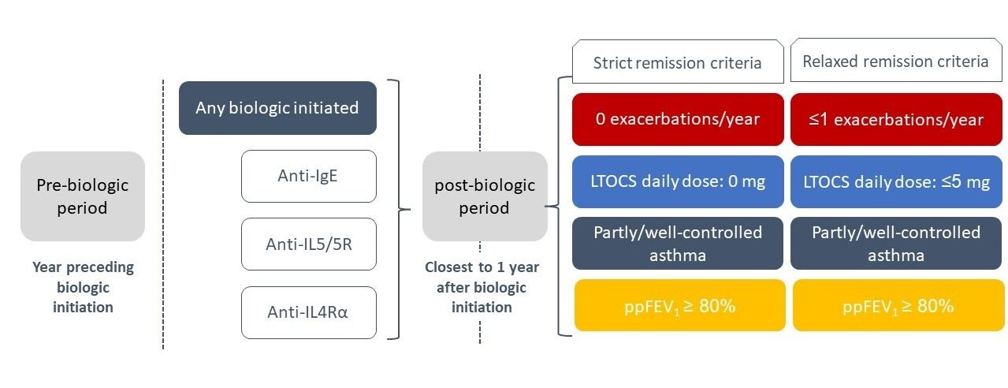
Response and remission definitions
Response
Minimum impairment pre-biologic:
- Exacerbations: ≥2/year, and/or
- LTOCS: use in past year, and/or
- Asthma control: uncontrolled or partly
controlled, and/or
- Lung function: <80% predicted FEV1
Remission
(No minimum impairment)
LTOCS: Long-term Oral Corticosteroids, ppFEV1: percent predicted forced expiratory volume in 1 second, anti-IgE: Anti-Immunoglobulin E, Anti-IL5: Anti-Interleukin 5, Anti-IL4Rα: Anti-Interleukin4Rα ​
​
Perez-de-Llano, L. et al., Am J Respir Crit Care Med 2024, https://doi.org/10.1164/rccm.202311-2192OC Scelo, G. et al., J Allergy Clin Immunol Pract. 2024 May 19:S2213-2198(24)00530-0. doi: 10.1016/j.jaip.2024.05.016. ​
Notes:
A minimum impairment pre-biologic was required when measuring response:
Minimum impairment pre-biologic:
- Exacerbations: ≥2/year, and/or
- LTOCS: use in past year, and/or
- Asthma control: uncontrolled or partly
controlled, and/or
- Lung function: <80% predicted FEV1
No minimum ore-biologic impairment was required for assessment of remission.

Slide 4
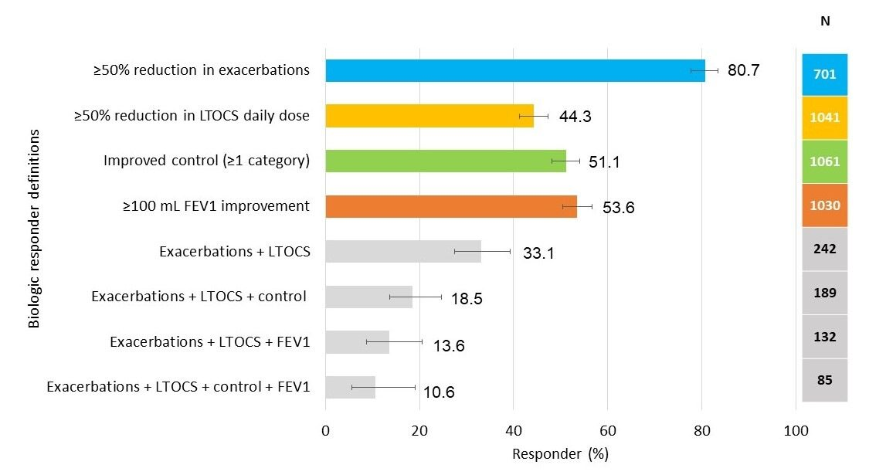
Spectrum of biologic responders, ranging from 11-80% depending upon type and number of domains used to define response
LTOCS: Long-term Oral Corticosteroids, FEV1: forced expiratory volume in 1 second.​
Scelo, G. et al., J Allergy Clin Immunol Pract. 2024 May 19:S2213-2198(24)00530-0. doi: 10.1016/j.jaip.2024.05.016. ​
Notes:
A large proportion of patients were responders (80% of patients reduced exacerbations by at least 50%), however residual impairment observed in responders.
Responses and their predictors vary according to the outcome assessed.

Slide 5
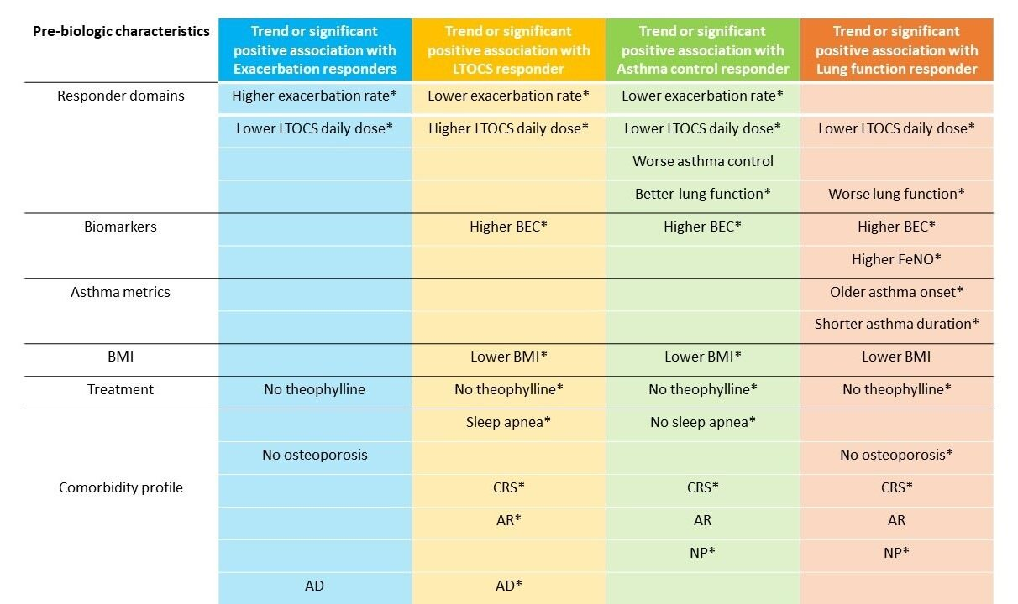
Patient and clinical characteristics associated with response
* p<0.05
LTOCS: Long-term Oral Corticosteroids, BMI: Body Mass Index, AD: Atopic Dermatitis, AR: Allergic Rhinitis, CRS: Chronic Rhinosinusitis, BEC: Blood Eosinophil Count, NP: Nasal Polyps, FeNO: Fractional Exhaled Nitric Oxide​
Scelo, G. et al., J Allergy Clin Immunol Pract. 2024 May 19:S2213-2198(24)00530-0. doi: 10.1016/j.jaip.2024.05.016. ​
Notes:
Multiple pre-biologic characteristics were associated with a better biologic response. Lung function response was more likely in those with a higher pre-biologic initiation FeNO, lower LTOCS, shorter duration of asthma, and older age at asthma onset. Other pre-biologic characteristics were common across all four responder domains (eg, greater pre-biologic impairment in the domain of interest), in common with previous research, or for all responder domains except exacerbations (eg, higher prebiologic BEC, lower BMI, history of a T2-related comorbidity).

Slide 6
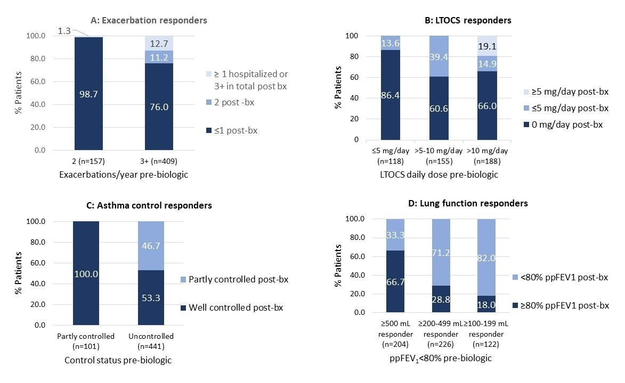
Residual impairments in responders by pre-biologic levels of impairment
LTOCS: Long-term Oral Corticosteroids, ppFEV1: percent predicted forced expiratory volume in 1 second, bx: biologics
​
​
Scelo, G. et al., J Allergy Clin Immunol Pract. 2024 May 19:S2213-2198(24)00530-0. doi: 10.1016/j.jaip.2024.05.016. ​
Notes:
However, despite being a responder, residual impairment is evident. The question of whether achieving response or being a responder is the end of the story very much depends on the level of prebiologic impairment in each domain assessed and what is achievable for each patient based on the level of that impairment. For example, 33.3% of lung function responders still had a ppFEV₁ of less than 80% after the biologic although the FEV₁ had already improved by 500 mL or greater with biologic treatment. This residual impairment may be due to drug, treatment, and social determinants (eg, adherence and access) and/or the heterogeneity of severe asthma, including the presence of an underlying pathophysiology not targeted by existing biologics, T2-low asthma, and/or nonpulmonary comorbidities such as obesity. Long-term nonreversible damage may also limit response in some patients, which suggests the need for earlier intervention for possibly optimum benefit. It is also important to consider that biologics represent only certain aspects of the treatable traits approach to management and may require supplementation with other therapies as appropriate. Alternatively, residual impairment may indicate the need to switch biologics and may prompt us to consider response as a journey to the final destination (ie, remission).

Slide 7
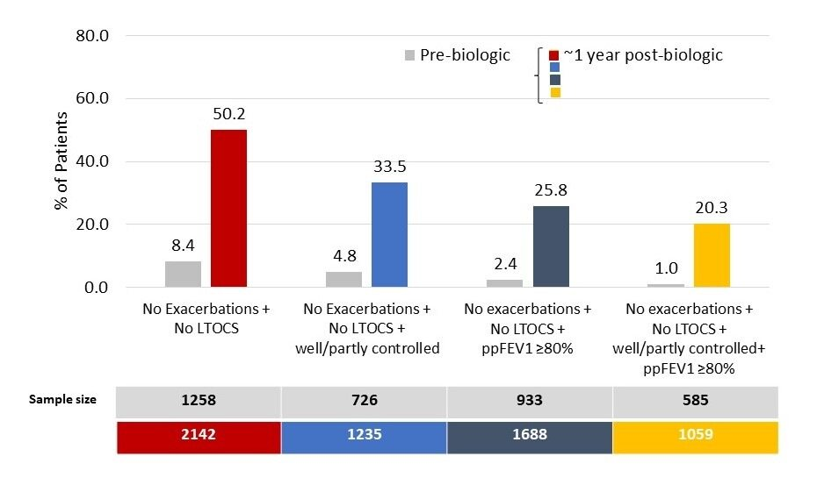
Proportion of patients in remission by different definitions
1 in 5 patients
meet remission criteria in all 4 domains
LTOCS: Long-term Oral Corticosteroids, ppFEV1: percent predicted forced expiratory volume in 1 second
Perez-de-Llano, L. et al., Am J Respir Crit Care Med 2024, https://doi.org/10.1164/rccm.202311-2192OC ​
​
Notes:
50.2%, 33.5%, 25.8% and 20.3% of patients met criteria for 2, 3 (+control), 3 (+lung function) and 4-domain-remission, respectively. The odds of achieving 4-domain remission decreased by 15% for every additional 10-years asthma duration (odds ratio: 0.85; 95% CI: 0.73, 1.00).
One in 5 patients with severe asthma met the criteria for clinical remission in all 4 domains within 1-year of biologic initiation, increasing to 1 in 2 patients when remission included exacerbation + LTOCS outcome domains only (indicative of bronchial inflammation and most effectively targeted by biologic therapy). These findings lend further weight to GINA recommendations to avoid LTOCS if possible in severe asthma (i.e. due to potential for adverse events, many of which do not reverse upon discontinuation, plus now with a negative association with remission).

Slide 8
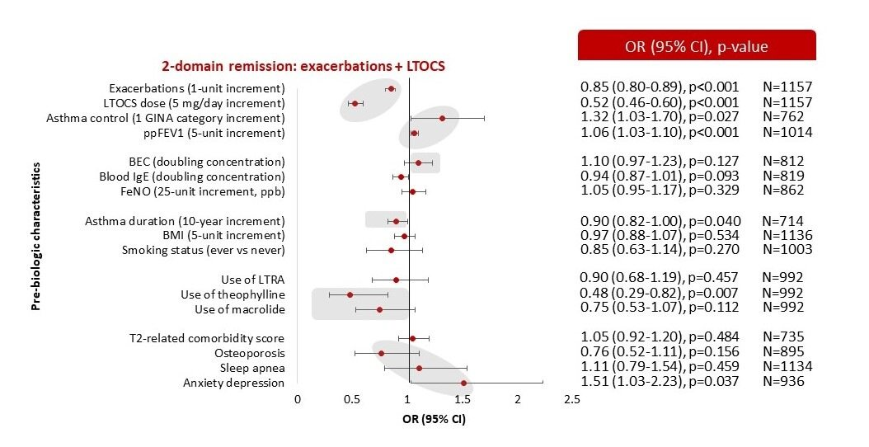
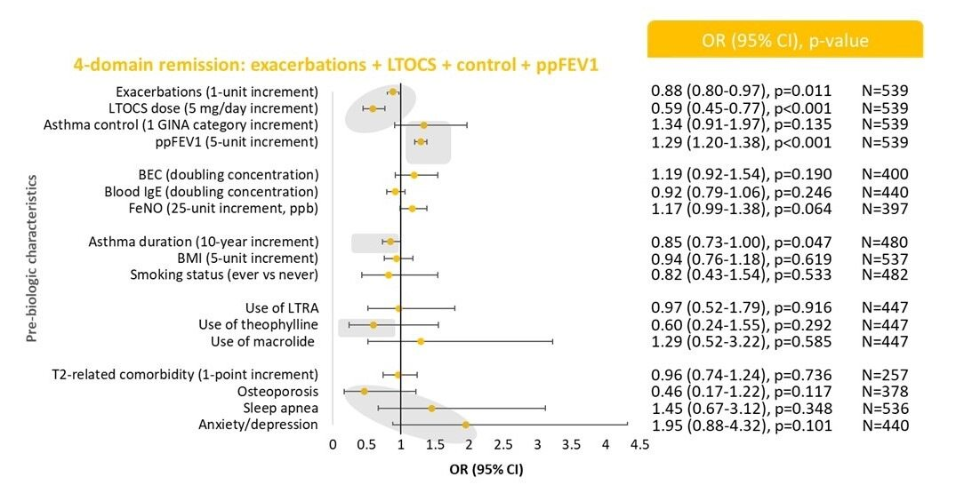
Patients with less severe disease and shorter duration of asthma pre-biologic have a better chance of achieving clinical remission post-biologic
4-domain remission:
No exacerbations + No LTOCS +
Well/partly controlled + ppFEV₁ ≥80%
2-domain remission:
No exacerbations + No LTOCS
LTOCS: Long-term Oral Corticosteroids, ppFEV1: percent predicted forced expiratory volume in 1 second, GINA: Global Initiave for Asthma, BMI: Body Mass Index, T2: Type 2, BEC: Blood Eosinophil Count,
NP: Nasal Polyps, FeNO: Fractional Exhaled Nitric ​Oxide, IgE: Immunoglobulin E, LTRA: Leukotriene Receptor Antagonist
Perez-de-Llano, L. et al., Am J Respir Crit Care Med 2024, https://doi.org/10.1164/rccm.202311-2192OC ​
​
Notes:
Importantly, patients with less severe disease and shorter duration of asthma pre-biologic-initiation had a better chance of achieving remission post-biologic.
The odds of remission increased in those with fewer exacerbations/year, lower LTOCS daily dose, better control and better lung function pre-biologic-initiation.
Pre-biologic correlates of remission were consistent across remission definitions. However, in contrast to what has been formerly observed with biologic response, where greater response is associated with greater pre-biologic-initiation disease severity, for remission those with less impairment pre-biologic had greater odds of achieving remission. Patients had a 29% increased odds of achieving 4-domain remission for every 5% greater ppFEV1, and were 41% less likely, respectively, to achieve remission for every additional 5 mg/day of LTOCS prescribed pre-biologic-initiation. The shorter duration of asthma as a remission predictor in the current study is particularly relevant and could indicate that the path to remission should start as early as possible.

Slide 9





FULL BEAM Response summary:
High response does not mean remission
Need for flexible interpretation of response to biologics
Large proportion of responders (80% of patients reduced exacerbations by at least 50%), however residual impairment observed in responders
Responses and their predictors vary according to the outcome assessed
Greater pre-biologic impairment is associated with a better response for all outcomes assessed. However, a shorter asthma duration is associated only with a better lung function response
Flexible interpretation to biologic response is needed, considering the degree of pre-biologic impairment and identification of characteristics (such as asthma duration) that can affect the response, to formulate a personalized likelihood of response
LTOCS: Long-Term Oral Cortocosteroids, ppFEV1: percent predicted Forced Expiratory Volume in 1 second
Scelo, G. et al., J Allergy Clin Immunol Pract. 2024 May 19:S2213-2198(24)00530-0. doi: 10.1016/j.jaip.2024.05.016. ​

Slide 10


FULL BEAM Remission summary:
Greater chance of remission if less severe impairment and shorter asthma duration at initiation of biologics
Only 20% of patients reached the strictest remission definition (no exacerbation, no LTOCS, well/partly controlled, and ppFEV1 >=80%)
Patients with less severe disease and shorter duration of asthma pre-biologic-initiation had a better chance of achieving remission post-biologic
The odds of achieving 4-domain remission decreased by 15% for every additional 10-years asthma duration
These results highlight the need to consider earlier intervention with biologics for patients with severe asthma prior to significant and irreversible lung function impairment
Since remission is more likely to occur if targeted earlier in the asthma life cycle, a paradigm shift away from targeting response in those with more severe asthma, towards the promotion of remission in those with less severe disease but at risk of developing severe asthma is needed
LTOCS: Long-Term Oral Corticosteroids, ppFEV1: percent predicted Forced Expiratory Volume in 1 second ​
​
Perez-de-Llano, L. et al., Am J Respir Crit Care Med 2024, https://doi.org/10.1164/rccm.202311-2192OC

