Slide 1
Adult severe asthma registries: a global and growing inventory
Breda Cushen, Mariko Siyue Koh, Trung N Tran, Neil Martin, Ruth Murray, Thendral Uthaman, Celine Yun Yi Goh, Rebecca Vella, Neva Eleangovan, Lakmini Bulathsinhala, Jorge F Maspero, Matthew J Peters, Florence Schleich, Paulo Pitrez, George Christoff, Mohsen Sadsatsafavi, Carlos A. Torres-Duque, Celeste Porsbjerg, Alan Altraja, Lauri Lehtimäki, Arnaud Bourdin, Christian Taube, Nikolaos G. Papadopoulos, Csoma Zsuzsanna, Unnur Björnsdóttir, Sundeep Salvi, Enrico Heffler, Takashi Iwanaga, Mona Al-Ahmad, Désirée Larenas-Linnemann, Job FM van Boven, Bernt Bøgvald Aarli, Piotr Kuna, Cláudia Chaves Loureiro, Riyad Al-Lehebi, Jae Ha Lee, Nuria Marina, Leif Bjermer, Chau-Chyun Sheu, Bassam Mahboub, John Busby, Andrew Menzies-Gow, Eileen Wang, David B. Price

Slide 2
Aim and Methods
Rationale
Currently, severe asthma inter-registry variability in data being collected is unknown
Aim
Severe asthma registries at the local, regional and national levels identified (n=37)
To examine data that ISAR and non-ISAR countries report collecting that enable global research and support individual country interests
Methods
Registries were identified by online searches (up to August 2022) and approaching 36 severe asthma experts globally
Participating registries provided data collection specifications or confirmed variables collected
Variables summarized:
Core variables (results from ISAR’s Delphi study)
Steroid-related comorbidity variables
Biologic safety variables (serious infection, anaphylaxis, and cancer)
COVID-19 variables
Additional variables (not belonging to the aforementioned categories)
ISAR affiliated*
(n=26)
Non-ISAR affiliated
(n=11)
*contributing data to ISAR
Cushen, B. et al., Adult Severe Asthma Registries: A Global and Growing Inventory. Pragmat Obs Res. 2023;14:127-147 https://doi.org/10.2147/POR.S399879

Slide 3
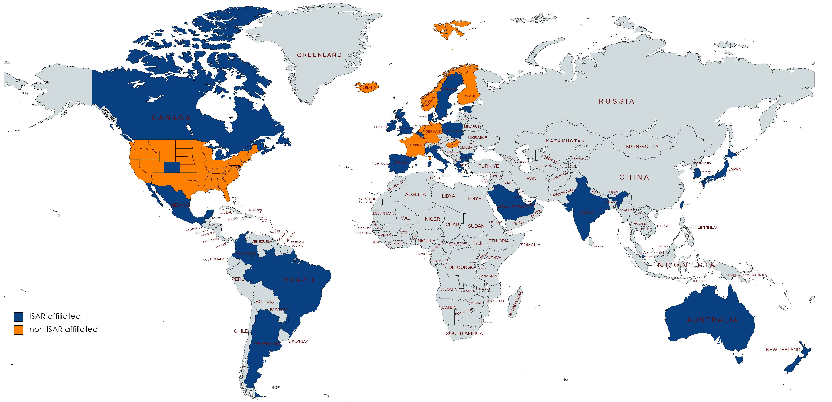
Severe asthma registries from across the globe
37 Registries across 35 countries
ISAR-affiliated registries*:
Argentina
Australia &
New Zealand
Belgium
Brazil
Bulgaria
Canada
Colombia
Denmark
Estonia
Greece
India
Ireland
Italy
Japan
Kuwait
Mexico
Poland
Portugal
Saudi Arabia
Singapore
South Korea
Spain
Sweden
Taiwan
United Arab Emirates
United Kingdom
United States (National Jewish Health,and Michigan state)
Non–ISAR-affiliated registries:
Finland
France
Germany (2 registries)
Hungary
Iceland
Netherlands
Norway
United States (CHRONICLE)
*ISAR affiliation status updated 06/10/2023
Cushen, B. et al., Adult Severe Asthma Registries: A Global and Growing Inventory. Pragmat Obs Res. 2023;14:127-147 https://doi.org/10.2147/POR.S399879

Slide 4
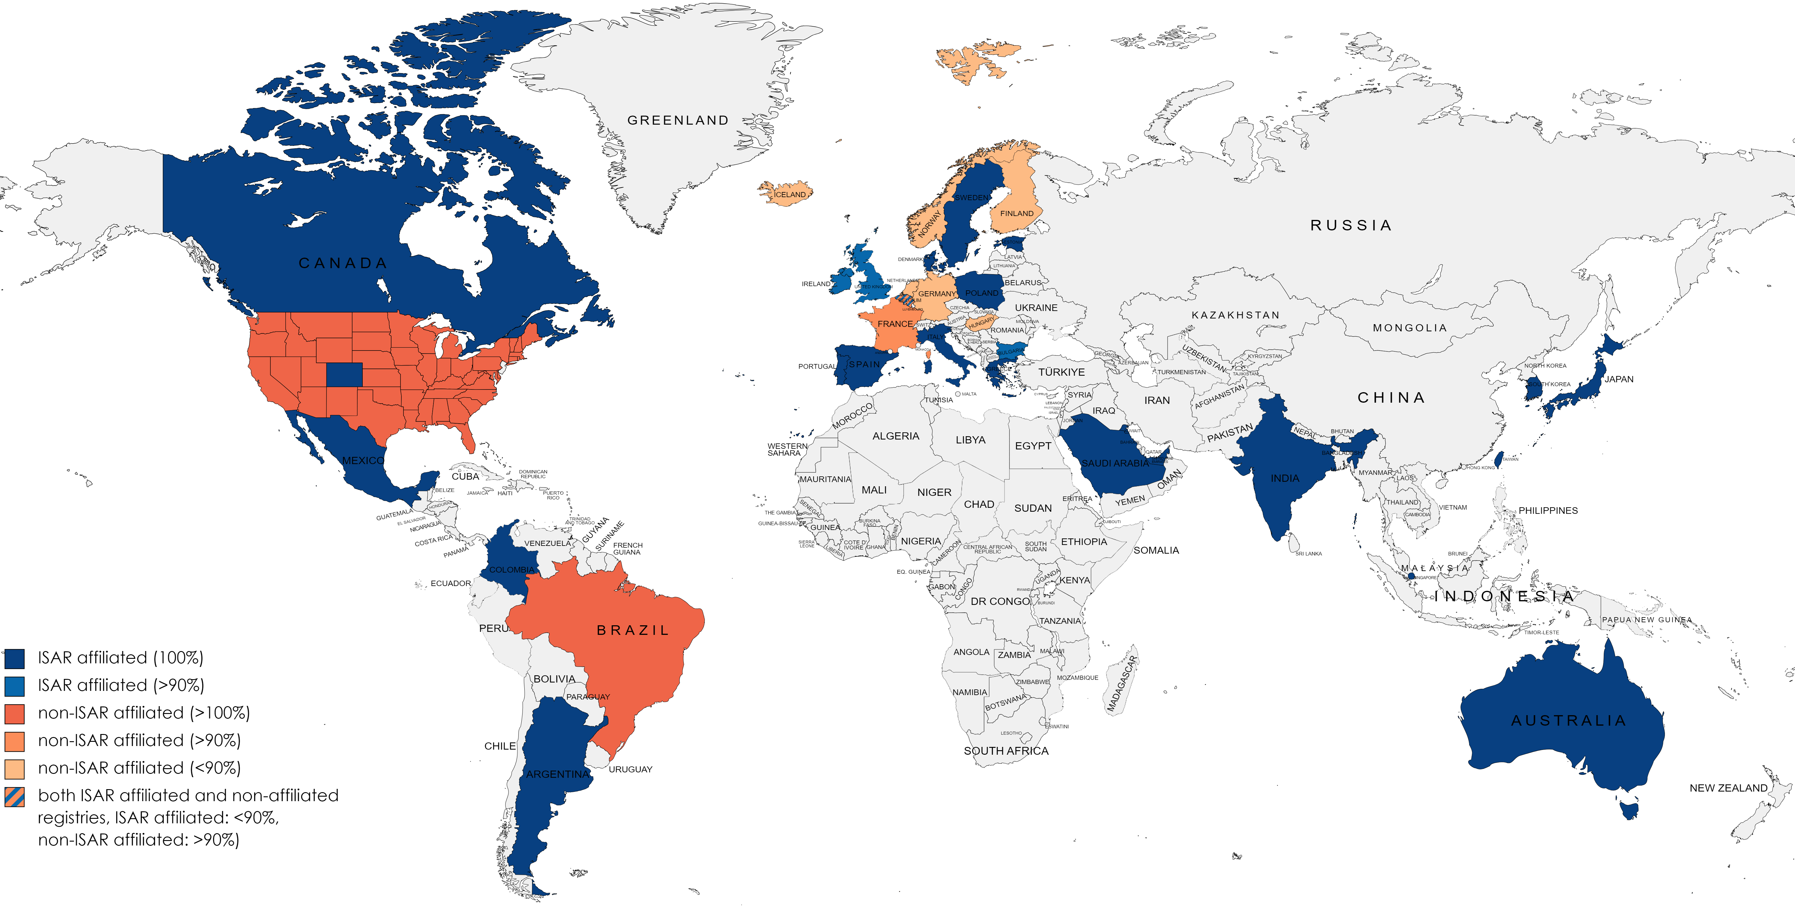
Severe asthma registries from across the globe
37 Registries across 35 countries
ISAR-affiliated registries*:
Argentina
Australia &
New Zealand
Belgium
Bulgaria
Canada
Colombia
Denmark
Estonia
Greece
India
Ireland
Italy
Japan
Kuwait
Mexico
Poland
Portugal
Saudi Arabia
Singapore
South Korea
Spain
Sweden
Taiwan
United Arab Emirates
United Kingdom
United States (National Jewish Health)
Non–ISAR-affiliated registries:
Brazil
Finland
France
Germany (2 registries)
Hungary
Iceland
Netherlands
Norway
United States (CHRONICLE)
*Affiliations with ISAR represented are in accordance with status at time of writing/production of publication
Cushen, B. et al., Adult Severe Asthma Registries: A Global and Growing Inventory. Pragmat Obs Res. 2023;14:127-147 https://doi.org/10.2147/POR.S399879

Slide 5
Majority of severe asthma registries collect >90% of ISAR’s core variables and most registries collect safety variables
25 ISAR-registries and 4 non-ISAR registries reported collecting >90% of the 65 core variables
24 registries reported collecting additional variables including data from asthma questionnaires
8 registries are linked to databases such as electronic medical records and national claims or disease databases
Cushen, B. et al., Adult Severe Asthma Registries: A Global and Growing Inventory. Pragmat Obs Res. 2023;14:127-147 https://doi.org/10.2147/POR.S399879

Slide 6
Conclusions
The majority of severe asthma registries reported collection of >90% of ISAR’s core variables
Most registries reported collecting safety variables and OCS comorbidity data, reflecting a common goal of documenting OCS burden and safety events in patients
The ISAR initiative has fostered data standardisation across countries.
This enables collection of unified data and increases statistical power for severe asthma research
Maintaining individuality alongside standardized variables supports registries to develop locally relevant research priorities and clinical interests
Severe asthma registries can inform local health policy, be incorporated into clinical guidelines, and be translated into quality improvement programs that enhance the care of asthma patients globally
Cushen, B. et al., Adult Severe Asthma Registries: A Global and Growing Inventory. Pragmat Obs Res. 2023;14:127-147 https://doi.org/10.2147/POR.S399879

