Slide 1
Disease Burden and Access to Biologic Therapy in Patients with Severe Asthma, 2017–2022: An Analysis of the International Severe Asthma Registry (EVEREST)
Tham T Le, David B Price, Clement Erhard, Bill Cook, Anna Quinton, Rohit Katial, George C Christoff, Luis Perez-de-Llano, Alan Altraja, Celine Bergeron, Arnaud Bourdin, Mariko Siyue Koh, Lauri Lehtimäki, Bassam Mahboub, Nikolaos G Papadopoulos, Paul Pfeffer, Chin Kook Rhee, Victoria Carter, Neil Martin, Trung N Tran, on behalf of the EVEREST Study Working Group
Tham T. et al., Disease Burden and Access to Biologic Therapy in Patients with Severe Asthma, 2017–2022: An Analysis of the International Severe Asthma Registry. J Asthma Allergy. In press

Slide 2
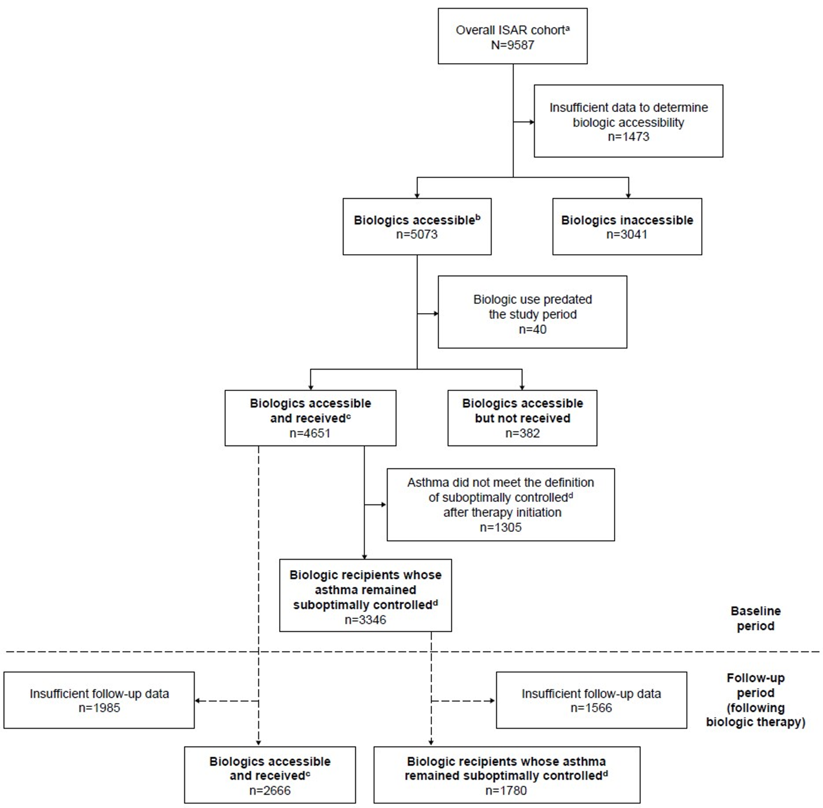
Aim and Methods¹
Background
Patients with severe asthma may be prescribed biologics to improve disease control. There are variations in access to biologics globally.²
Aim
1
2
Characterize the global disease burden of patients with severe asthma without access to biologics and those who have access but do not receive biologics, as well as the remaining unmet need despite use of these therapies.
3
4
Methods
Historical cohort study of patients with severe asthma (aged ≥18 years) in ISAR receiving GINA 2018 step 5 treatment, or with uncontrolled disease at GINA step 4
Prospective data on patient clinical characteristics, healthcare resource utilization, and medication use over a 12-month period between December 2017 and May 2022 were assessed for five groups
5
GINA = Global Initiative for Asthma; ISAR = International Severe Asthma Registry
¹Tham T. et al., Disease Burden and Access to Biologic Therapy in Patients with Severe Asthma, 2017–2022: An Analysis of the International Severe Asthma Registry. J Asthma Allergy. In press; ²Porsbjerg CM et al., Global variability in administrative approval prescription criteria for biologic therapy in severe asthma. J Allergy Clin Immunol Pract. 2022;10(5):1202-1216.e1223.

Slide 3
High biomarkers, comorbidity prevalence and disease burden across all groups, including T2-targeted biologic recipients and those who did not receive biologics
Baseline clinical characteristics and asthma-related HCRU (% of patients)
Approximately two-thirds of patients across groups had BEC ≥300 cells/µL, except for the biologics inaccessible group (46.3%).
Approximately half of patients in the biologics inaccessible and biologics accessible but not received groups, and two-thirds of patients in the other groups, had FeNO ≥25 ppb.
Chronic rhinosinusitis was present in ~40% of patients across groups, but was more common in the biologics accessible but not received group (59.0%).
Among the patients who lacked access to biologics, ~40% experienced ≥1 exacerbations.
BEC = Blood eosinophil count; FeNO = Fractional exhaled nitric oxide; HCRU = Healthcare resource utilization; IgE = Immunoglobulin E; T2 = Type 2
Tham T. et al., Disease Burden and Access to Biologic Therapy in Patients with Severe Asthma, 2017–2022: An Analysis of the International Severe Asthma Registry. J Asthma Allergy. In press

Slide 4
Substantial burden of exacerbations and uncontrolled asthma across all groups, particularly in patients without access to biologics and those who have access but did not receive biologics
Proportions of patients with severe asthma who experienced ≥2 exacerbations, had uncontrolled asthma and received LTOCS during the 12 months before the first ISAR visit*
LTOCS = Long-term oral corticosteroids
*The index date was the first visit recorded in ISAR with measurements meeting the group eligibility criteria; for biologic users, the index date was the ISAR visit that is closest to the date on first biologic.
Percentages exclude patients with missing values. Asthma control as an outcome was assessed using the Global Initiative for Asthma (GINA) 2019 criteria.
Tham T. et al., Disease Burden and Access to Biologic Therapy in Patients with Severe Asthma, 2017–2022: An Analysis of the International Severe Asthma Registry. J Asthma Allergy. In press

Slide 5
Considerable burden of exacerbations, asthma control and LTOCS use among T2-targeted biologic recipients despite treatment
Proportions of patients with severe asthma who experienced ≥2 exacerbations, had uncontrolled asthma and received LTOCS during the 12 months post-biologic initiation*
Two-thirds of T2-targeted biologic recipients had asthma that remained suboptimally controlled† despite treatment.
LTOCS = Long-term oral corticosteroids; T2 = Type 2
*The index date was the first visit recorded in ISAR with measurements meeting the group eligibility criteria; for biologic users, the index date was the ISAR visit that is closest to the date on first biologic. For the subgroup of biologic recipients whose asthma remained suboptimally controlled, the index date was the date of the third dose of biologic treatment; among those that switched or stopped biologics, the index date was the ISAR visit closest to the date on first biologic.
†The biologic recipients whose asthma remained suboptimally controlled group was defined as patients within the biologics accessible and received group who were prescribed at least three doses of a biologic and either had uncontrolled asthma following biologic initiation, had a severe exacerbation following biologic initiation, or received LTOCS treatment. Patients who had switched or stopped their biologic treatment owing to a reported lack of clinical efficacy were also included in this group.
Tham T. et al., Disease Burden and Access to Biologic Therapy in Patients with Severe Asthma, 2017–2022: An Analysis of the International Severe Asthma Registry. J Asthma Allergy. In press

Slide 6
Summary: Substantial disease burden was observed in patients without access to biologics, those who have access but did not receive biologics, and T2-targeted biologic recipients
Key findings
Practice change needed
~55% of patients who lacked access to biologics and ~71% of patients who had access but did not receive biologics had uncontrolled asthma during the 12 months before the first ISAR visit*.
Among T2-targeted biologic recipients, a sizable proportion still experienced considerable burden in terms of exacerbations, HCRU, asthma control, and LTOCS use.
There is a need for regulators to increase and standardize access to biologics, and for healthcare systems to better allocate resources and enhance treatment pathways.
There remains a high unmet need among T2-targeted biologic recipients, highlighting the importance of ongoing research and the development of more effective therapy options.
HCRU = Healthcare resource utilization; LTOCS = Long-term oral corticosteroids; T2 = Type 2
*The index date was the first visit recorded in ISAR with measurements meeting the group eligibility criteria.
Tham T. et al., Disease Burden and Access to Biologic Therapy in Patients with Severe Asthma, 2017–2022: An Analysis of the International Severe Asthma Registry. J Asthma Allergy. In press

