Slide 1
Potential Severe Asthma Hidden in UK Primary Care
Dermot Ryan, Heath Heatley, Liam G Heaney, David J Jackson, Paul E Pfeffer, John Busby, Andrew N Menzies-Gow, Rupert Jones, Trung N Tran, Mona Al-Ahmad, Vibeke Backer, Manon Belhassen, Sinthia Bosnic-Anticevich, Arnaud Bourdin, Lakmini Bulathsinhala, Victoria Carter, Isha Chaudhry, Neva Eleangovan, J Mark FitzGerald, Peter G Gibson, Naeimeh Hosseini, Alan Kaplan, Ruth B Murray, Chin Kook Rhee, Eric Van Ganse, David B Price
The Journal of Allergy and Clinical Immunology: In Practice 2021;9(4):1612-1623.e9

Slide 2
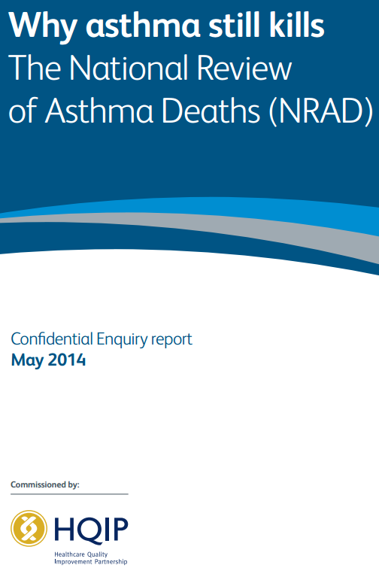
Background
Referral of difficult-to-treat asthma to specialist care is associated with improved outcomes¹.
19% of asthma deaths in the UK were associated with potentially avoidable factors related to access to specialist care².
Identifying patients with potential severe asthma (PSA) who are hidden in primary care (i.e., not referred for specialist review) remains a challenge.
1. Erickson S et al. Health Serv Res 2005;40(5 Pt 1):1443-1465, 2. Royal College of Physicians. Accessed via: https://www.rcplondon.ac.uk/projects/outputs/why-asthma-still-kills, 3. Ryan D, Price D et al. J Allergy Clin Immunol Pract 2021;9(4):1612-1623.e9

Slide 3
A Historical Cohort Study - Design
Potential severe asthma*
UK-ISAR
Was referred to a specialist in the previous year
Was not referred to a specialist in the previous year or not receiving specialist care
Potential Severe Asthma* REFERRED
Potential Severe Asthma NOT REFERRED (i.e. hidden)
Confirmed severe asthma
Objective 1: To identify patients with potential severe asthma (PSA)* managed in UK primary care
Objective 2: To estimate how many are hidden
Objective 3: To compare the demographics and clinical characteristics of patients with PSA with those of patients with a confirmed severe diagnosis
*Potential Severe Asthma Definition: Receiving treatment at GINA Step 4 & experiencing ≥2 exacerbations/year OR receiving treatment at GINA Step 5
Ryan D, Price D et al. J Allergy Clin Immunol Pract 2021;9(4):1612-1623.e9

Slide 4
Many Patients Managed in Primary Care Experience Frequent Exacerbations – Regardless of GINA Step
N=207,557
GINA, Global Initiative for Asthma; ISAR, International Severe Asthma Registry; OPCRD, Optimum Patient Care Research Database
Ryan D, Price D et al. J Allergy Clin Immunol Pract 2021;9(4):1612-1623.e9

Slide 5
An Estimated 8% of Asthma Patients In Primary Care Were Identified As Potential Severe Asthma Patients
72% were unreferred
Common characteristics among these patients:
Poor lung function
Uncontrolled asthma
Comorbdities: allergic rhinitis & eczema
Ex-smoker
Female
In their 60s
Overweight/obese
n=191,148
92%
n=16,409
Ryan D, Price D et al. J Allergy Clin Immunol Pract 2021;9(4):1612-1623.e9

Slide 6
Conclusion
A significant proportion of severe asthma patients remain hidden in primary care
The majority of these patients are never referred to a specialist and may be managed with long-term OCS
Understanding the characteristics associated with potential severe asthma may help with earlier identification
Ryan D, Price D et al. J Allergy Clin Immunol Pract 2021;9(4):1612-1623.e9

