Slide 1
Characterization of Patients in the International Severe Asthma Registry with High Steroid Exposure Who Did or Did Not Initiate Biologic Therapy GLITTER I
Wenjia Chen, Mohsen Sadatsafavi , Trung N Tran, Ruth B Murray, Chong Boon Nigel Wong, Nasloon Ali, Cono Ariti , Esther Garcia Gil, Anthony Newell, Marianna Alacqua, Mona Al-Ahmad, Alan Altraja, Riyad Al-Lehebi, Mohit Bhutani, Leif Bjermer, Anne Sofie Bjerrum, Arnaud Bourdin, Lakmini Bulathsinhala, Anna von Bülow, John Busby, Giorgio Walter Canonica, Victoria Carter, George C Christoff, Borja G Cosio, Richard W Costello, J Mark FitzGerald, João A Fonseca, Kwang Ha Yoo, Liam G Heaney, Enrico Heffler, Mark Hew, Ole Hilberg, Flavia Hoyte, Takashi Iwanaga, David J Jackson, Rupert C Jones, Mariko Siyue Koh, Piotr Kuna, Désirée Larenas-Linnemann, Sverre Lehmann, Lauri A Lehtimäki, Juntao Lyu, Bassam Mahboub, Jorge Maspero, Andrew N Menzies-Gow, Concetta Sirena, Nikolaos Papadopoulos, Andriana I Papaioannou, Luis Pérez de Llano, Diahn-Warng Perng, Matthew Peters, Paul E Pfeffer, Celeste M Porsbjerg, Todor A Popov, Chin Kook Rhee, Sundeep Salvi, Camille Taillé, Christian Taube, Carlos A Torres-Duque, Charlotte S Ulrik, Seung Won Ra, Eileen Wang, Michael E Wechsler, David B Price
Chen W. et al., Characterization of Patients in the International Severe Asthma Registry with High Steroid Exposure Who Did or Did Not Initiate Biologic Therapy. J Asthma Allergy. 2022;15:1491-1510 https://doi.org/10.2147/JAA.S377174

Slide 2
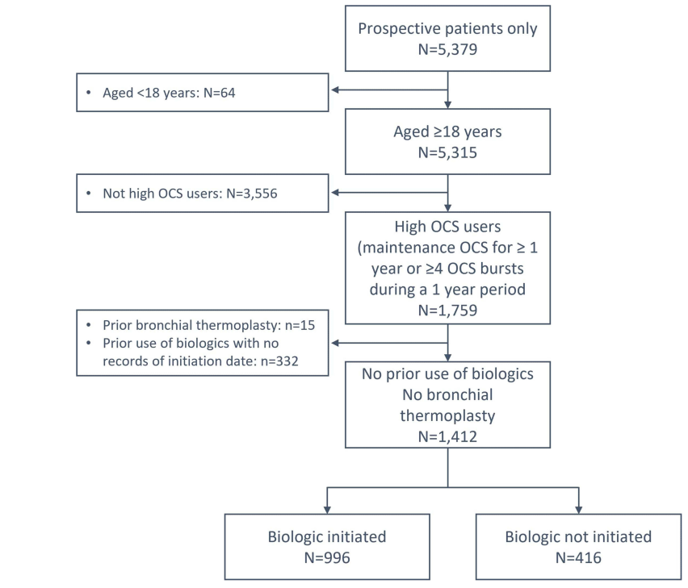
Aim and Methods
Background
Many severe asthma patients with high oral corticosteroid exposure (HOCS) often do not initiate biologics despite being eligible
Aim
Compare the characteristics of severe asthma patients with HOCS who did and did not initiate biologics
Methods
Baseline characteristics of patients with HOCS (long-term maintenance OCS therapy for at least 1 year, or ≥4 courses of steroid bursts in a year) from ISAR who initiated or did not initiate biologics (anti-lgE, anti-IL5/5R or anti-IL4R), were described at the time of biologic initiation or registry enrolment
Statistical relationships were tested using Pearson’s chi-squared tests for categorical variables, and t-tests for continuous variables, adjusting for potential errors in multiple comparisons
70.5%
29.5%
International Severe Asthma Registry data : ISAR, OCS: Oral corticosteroids, anti-IgE: Anti-immunoglobulin E, anti-IL5: anti-immunoglobulin 5, anti-IL4: Anti-immunoglobulin 4
Chen W. et al., Characterization of Patients in the International Severe Asthma Registry with High Steroid Exposure Who Did or Did Not Initiate Biologic Therapy. J Asthma Allergy. 2022;15:1491-1510 https://doi.org/10.2147/JAA.S377174

Slide 3
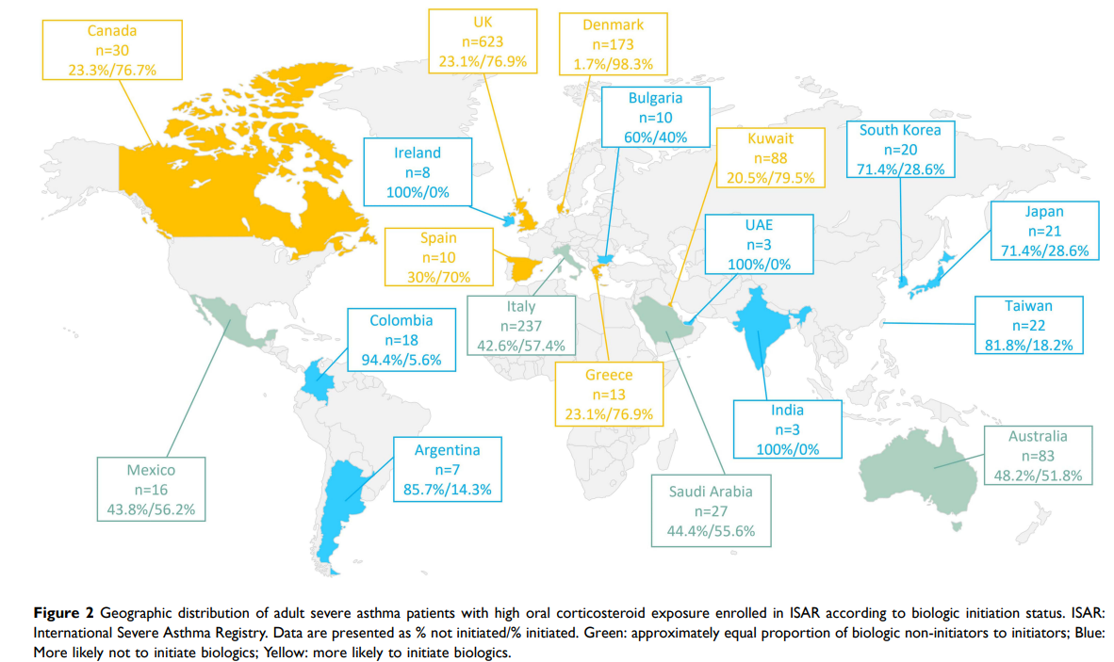
Disparity in biologic accessibility worldwide evident: 29% of SA patients with high oral corticosteroid exposure did not receive biologics
Pattern of biologic initiation related to country-income level
Inconsistency between the initiation of biologics and country-specific biologic accessibility- suggesting that prescription criteria, and by extension, biologic accessibility, not the sole determinants for biologic initiation in certain countries
International Severe Asthma Registry data : ISAR, HOCS: High Oral Corticosteroid exposure, SA: Severe Asthma
Chen W. et al., Characterization of Patients in the International Severe Asthma Registry with High Steroid Exposure Who Did or Did Not Initiate Biologic Therapy. J Asthma Allergy. 2022;15:1491-1510 https://doi.org/10.2147/JAA.S377174

Slide 4
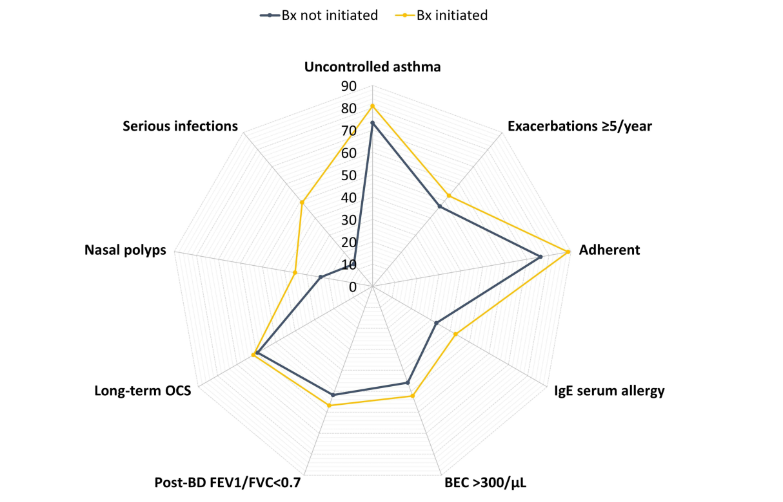
Serious infectious events, nasal polyps and inadequate asthma control appear to encourage biologic prescribing for SA patients with high oral corticosteroid exposure
Clinical characteristics of adult severe asthma patients with high oral corticosteroid exposure enrolled in ISAR who did and did not initiate biologic therapy
Compared to non-initiators, patients who initiated biologics were/had:
More likely to have uncontrolled asthma (80.8% vs 73.2%, p=0.004)
More likely to have a serious infection, defined as an infection that required hospitalization, invasive or non-invasive ventilation, IV antibiotics, or that resulted in a fatal outcome (49.0% vs 13.3%, p<0.001)
More likely to have nasal polyps (35.2% vs 23.6%, p<0.001)
Modestly greater degree of airflow limitation according to the proportion with a FEV1/FVC ratio of less than 0.7 (56.8% vs 51.8%, p=0.013)
BEC, blood eosinophil count; BD, bronchodilator; Bx, biologic; FEV1, forced expiratory volume in one second; FVC, forced vital capacity; IgE, immunoglobulin E; ISAR, International Severe Asthma Registry; OCS, oral corticosteroid, HOCS: High Oral Corticosteroid exposure, SA: Severe Asthma, IV:Intravenous
Chen W. et al., Characterization of Patients in the International Severe Asthma Registry with High Steroid Exposure Who Did or Did Not Initiate Biologic Therapy. J Asthma Allergy. 2022;15:1491-1510 https://doi.org/10.2147/JAA.S377174

Slide 5
Initiation of biologic therapy more likely in those with greater degree of eosinophilic asthma
Clinical characteristics of adult severe asthma patients with high oral corticosteroid exposure enrolled in ISAR who did and did not initiate biologic therapy
Patients who initiated biologics had/were:
Higher mean BEC (483/µL vs 399/µL, p=0.003)
Higher FeNO concentrations (25–50 ppb, 31.4% vs 24.3%; >50 ppb, 39.4% vs 35.8%, p=0.010)
More likely to be of ISAR Grade 3 eosinophilic phenotype (90.8% vs 68.0%, p<0.001)
Fewer biologic initiators had low T2 biomarkers compared to non-initiators (8.7% vs 16.4%, p=0.003), defined as BEC <150/µL and FeNO<25ppb)
BEC, blood eosinophil count; BD, bronchodilator; Bx, biologic; FEV1, forced expiratory volume in one second; FVC, forced vital capacity; IgE, immunoglobulin E; ISAR, International Severe Asthma Registry; OCS, oral corticosteroid, HOCS: High Oral Corticosteroid exposure, FeNO: Fractional Exhaled Nitric Oxide, T2: Type 2
Chen W. et al., Characterization of Patients in the International Severe Asthma Registry with High Steroid Exposure Who Did or Did Not Initiate Biologic Therapy. J Asthma Allergy. 2022;15:1491-1510 https://doi.org/10.2147/JAA.S377174

Slide 6
One third of severe asthma patients with high oral corticosteroid exposure did not receive biologics despite similar exacerbation frequency and HCRU as those who initiated a biologic
Clinical characteristics of adult severe asthma patients with high oral corticosteroid exposure enrolled in ISAR who did and did not initiate biologic therapy
Compared to non-initiators, patients who initiated biologics were/had:
Similar number of asthma exacerbations over the past year (5.7 vs 5.3, p=0.15)
Similar post-bronchodilator FEV1 as a percentage of predicted FEV1 (73.1% vs 72.7%, p=0.85)
Similar proportions of patients with hospital admissions (28.7% vs 31.5%, p=0.30) and ICU admissions involving use of invasive ventilations (6.9% vs 6.5%, p=0.77)
BEC, blood eosinophil count; BD, bronchodilator; Bx, biologic; FEV1, forced expiratory volume in one second; FVC, forced vital capacity; IgE, immunoglobulin E; ISAR, International Severe Asthma Registry; OCS, oral corticosteroid, HOCS: High Oral Corticosteroid exposure, HCRU: healthcare resource utilisation, ICU: Intensive Care Unit
Chen W. et al., Characterization of Patients in the International Severe Asthma Registry with High Steroid Exposure Who Did or Did Not Initiate Biologic Therapy. J Asthma Allergy. 2022;15:1491-1510 https://doi.org/10.2147/JAA.S377174

Slide 7
Summary: One third of severe asthma patients with high oral corticosteroid exposure did not receive biologics despite similarities in disease burden
Key findings:
Eosinophilic phenotype, serious infectious events, nasal polyps, airflow limitation and inadequate asthma control appear to encourage physicians to prescribe biologic therapy
However, one third of severe HOCS (high oral corticosteroid exposure) asthma patients did not receive biologics despite similar exacerbation frequency and HCRU as those who initiated a biologic therapy
Practice change needed:
Multiple characteristics need to be considered to guide the initiation of biologics in SA patients
Individualized treatment algorithms are needed to guide the initiation of biologics
HOCS: High Oral Corticosteroid exposure, HCRU: healthcare resource utilisation, SA: Severe Asthma
Chen W. et al., Characterization of Patients in the International Severe Asthma Registry with High Steroid Exposure Who Did or Did Not Initiate Biologic Therapy. J Asthma Allergy. 2022;15:1491-1510 https://doi.org/10.2147/JAA.S377174

