Slide 1
Association between T2-related co-morbidities and effectiveness of biologics in severe asthma
Michael E Wechsler, Ghislaine Scelo, PhD, ​​Désirée E.S. Larenas-Linnemann​, Carlos A Torres-Duque, Jorge Maspero, Trung N Tran, Ruth B Murray, Neil Martin, Andrew N Menzies-Gow, Mark Hew, Matthew J Peters, Peter G Gibson, George C Christoff, Todor A Popov, Andréanne Côté, Celine Bergeron, Delbert Dorscheid, J Mark FitzGerald, Kenneth R. Chapman, Louis Philippe Boulet, Mohit Bhutani, Mohsen Sadatsafavi, Libardo Jiménez-Maldonado, Mauricio Duran-Silva, Bellanid Rodriguez, Carlos Andres Celis-Preciado, Diana Jimena Cano-Rosales, Ivan Solarte, Maria Jose Fernandez- Sanchez, Patricia Parada-Tovar, Anna von Bülow, Anne Sofie Bjerrum, Charlotte S Ulrik, Karin Dahl Assing, Linda Makowska Rasmussen, Susanne Hansen, Alan Altraja, Arnaud Bourdin, Camille Taille, Jeremy Charriot, Nicolas Roche, Andriana I Papaioannou, Konstantinos Kostikas, Nikolaos G Papadopoulos, Sundeep Salvi, Deirdre Long, Patrick D Mitchell, Richard Costello, Concetta Sirena, Cristina Cardini, Enrico Heffler, Francesca Puggioni, Giorgio Walter Canonica, Giuseppe Guida, Takashi Iwanaga, Mona Al-Ahmad, Ulises García, Piotr Kuna, João A Fonseca, Riyad Al-Lehebi, Mariko S Koh, Chin Kook Rhee, Borja G Cosio, Luis Perez de Llano, Diahn-Warng Perng, Erick Wan-Chun Huang, Hao-Chien Wang, Ming-Ju Tsai, Bassam Mahboub, Laila Ibraheem Jaber Salameh, David J. Jackson, John Busby, Liam G Heaney, Paul E. Pfeffer, Amanda Grippen Goddard, Eileen Wang, Flavia C.L. Hoyte, Nicholas M Chapman, Rohit Katial, Victoria Carter, Lakmini Bulathsinhala, Neva Eleangovan, Con Ariti, Juntao Lyu, Celeste Porsbjerg, and David B. Price

Slide 2
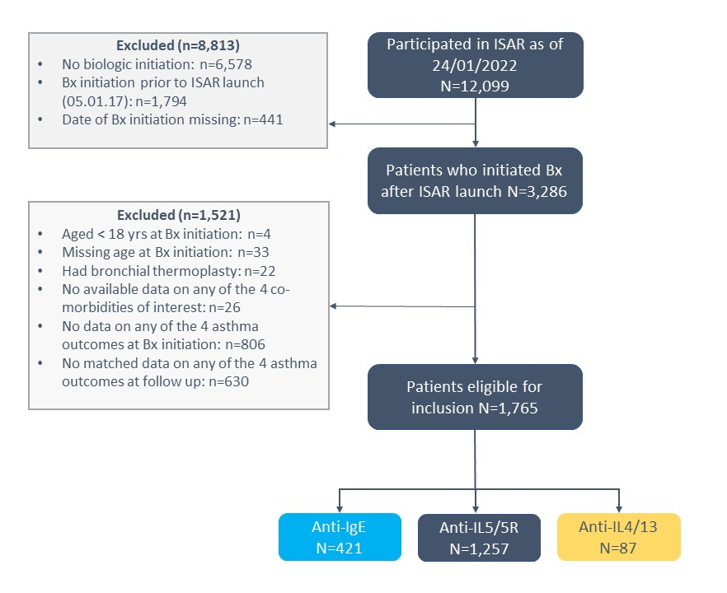
Aim and Methods
Rationale
Previous studies investigating comorbidity impact on biologic effectiveness have been relatively small, of short duration, and have not compared biologic classes
Aim
To determine the association between T2-related comorbidities and biologic effectiveness in adults with severe asthma (SA)
Methods
This cohort study used ISAR data (n=21 countries, 2017-2022) to quantify pre- to post-biologic change for four outcomes (annual asthma exacerbation rate, % predicted FEV1 (ppFEV1), asthma control, and long-term oral corticosteroid daily dose [LTOCS]) in patients with/without allergic rhinitis (AR), chronic rhinosinusitis +/- nasal polyps (CRS+/-NP), NP, or eczema/atopic dermatitis (AD).
International Severe Asthma Registry data : ISAR
American Journal of Respiratory and Critical Care Medicine (AJRCCM)

Slide 3
Irrespective of T2 comorbidities all groups showed improvement but greater in those with CRS+/- NP
T2-related and
OCS-related
T2-related
only
OCS-related
only
Exacerbation rates reduce (reduction shown in red) with biologics for all, regardless of presence of T2 comorbidity
ppFEV1 increases (increase shown in red) for all following biologic initiation, irrespective of comorbidity status
%of patients with uncontrolled asthma decreases significantly (shown in red) across all groups irrespective of comorbidity status, following biologic initiation
OCS-related and mimicking/aggravating asthma
None
T2-related and mimicking/aggravating asthma
Figures in red show the drop in mean LTOCS dose following biologic initiation, with reduction in dose achieved for all groups irrespective of presence of T2 comorbidities
ppFEV1: Forced expiratory volume in one second, expressed in percentage of predicted value in healthy individuals of same age, gender, and height; LTOCS: long-term oral corticosteroids.

Slide 4
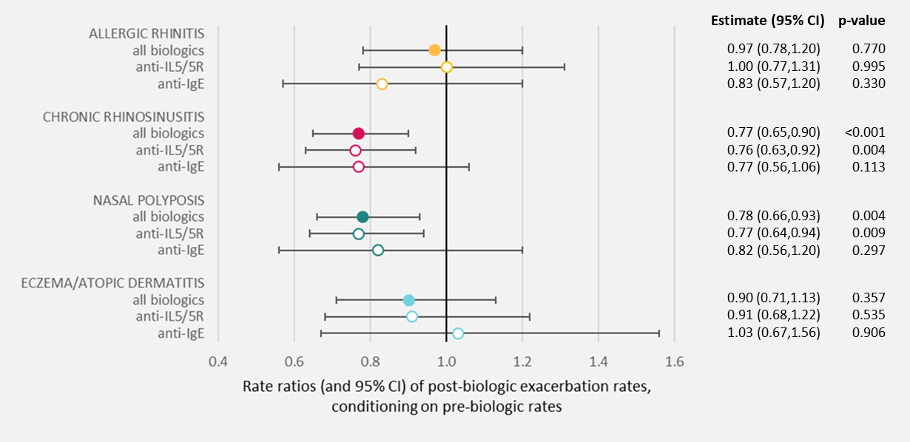
Severe asthma patients with CRS / NP benefit from biologics to a greater extent than patients without: exacerbations
T2-related and
OCS-related
T2-related
only
OCS-related
only
Biomarker independent
Adjusting for BEC had no impact on the estimate for exacerbations for patients with CRS +/-NP (rate ratio = 0.77, 95% CI: 0.65, 0.91, p=0.002)
OCS-related and mimicking/aggravating asthma
None
T2-related and mimicking/aggravating asthma
BEC: Blood Eosinophil Count, CRS: Chronic rhinosinusitis; NP: Nasal polyposis; 95% CI: 95% confidence interval.

Slide 5
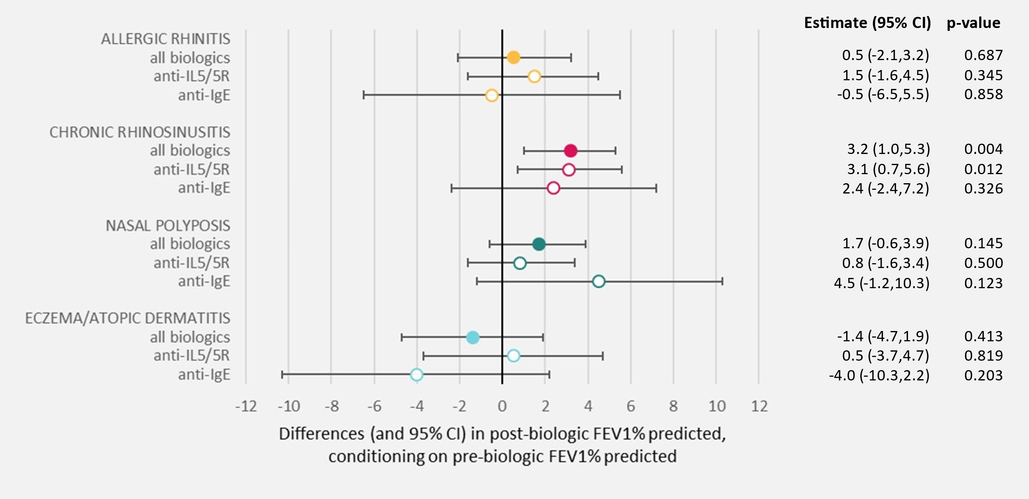
Severe asthma patients with CRS / NP benefit from biologics to a greater extent than patients without: lung function
T2-related and
OCS-related
T2-related
only
OCS-related
only
OCS-related and mimicking/aggravating asthma
None
T2-related and mimicking/aggravating asthma
CRS: Chronic rhinosinusitis; FEV1% predicted: : Forced expiratory volume in one second, expressed in percentage of predicted value in healthy individuals of same age, gender, and height; NP: Nasal polyposis; 95% CI: 95% confidence interval.

Slide 6
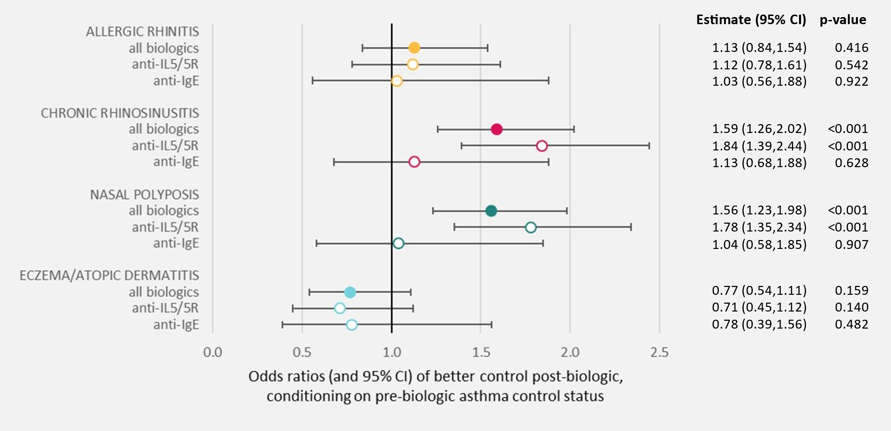
Severe asthma patients with CRS / NP benefit from biologics to a greater extent than patients without: asthma control
T2-related and
OCS-related
T2-related
only
OCS-related
only
Biomarker independent
Although attenuated, association for asthma control trends in patients with NP remain when adjusting for BEC (odds ratio=1.37, 95% CI: 1.06-1.77), p=0.015)
OCS-related and mimicking/aggravating asthma
None
T2-related and mimicking/aggravating asthma
BEC: Blood Eosinophil Count, CRS: Chronic rhinosinusitis; NP: Nasal polyposis; 95% CI: 95% confidence interval.

Slide 7
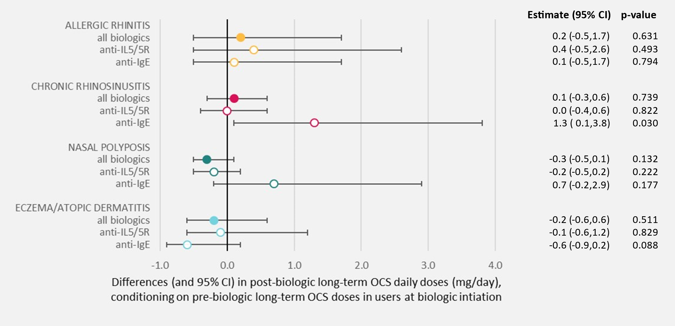
No additional benefit observed in terms of LTOCS dose reduction
T2-related and
OCS-related
T2-related
only
OCS-related
only
OCS-related and mimicking/aggravating asthma
None
T2-related and mimicking/aggravating asthma
95% CI: 95% confidence interval.

Slide 8
PRISM II Summary The power of biologics to improve severe asthma outcomes in patients with T2 comorbidities
Association between T2-related co-morbidities and effectiveness of biologics in severe asthma
Where
Results
ISAR Global Study
21 countries + 1765 severe asthma patients
Biologics led to improvements in all four asthma outcomes irrespective of comorbidity status
Comorbid CRS+/-NP : 23% fewer exacerbations, 59% higher odds of better post-biologic control
Who
With/without AR, CRS+/-NP
NP, or AD
Similar estimates for those with comorbid NP
Independent of biomarker profile
AR and AD conversely were not predictive of treatment effect
Initiated on anti–IL-5/5R,
anti-IgE,or anti–IL-4/13
Practice change
What
Pre and post biologic change in:
Annual exacerbation rate,
% predicted FEV1
CRS +/- NP key components in predicting successful treatment with biologics
Systematic evaluation for comorbidities + multidisciplinary collaboration vital in achieving optimal outcomes in severe asthma care
asthma control
LTOCS daily dose
AR: allergic rhinitis, CRS+/-NP: chronic rhinosinusitis +/- nasal polyps , AD: eczema/atopic dermatitis, LTOCS: Long term Oral Corticosteroids
.

