Slide 1
International Severe Asthma Registry (ISAR): protocol for a global registry
J. Mark Fitzgerald et al, BMC Medical Research Methodology 20, 212 (2020)

Slide 2
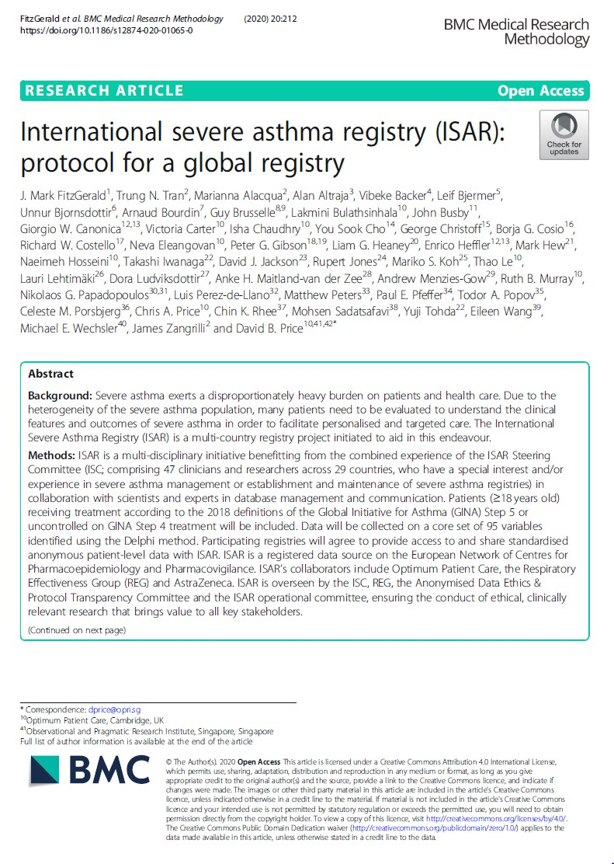
Background and aims
Background
Severe asthma exerts a disproportionately heavy burden on patients and healthcare.
Due to the heterogeneity of the severe asthma population, many patients need to be evaluated to understand clinical features and disease outcomes in order to facilitate personalized and targeted care.
ISAR is a multi-country registry project initiated to aid in this endeavour.
Aims
To describe the ISAR protocol for registry development and management, the rationale behind each step and the potential benefits of ISAR to the adult severe asthma population.
Full Text available here.
ISAR: International Severe Asthma Registry

Slide 3
Why is a global severe asthma registry needed?
Connect national/regional registries (retaining their values), enabling inter-operability, data sharing
and cross comparison.
Have sufficient statistical power to answer pertinent clinical and research questions.
Reduce the variability of data collected by standardising variables across countries and regions.
Have pre-defined and extensive processes in place to ensure that data capture and data harmonisation are of high quality.
Improve understanding of the severe asthma population and examine the response to therapies
according to nationality, phenotypes, biomarkers, treatment and socio-economic status.
Permit continued development with long-term patient follow-up to enable a real-life understanding of severe asthma.

Slide 4
ISAR design and governance
ISAR is a registered data source on the European Network of Centres for Pharmacoepidemiology and Pharmacovigilance (ENCePP), and is currently supported by 3 core collaborators:
Optimum Patient Care (OPC),
A not-for-profit social enterprise providing medical research and services to improve the diagnosis, treatment and care
of chronic diseases and is responsible for delivery of the ISAR database.
OPC is a co-funder of ISAR.
The Respiratory Effectiveness Group (REG), and
An investigator-led, not-for-profit research initiative promoting the value of real-life research.
AstraZeneca (AZ).
Together with OPC, AZ is a co-funder of ISAR.
More details can be found on the ISAR website under the Collaboration Partners tab.
ISAR: International Severe Asthma Registry

Slide 5
Components of ISAR
Oversight
Registries, countries & experts
Research
Data owner- ship
Patients
Registry
variables
Database
Electronic data capture
Data collection
Data quality & manage- ment
ISAR: International Severe Asthma Registry

Slide 6
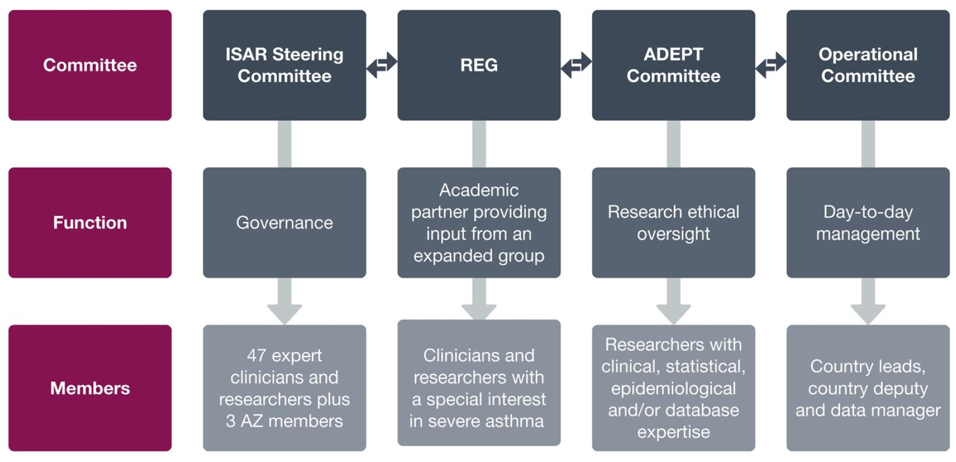
ISAR oversight: committees, functions and members
ISAR is overseen by 4
governing bodies:
The ISAR Steering Committee (ISC),
The Respiratory Effectiveness Group (REG),
The Anonymised Data Ethics & Protocol Transparency (ADEPT)
Committee, and
The ISAR Operational Committee.
ISAR governance.
ISAR: International Severe Asthma Registry

Slide 7
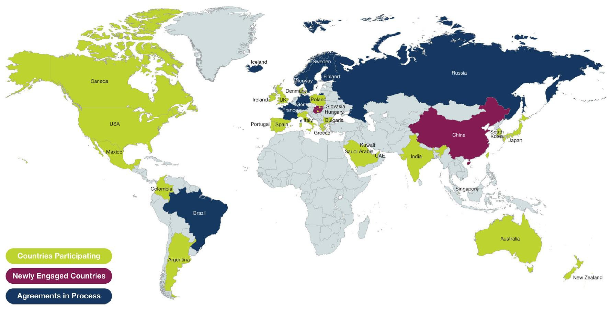
ISAR registries, countries, and experts
ISAR’s membership currently includes registries from more than 30 participating countries, allowing for extensive collaboration and potentially new research ideas.
ISAR snapshot as at 21st July 2020.
ISAR: International Severe Asthma Registry

Slide 8
ISAR registries, countries, and experts
Registry Status | Collaborating Country | Registry Name | Start Year
Existing Registry | UK | UK Severe Asthma Registry | 2006
 | USA | National Jewish Health Electronic Medical Record (NJH EMR) | 2010
 | South Korea | Severe Asthma Work Group of Korean Academy of Asthma, Allergy and Clinical Immunology (KAAACI) | 2010
 | Germany | German Asthma Network (GAN) | 2011
 | Australia & New Zealand | Australasian Severe Asthma Registry (ASAR) hosted by TSANZ | 2013
 | Ireland | INhaler Compliance Assessment in Severe Unstable Asthma (INCA SUN) | 2015
 | Italy | Severe Asthma Network Italy (SANI) | 2016
 | Spain | Spanish Guideline on the Management of Asthma Database (GEMA-Data) | 2017
New Registry | Denmark | Danish Severe Asthma Registry (DSAR) | 2018
 | Sweden | Swedish Severe Asthma Registry; starting in 2020
 | Finland | Currently collecting data independently from ISAR | 2019
 | Iceland | Currently collecting data independently from ISAR | 2020
 | Norway | Starting in 2021
 | Bulgaria | Bulgarian Severe Asthma Registry (BULSAR) | 2018
 | Portugal | Portugal Severe Asthma Registry (Registo de Asma Grave Portugal [RAG]) | 2018
 | Russia | Russian Severe Asthma Registry (RSAR) | 2018
Registry Status | Collaborating Country | Registry Name | Start Year
New Registry | Argentina | Argentinian Severe Asthma Registry | 2019
 | Belgium | Currently collecting data independently from ISAR | 2018
 | Brazil | Brazilian Severe Asthma Registry; starting in 2020
 | Canada | Canadian Severe Asthma Registry | 2019
 | China | Starting in 2021
 | Colombia | Colombian Severe Asthma Registry | 2019
 | France | French Severe Asthma Registry | 2019
 | Greece | Greek Severe Asthma Registry | 2019
 | India | Indian Severe Asthma Registry | 2019
 | Japan | Japanese Severe Asthma Registry | 2019
 | Kuwait | Kuwaitian Severe Asthma Registry | 2018
 | Mexico | Mexican Severe Asthma Registry | 2019
 | Poland | Polish Severe Asthma Registry | 2020
 | Saudi Arabia | Saudi Arabian Severe Asthma Registry | 2019
 | Singapore | Singapore Severe Asthma Registry (S-SAR) | 2020
 | Taiwan | Taiwanese Severe Asthma Registry | 2019
 | UAE | UAE Severe Asthma Registry | 2019

Slide 9
ISAR patients
On average, 2000 new patients will be enrolled globally each year, for at least 5 years from the start of
ISAR (May 2017).
Eligibility criteria were chosen to reflect severe asthma patients in the real-world setting and to broaden the scope to include patients with uncontrolled moderate-to-severe asthma.
– Patients with asthma-chronic obstructive pulmonary disease overlap (ACO) will also be included.
Inclusion | Exclusion
Adult (≥18 years old) patients with severe asthma | Lack of informed consent for participation
Undergoing GINA Step 5 treatment or Uncontrolled on GINA Step 4 treatment – defined as at least one of the following (per ATS/ERS guidelines): Poor symptom control: ACQ consistently > 1.5, ACT < 20 (or ‘not well controlled’) or GINA not well controlled Airflow limitation: Pre-bronchodilator FEV₁ < 80% predicted, with reduced FEV₁/FVC (defined as less than the lower limit of normal) Serious exacerbations: ≥1 hospitalisation, ICU stay or mechanical ventilation in the previous year Frequent severe exacerbations: ≥2 bursts of systemic corticosteroids with each course > 3 days in the previous year
ACQ: Asthma Control Questionnaire; ACT: Asthma Control Test; ATS: American Thoracic Society; ERS: European Respiratory Society; FEV₁: forced expiratory volume in one second; FVC: forced vital capacity; GINA: Global Initiative for Asthma; ICU: intensive care unit; ISAR: International Severe Asthma Registry

Slide 10
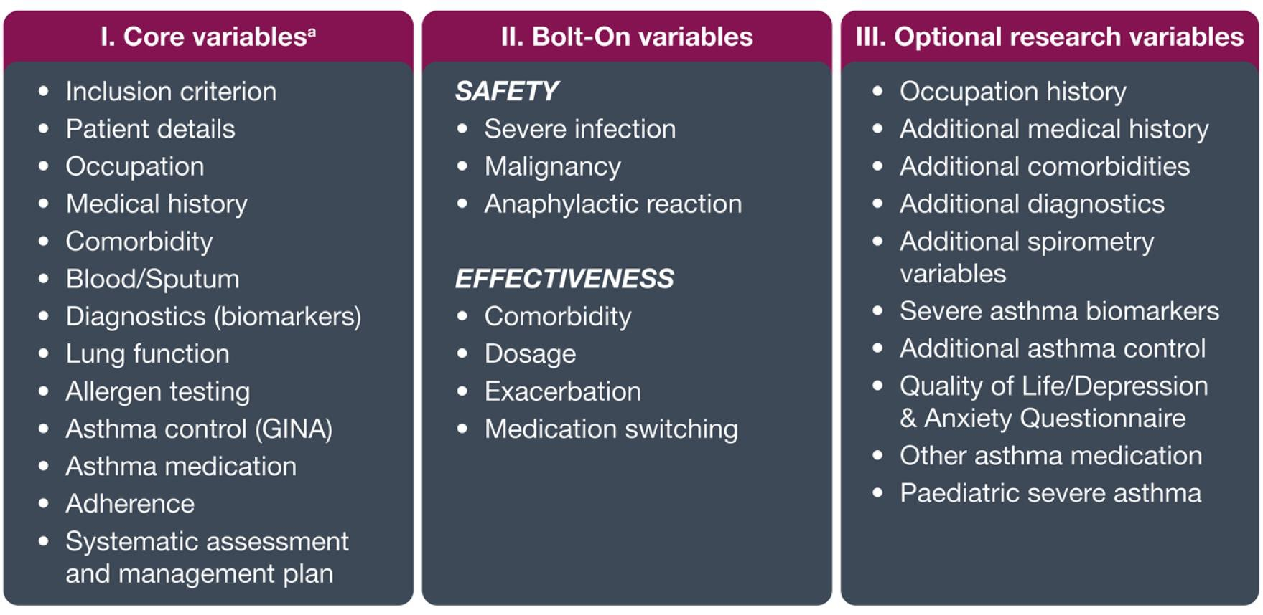
ISAR core variables
95 standardised and mandatory core variables which include data on patient demographics, medical history and diagnostics, clinical characteristics, patient-reported outcomes and treatment management plans should be collected by any registry wishing to contribute data to ISAR.
Newest developments:
An ISAR patient response questionnaire to assist affected sites with collecting patient data remotely in the era of Covid-19.
– Optional Covid-19 variables included for patients to complete, allowing ISAR to develop and evolve within the changing global respiratory environment.
GINA: Global Initiative for Asthma; ISAR: International Severe Asthma Registry

Slide 11
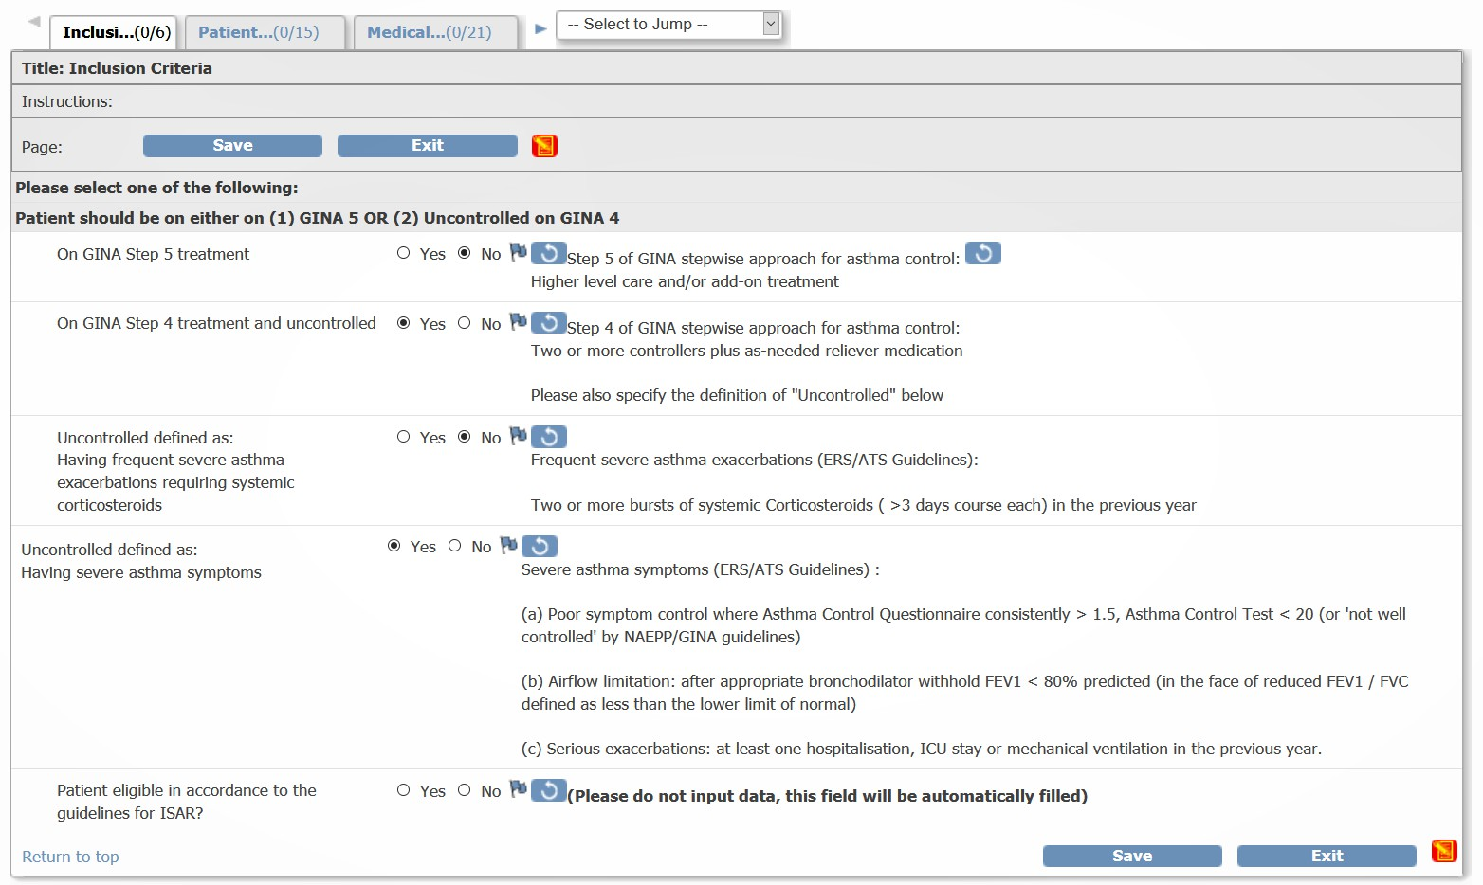
ISAR data collection
Data will be collected using a comprehensive electronic case report form (eCRF).
Registries can either enter data directly in the eCRFs or opt to collect the data on paper and enter it into the eCRF at a later date based on their clinical process.
Data collection will comply with the standards established by the ISC and agreed by each participating registry.
– This allows datasets across all registries to be combined, further standardising ISAR data effectively.
ISAR: International Severe Asthma Registry
A screenshot of the ISAR eCRF.

Slide 12
ISAR electronic data capture (EDC)
All new data will be entered directly into the EDC system (REDCap or OpenClinica).
EMR data will be integrated with eCRF data from the EDC systems and will be de-identified prior to importing it to the central data warehouse where the data will be stored with a unique patient identification number.
All participating sites will
have access and ownership to their own data,
be trained on using the EDC systems, and
be responsible for extracting batches of patient data at a quarterly frequency for inclusion to ISAR.
OPC will be responsible for
monitoring and mapping the data into the central ISAR data repository and safely transporting and importing each batch into the central ISAR data repository.
For countries with data sharing regulations de-limiting data privacy, ISAR will accommodate anonymised data sharing on a project-by-project basis.
EMR: electronic medical records; ISAR: International Severe Asthma Registry; OPC: Optimum Patient Care; SNOMED CT: systematized nomenclature of medicine clinical terms

Slide 13
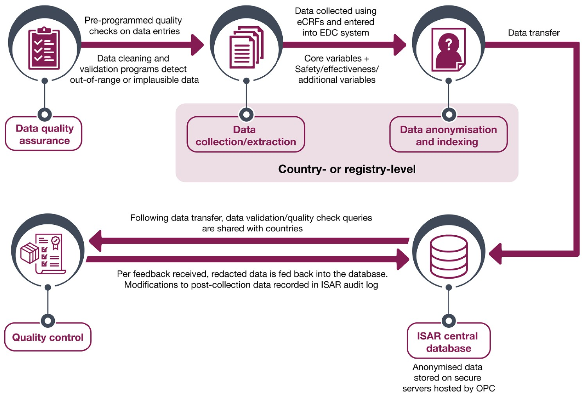
ISAR database
Data will be collected from a combination of existing and new registries with systems that are largely aligned with the standard data collection fields of ISAR e.g.
Dendrite Clinical Systems (UK)
REDCap (Italy)
OpenClinica (e.g. Canada, Greece, and Japan)
Zitelab (Denmark)
Data imported will be as per instructions listed in a separate ISAR data management plan, which will be provided to all registries.
Data acquisition, quality control and management of ISAR are illustrated above.
eCRF: electronic case report form; EDC: Electronic Data Capture; ISAR: International Severe Asthma Registry; OPC: Optimum Patient Care

Slide 14
ISAR data quality and management
Data quality is ensured before and during the data collection process through a series of pre- programmed data quality checks that automatically detect out-of-range or anomalous entries on the eCRF.
To minimise data entry errors, most of the fields requested on the ISAR eCRF are numeric or categorical.
After data extraction, further data cleaning and validation processes will also be performed on all data to maximise data quality control.
Ad hoc queries (done at the country level or OPC level) will be generated within the electronic data capture (EDC) system and followed up with country data managers and/or the country study coordinator (where applicable) for resolution.
All data modifications will be recorded in an audit log and all data transfers and disputes will be shared and documented in the country and ISAR central data manager logs.
eCRF: electronic case report form; ISAR: International Severe Asthma Registry

Slide 15
ISAR data ownership
Each country retains ownership of their data.
All participating countries agree to allow output of data from their respective registries upon joining ISAR for collaborative independent research approved by the ISC and ADEPT.
The extraction and integration of datasets for ethically approved research studies will be managed by
OPC.
The nature and frequency of data extraction and transfer (quarterly) from registries to OPC are detailed in the ISAR data sharing agreement.
ADEPT: Anonymised Data Ethics, Protocols & Transparency; ISAR: International Severe Asthma Registry; ISC: ISAR Steering Committee; OPC: Optimum Patient Care

Slide 16
ISAR research
The research goal of ISAR is to complete eight global research projects and eight project-specific
datasets for academic and commercial research by ISAR members over a 5-year period.
New collaborators may also join ISAR by clicking the ‘J^{J}o^{O}in^{IN}T^{TH}h^{E}e^{R}R^{E}e^{G}g^{IS}i^{T}s^{R}tr^{Y}y’ tab on the ISAR home page.
ISC members, country leads, contributors and visitors to the ISAR website may contribute research ideas by clicking the ‘S^{S}u^{U}b^{B}m^{M}i^{I}t^{T}A^{A} P^{PR}r^{O}o^{P}p^{O}o^{S}s^{A}a^{L}l ^{O}o^{R}r R^{RE}e^{Q}q^{U}u^{E}e^{S}s^{T}t^{R}R^{ESE}es^{A}e^{R}a^{C}r^{H}ch’ tab on the ISAR home page.
– All research ideas will be reviewed, assessed and prioritised by the ISC.
ISAR is also open to collaborating with and extracting data from other databases which consist of datasets that are not part of the core ISAR projects but have alignment of variables, enabling the combination of data for specific projects.
ISAR: International Severe Asthma Registry; ISC: ISAR Steering Committee

Slide 17
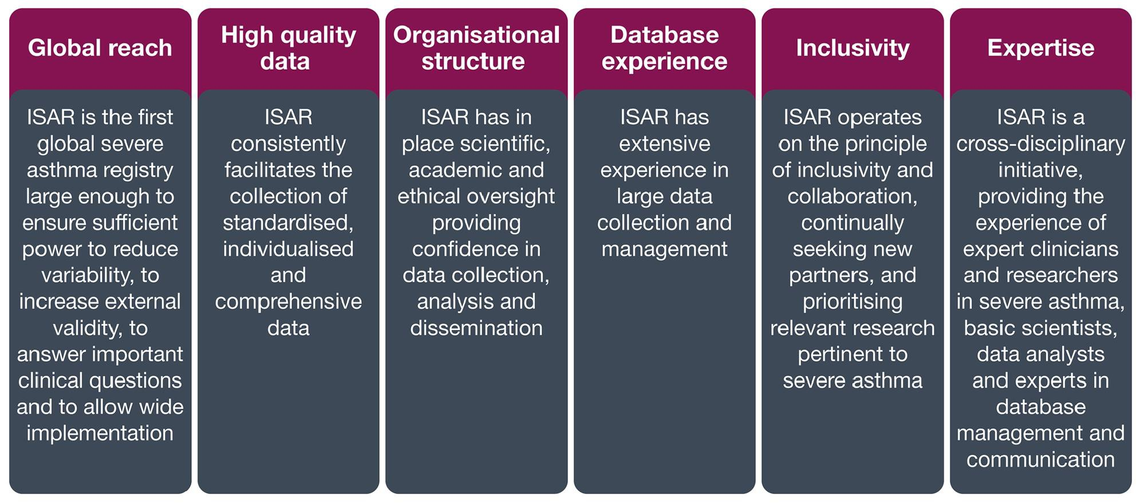
Key strengths of ISAR
You may find the ISAR mission statement which fully describes how ISAR may improve our
understanding of severe asthma here.
ISAR: International Severe Asthma Registry

Slide 18
Future direction of ISAR
ISAR plans to include additional countries covering Africa, Asia, South America, the
Middle East, and Eastern Europe.
Other prospects include linkages with other databases and integration with electronic medical records.
Longitudinal research in patients with less severe asthma and the development of a paediatric ISAR in order to cover the entire severe asthma life cycle are also being considered.
ISAR: International Severe Asthma Registry

Slide 19
Conclusions and Summary
By acting as a data custodian of international patient data, ISAR works as an open border
initiative, providing a platform to facilitate data sharing.
The registry provides enough statistical power to address important research questions in severe asthma aimed at a wide range of topics.
Through ISAR, it is expected that the harmonised, standardised nature of data contained and the collaborative partnerships being made possible may reveal previously unthought of or neglected research avenues.
In summary, ISAR aims to offer a rich source of real-life data for scientific research to
understand and improve patient outcomes in severe asthma.
Furthermore, the registry will provide an international platform for research collaboration in respiratory medicine, with the overarching aim of improving primary and secondary care of adults with severe asthma globally.
ISAR: International Severe Asthma Registry

