Slide 1
Analysis of comorbidities and multimorbidity in adult patients in the International Severe Asthma Registry: PRISM I
Ghislaine Scelo, PhD, Carlos A. Torres-Duque, Jorge Maspero, Trung N. Tran, MD, Ruth Murray, PhD, Neil Martin, MD, PhD,∙ Andrew N. Menzies-Gow, PhD, Mark Hew, PhD, Matthew J. Peters, PhD, Peter G. Gibson, MBBS, George C. Christoff, MD, MPH, PhD,∙ Todor A. Popov, MD, PhD, Andréanne Côté, MD, MSc, Celine Bergeron, MD, MSc, Delbert Dorscheid, MD, PhD, J. Mark FitzGerald, MD, ∙ Kenneth R. Chapman, MD, Louis Philippe Boulet, MD, ∙ Mohit Bhutani, MD,∙ Mohsen Sadatsafavi, MD, PhD, ∙ Libardo Jiménez-Maldonado, MD, ∙ Mauricio Duran-Silva, MD, Bellanid Rodriguez, BSc, Carlos Andres Celis-Preciado, MD, MSc,∙ Diana Jimena Cano-Rosales, MD, ∙ Ivan Solarte, MD, MHPE,∙ Maria Jose Fernandez-Sanchez, MD, MSc, Patricia Parada-Tovar, BSc, ∙ Anna von Bülow, MD, PhD,∙ Anne Sofie Bjerrum, MD, PhD,∙ Charlotte S. Ulrik, MD, DMSc,∙ Karin Dahl Assing, MD, ∙ Linda Makowska Rasmussen, MD, PhD, Susanne Hansen, PhD,∙ Alan Altraja, MD, PhD, Arnaud Bourdin, MD, PhD, Camille Taille, MD, PhD, Jeremy Charriot, MD, PhD, Nicolas Roche, MD, PhD, Andriana I. Papaioannou, MD, PhD, Konstantinos Kostikas, MD, PhD,∙ Nikolaos G. Papadopoulos, MD, PhD, Sundeep Salvi, MD, PhD,∙ Deirdre Long, RGN, RANP, MSc, ∙ Patrick D. Mitchell, MD,∙ Richard Costello, MB, MD, ∙ Concetta Sirena, PhD, ∙ Cristina Cardini, MD, ∙ Enrico Heffler, MD, PhD,∙ Francesca Puggioni, MD, Giorgio Walter Canonica, MD, ∙ Giuseppe Guida, MD, PhD, ∙ Takashi Iwanaga, MD, PhD, ∙ Mona Al-Ahmad, MBBCh, ∙ Désirée Larenas Linnemann, MD, ∙ Ulises Garcia, MD, ∙ Piotr Kuna, MD, PhD,∙ João A. Fonseca, MD, PhD,∙ Riyad Al-Lehebi, MD, ∙ Mariko Siyue Koh, MBBS,∙ Chin Kook Rhee, MD, PhD, ∙ Borja G. Cosio, MD, PhD, Luis Perez de Llano, MD, PhD, ∙ Diahn-Warng Perng (Steve), MD, PhD,∙ Erick Wan-Chun Huang, MD, PhD, ∙ Hao-Chien Wang, MD, PhD,∙ Ming-Ju Tsai, MD, PhD, Bassam Mahboub, MD,∙ Laila Ibraheem Jaber Salameh, PhD, David Jackson, PhD, John Busby, PhD, ∙ Liam G. Heaney, MD,∙ Paul Pfeffer, PhD,∙ Amanda Grippen Goddard, DO, ∙ Eileen Wang, MD, MPH, ∙ Flavia Hoyte, MD, ∙ Michael E. Wechsler, MD,∙ Nicholas Chapman, DO,∙ Rohit Katial, MD, ∙ Victoria Carter, BSc, Lakmini Bulathsinhala, MPH, Neva Eleangovan, ∙ Con Ariti, MSc,∙ Juntao Lyu, PhD, David B. Price, MB Bchir,∙ Celeste Porsbjerg, MD, PhD
Scelo, G., et al. Analysis of comorbidities and multimorbidity in adult patients in the International Severe Asthma Registry, Annals of Allergy, Asthma & Immunology, Volume 132, Issue 1, 42 – 53, DOI: 10.1016/j.anai.2023.08.021

Slide 2
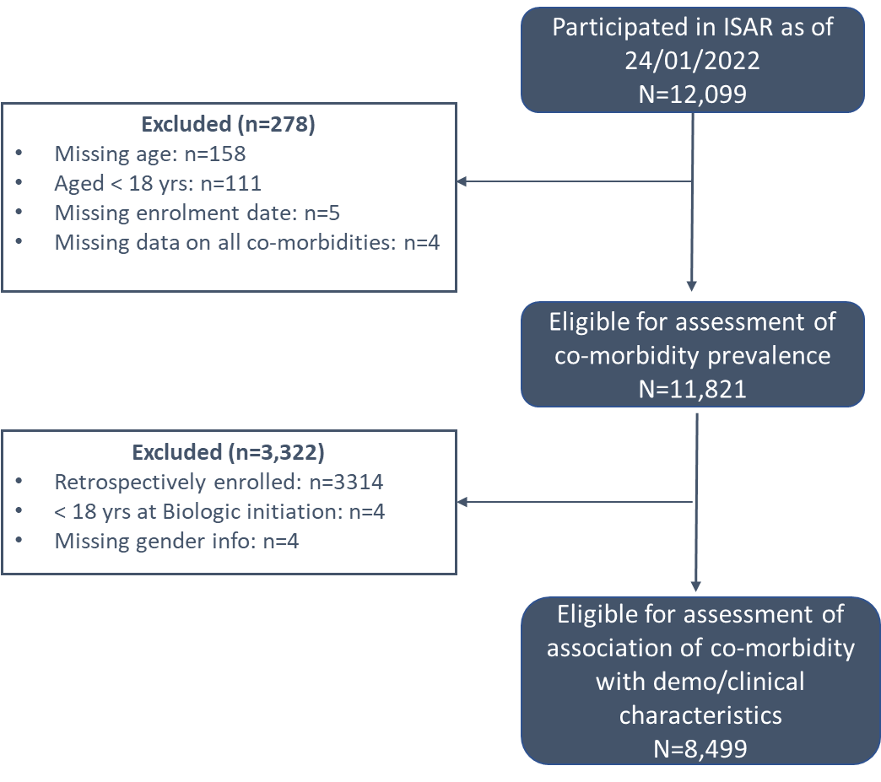
Aim and Methods
Rationale
Investigation for the presence of asthma comorbidities is recommended by the Global Initiative for Asthma because their presence can complicate asthma management
Aim
To understand the prevalence and pattern of comorbidities and multimorbidity in adults with severe asthma and their association with asthma-related outcomes
Methods
Cross-sectional study using ISAR data from 22 countries
30 comorbidities were identified and categorized a priori as any of the following: (1) potentially type 2–related comorbidities, (2) potentially OCS-related comorbidities, or (3) comorbidities mimicking or aggravating asthma.
The association between comorbidities and asthma-related outcomes was investigated using multivariable models adjusted for country, age at enrollment, and sex (ie male or female).
International Severe Asthma Registry data : ISAR, OCS: oral corticosteroid
Scelo, G., et al. Analysis of comorbidities and multimorbidity in adult patients in the International Severe Asthma Registry, Annals of Allergy, Asthma & Immunology, Volume 132, Issue 1, 42 – 53, DOI: 10.1016/j.anai.2023.08.021

Slide 3
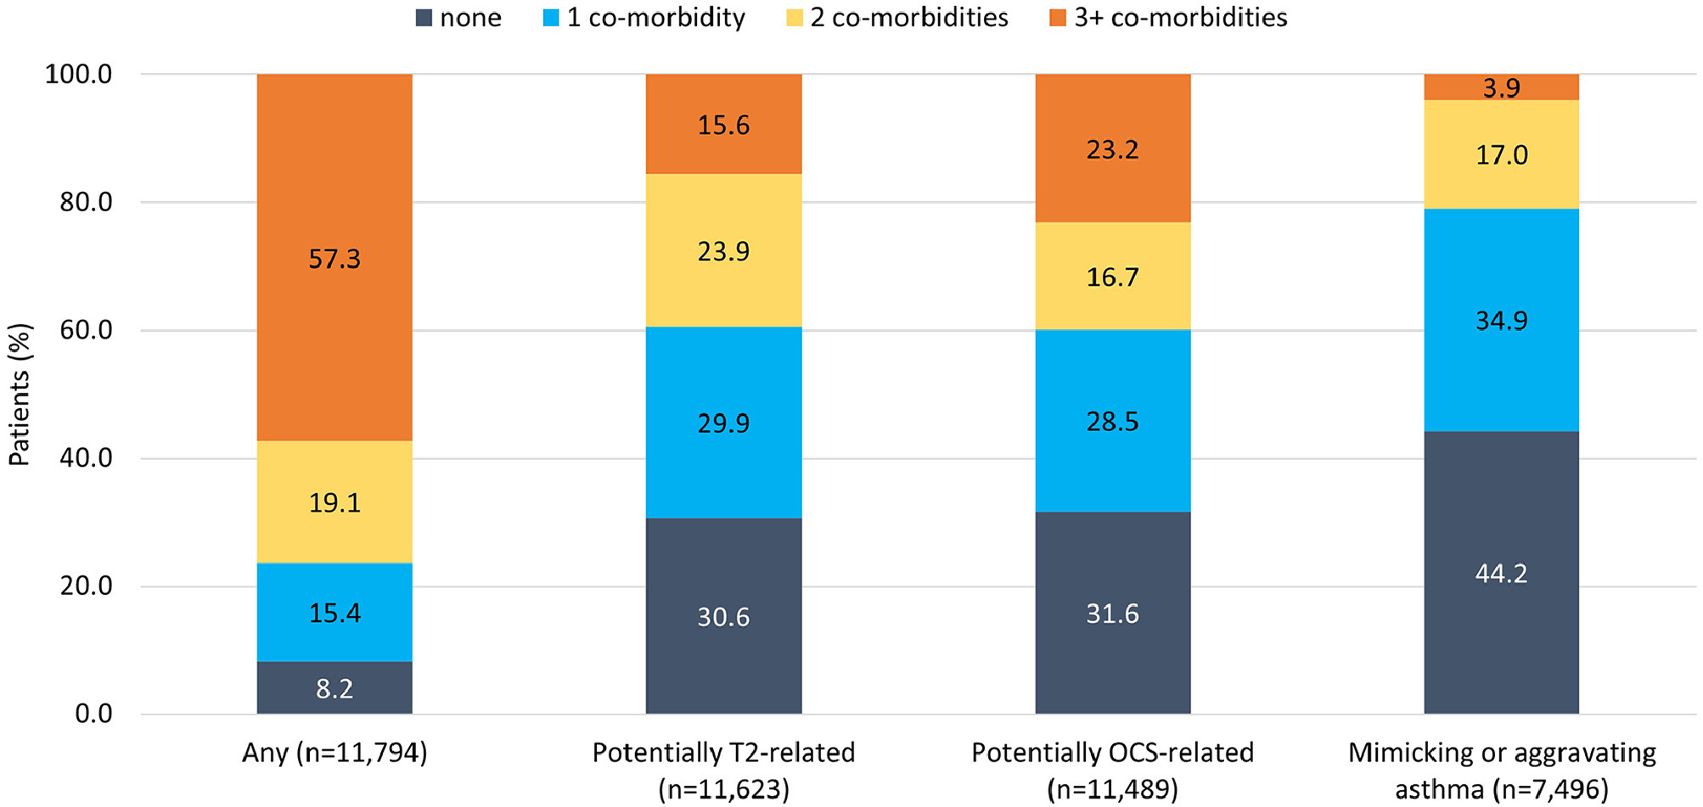
Most patients had at least 3 comorbidities of any type
T2-related and
OCS-related
T2-related
only
OCS-related
only
39.5% had 2 or more potentially T2-related comorbidities
39.9% had 2 or more potentially OCS-related comorbidities
20.9% had 2 or more comorbidities mimicking or aggravating asthma
OCS-related and mimicking/aggravating asthma
None
T2-related and mimicking/aggravating asthma
T2: Type 2, OCS: Oral Corticosteroid
Scelo, G., et al. Analysis of comorbidities and multimorbidity in adult patients in the International Severe Asthma Registry, Annals of Allergy, Asthma & Immunology, Volume 132, Issue 1, 42 – 53, DOI: 10.1016/j.anai.2023.08.021

Slide 4
Many individual comorbidities were associated with receiving LTOCS*
T2-related and
OCS-related
T2-related
only
OCS-related
only
OCS-related and mimicking/aggravating asthma
None
T2-related and mimicking/aggravating asthma
*The reference category for each analysis was absence of the comorbidity of interest
COPD, chronic obstructive pulmonary disease; FEV1, forced expiratory volume in 1 second; GERD, gastroesophageal reflux disease; OCS, oral corticosteroid; OR, odds ratio, LTOCS: Long-term Oral Corticosteroids.
Scelo, G., et al. Analysis of comorbidities and multimorbidity in adult patients in the International Severe Asthma Registry, Annals of Allergy, Asthma & Immunology, Volume 132, Issue 1, 42 – 53, DOI: 10.1016/j.anai.2023.08.021

Slide 5
Many individual comorbidities were associated with higher exacerbation rates*
T2-related and
OCS-related
T2-related
only
OCS-related
only
OCS-related and mimicking/aggravating asthma
None
T2-related and mimicking/aggravating asthma
*The reference category for each analysis was absence of the comorbidity of interest
COPD, chronic obstructive pulmonary disease; FEV1, forced expiratory volume in 1 second; GERD, gastroesophageal reflux disease; OCS, oral corticosteroid; OR, odds ratio, LTOCS: Long-term Oral Corticosteroids.
Scelo, G., et al. Analysis of comorbidities and multimorbidity in adult patients in the International Severe Asthma Registry, Annals of Allergy, Asthma & Immunology, Volume 132, Issue 1, 42 – 53, DOI: 10.1016/j.anai.2023.08.021

Slide 6
Poor asthma control associated with almost all potentially OCS-related comorbidities*
*The reference category for each analysis was absence of the comorbidity of interest
COPD, chronic obstructive pulmonary disease; FEV1, forced expiratory volume in 1 second; GERD, gastroesophageal reflux disease; OCS, oral corticosteroid; OR, odds ratio, LTOCS: Long-term Oral Corticosteroids.
Scelo, G., et al. Analysis of comorbidities and multimorbidity in adult patients in the International Severe Asthma Registry, Annals of Allergy, Asthma & Immunology, Volume 132, Issue 1, 42 – 53, DOI: 10.1016/j.anai.2023.08.021

Slide 7
Having hypertension or osteoporosis was associated with a worse outcome in each of the 4 asthma outcomes assessed*
*The reference category for each analysis was absence of the comorbidity of interest
COPD, chronic obstructive pulmonary disease; FEV1, forced expiratory volume in 1 second; GERD, gastroesophageal reflux disease; OCS, oral corticosteroid; OR, odds ratio, LTOCS: Long-term Oral Corticosteroids.
Scelo, G., et al. Analysis of comorbidities and multimorbidity in adult patients in the International Severe Asthma Registry, Annals of Allergy, Asthma & Immunology, Volume 132, Issue 1, 42 – 53, DOI: 10.1016/j.anai.2023.08.021

Slide 8
Chronic Rhinosinusitis and Nasal Polyps associated with greater number of exacerbations and use of LTOCS*
Odds Ratios and 95% CIs of Receiving Long-Term OCS Associated With the Presence of Comorbidities
Comorbidities | Sample size | OR (95% CI) | P value
Potentially T2-related categories
Allergic rhinitis | 7976 | 0.97 (0.86-1.10) | .65
Chronic rhinosinusitis | 8020 | 1.46 (1.30-1.64) | <.001
Nasal polyposis | 8271 | 1.40 (1.22-1.60) | <.001
Eczema/atopic dermatitis | 8255 | 0.87 (0.71-1.06) | .17
Compared with those without CRS, patients with comorbid CRS had 29% more exacerbations and were 46% more likely to receive LTOCS
Nasal polyposis was also associated with a poorer outcome for these 2 variables
Allergic rhinitis was associated with higher exacerbation rates only
AD was not associated with a significantly poorer asthma outcome for any variable assessed
Ratios of Means and 95% CIs of Number of Exacerbations in the Year Preceding Enrolment Associated With the Presence of Comorbidities
Comorbidities | Sample size | Ratio of means (95% CI) | P value
Potentially T2-related categories
Allergic rhinitis | 7060 | 1.12 (1.04-1.21) | .003
Chronic rhinosinusitis | 7036 | 1.29 (1.21-1.38) | <.001
Nasal polyposis | 7283 | 1.16 (1.07-1.25) | <.001
Eczema/atopic dermatitis | 7265 | 1.11 (0.99-1.23) | .07
*The reference category for each analysis was absence of the comorbidity of interest
OCS, oral corticosteroid; OR, odds ratio; T2, type 2, CRS: Chronic Rhinosinusitis, AD: Atopic Dermatitis, LTOCS: Long-term Oral Corticosteroids, CI: Confidence Intervals
Scelo, G., et al. Analysis of comorbidities and multimorbidity in adult patients in the International Severe Asthma Registry, Annals of Allergy, Asthma & Immunology, Volume 132, Issue 1, 42 – 53, DOI: 10.1016/j.anai.2023.08.021

Slide 9
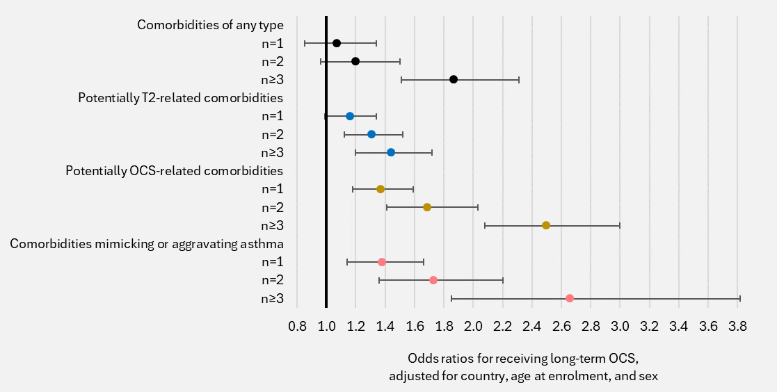
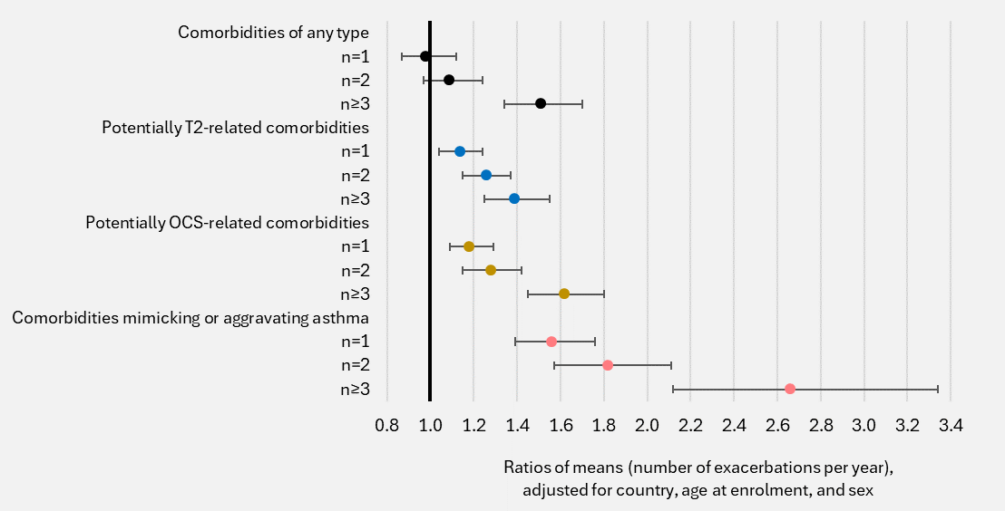
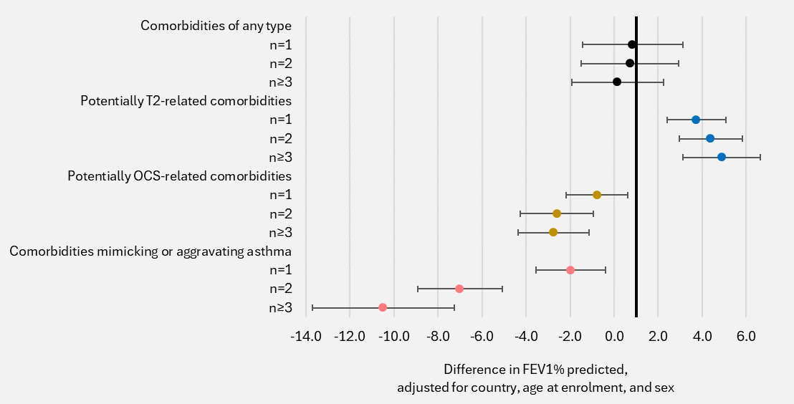
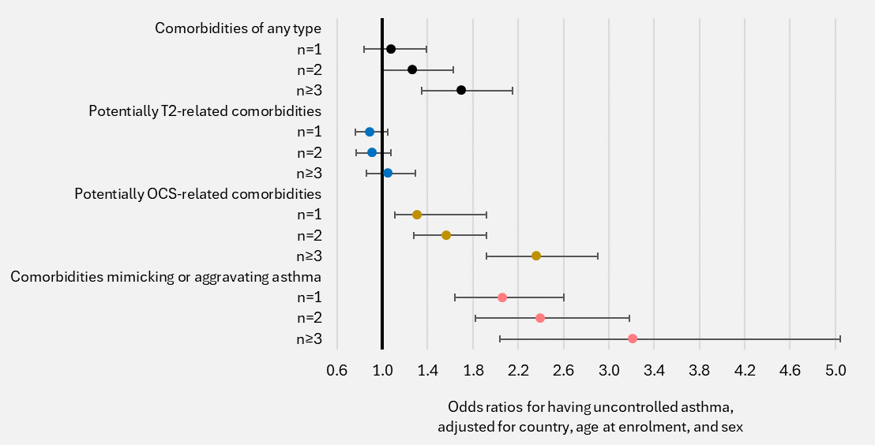
Patients with a greater number of comorbidities, both overall and for each comorbidity category, had worse asthma outcomes
Long-term OCS use
Exacerbation rates
T2-related and
OCS-related
T2-related
only
OCS-related
only
FEV₁ percent predicted
Uncontrolled asthma
T2-related and mimicking/aggravating asthma
FEV1, forced expiratory volume in 1 second; OCS, oral corticosteroids; T2, type 2. The reference category for each analysis was to have no comorbidity of the type of interest.
Scelo, G., et al. Analysis of comorbidities and multimorbidity in adult patients in the International Severe Asthma Registry, Annals of Allergy, Asthma & Immunology, Volume 132, Issue 1, 42 – 53, DOI: 10.1016/j.anai.2023.08.021

Slide 10
Summary: Comorbidity or multimorbidity is reported in most adults with severe asthma and is associated with poorer asthma-related outcomes
Key findings:
Over 50% of patients had 3 or more comorbidities
Exacerbation rates and odds of LTOCS use higher for those with comorbid AR, CRS, or NP
Marked cumulative negative effect of multiple T2-related comorbidities on exacerbation rate and LTOCS: particularly important since 40% had at least 2 T2-related comorbidities
Poor asthma control associated with all potentially OCS-related comorbidities (with the exception of dyslipidemia)
LTOCS associated with the largest number of comorbidities across the spectrum
Practice change needed:
Systematic evaluation for comorbidities during routine asthma review
Standardized comorbidity data collection
Multidisciplinary and holistic approach to asthma management, to improve outcomes for severe asthma patients
The reference category for each analysis in the study was absence of the comorbidity of interest
OCS, oral corticosteroid; T2, type 2, CRS: Chronic Rhinosinusitis, AR: Allergic Rhinitis, LTOCS: Long-term Oral Corticosteroids, NP: Nasal Polyps
Scelo, G., et al. Analysis of comorbidities and multimorbidity in adult patients in the International Severe Asthma Registry, Annals of Allergy, Asthma & Immunology, Volume 132, Issue 1, 42 – 53, DOI: 10.1016/j.anai.2023.08.021

