Slide 1
Impact of Socioeconomic Status on Adult Patients with Asthma:
A Population-based Cohort Study from UK Primary Care
John Busby, David Price, Riyad Al-Lehebi, Sinthia Bosnic-Anticevich, Job FM van Boven, Benjamin Emmanuel, J Mark FitzGerald, Mina Gaga, Susanne Hansen, Mark Hew, Takashi Iwanaga, Désirée Larenas Linnemann, Bassam Mahboub, Patrick Mitchell, Daniela Morrone, Jonathan Pham, Celeste Porsbjerg, Nicolas Roche, Eileen Wang, Neva Eleangovan, Liam G Heaney

Slide 2
Background and Objectives¹
Background
Objectives
Socioeconomic status (SES) is known to affect asthma outcomes such as morbidity, mortality and healthcare utilization
1. Describe the socioeconomic disparities
in a UK primary care asthma cohort
2. Identify the factors that influence the impact of SES on asthma outcomes
Suggested reasons for worse asthma
outcomes in deprived populations
include poorer living conditions and reduced access to specialist care
3. Study the impact of SES on asthma presentations (e.g., blood eosinophils), treatment processes (e.g., respiratory referrals) and outcomes (e.g., asthma control and exacerbations)
UK guidelines: patients with asthma
that remains uncontrolled despite
standard therapies should be referred to specialists²
SES = Socioeconomic status
¹Busby J, Price D et al. J Asthma Allergy 2021;in press; ²BTS/SIGN. British guideline on the management of asthma: quick reference guide, 2019

Slide 3
Study design
Inclusion criteria
Analyses
Aged ≥18 years old
Asthma diagnosis
≥3 years of data available
Asthma presentations
Blood eosinophils
Peak flow
Treatment processes
Medication adherence
Asthma reviews
Respiratory referrals
Historical cohort study
1-year follow-up
Deprivation quintiles
Clinical outcomes
Asthma control
Exacerbations
Socioeconomic status derived from UK 2011 Indices of Multiple Deprivation scores*:
Quintile 5: least deprived
Quintile 1: most deprived
Sensitivity analyses:
– Impact of demographic factors and asthma severity (≥2 exacerbations) on clinical outcomes
*Indices of Multiple Deprivation scores reflect the relative deprivation of the areas where the general practices are located ; they take a weighted average of income, employment, health, education, housing, crime and living environment
Busby J, Price D et al. J Asthma Allergy 2021;in press.

Slide 4
Socioeconomic disparities in a UK primary care asthma cohort
13.0%
22.2%
24.4%
21.2%
19.2%
Quintile 5 Quintile 4 Quintile 3 Quintile 2 Quintile 1
N=127,040
Least deprived
Most deprived
Busby J, Price D et al. J Asthma Allergy 2021;in press.

Slide 5
Demographic and clinical characteristics of asthma patients by SES
Most deprived patients were more likely to have atopic disease and uncontrolled asthma than least deprived patients
100
97.5
All p <0.001
88.3
82.6
80
77.6
Proportion of patients (%)
_{58.0} 60.2
59.2
60
50.8
47.8
43.0
44.7
40
34.5
29.2 _{28.4}
24.2
20.3
20
_{15.1} 16.2
0
Age ≥35 years
Female
White ethnicity Never-smokers Atopic disease GINA Steps 4 or Asthma review
5
Uncontrolled
disease
Any
exacerbations
Least deprived quintile (n=28,215) Most deprived quintile (n=16,534)
GINA = Global Initiative for Asthma; SES = Socioeconomic status
Busby J, Price D et al. J Asthma Allergy 2021;in press.

Slide 6
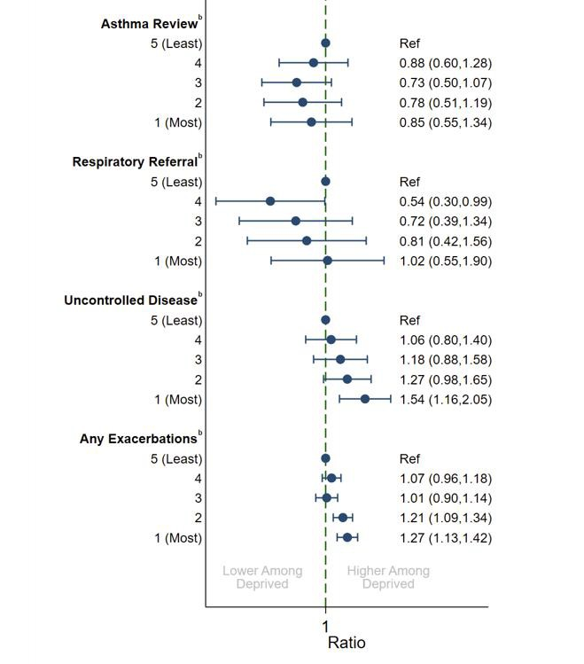
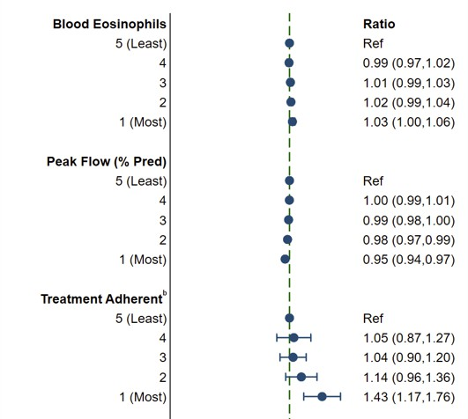
Impact of SES on asthma presentations, treatment processes and clinical outcomes in UK primary careª
Most deprived patients had more uncontrolled asthma and greater likelihood of exacerbations than least deprived patients, but rates of respiratory referrals remained comparable
Sensitivity analysis: Similar rates of respiratory referrals between most and least deprived patients remained among those with ≥2 exacerbations
Clinical implication: More deprived patients may have greater need for specialist reviews and phenotype- targeted treatments like biologics
ªAdjusted for year, age (5-year groups) and sex; ^{b}Odds ratio. Patient numbers: n=45,761 for blood eosinophils; n=71,291 for peak flow; n=102,712 for treatment adherent; n=127, 040 for asthma review; n=127,040 for respiratory referral; n=40,078 for uncontrolled disease; n=127,040 for any exacerbations
SES = Socioeconomic status
Busby J, Price D et al. J Asthma Allergy 2021;in press.

Slide 7
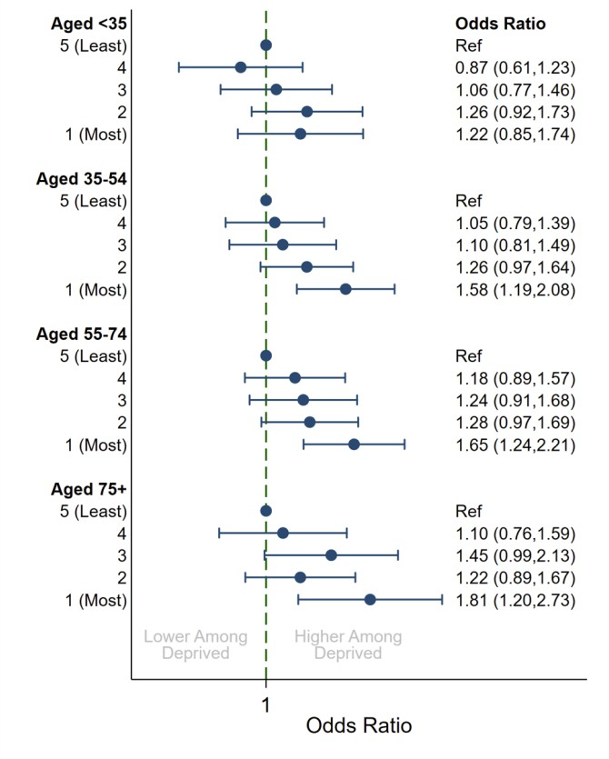
Age influences the magnitude of SES’s impact on asthma outcomes
Uncontrolled asthma
The impact of increased deprivation on asthma control was greater in patients aged
≥75 years than in those aged <35 years
SES = Socioeconomic status
Busby J, Price D et al. J Asthma Allergy 2021;in press.

Slide 8
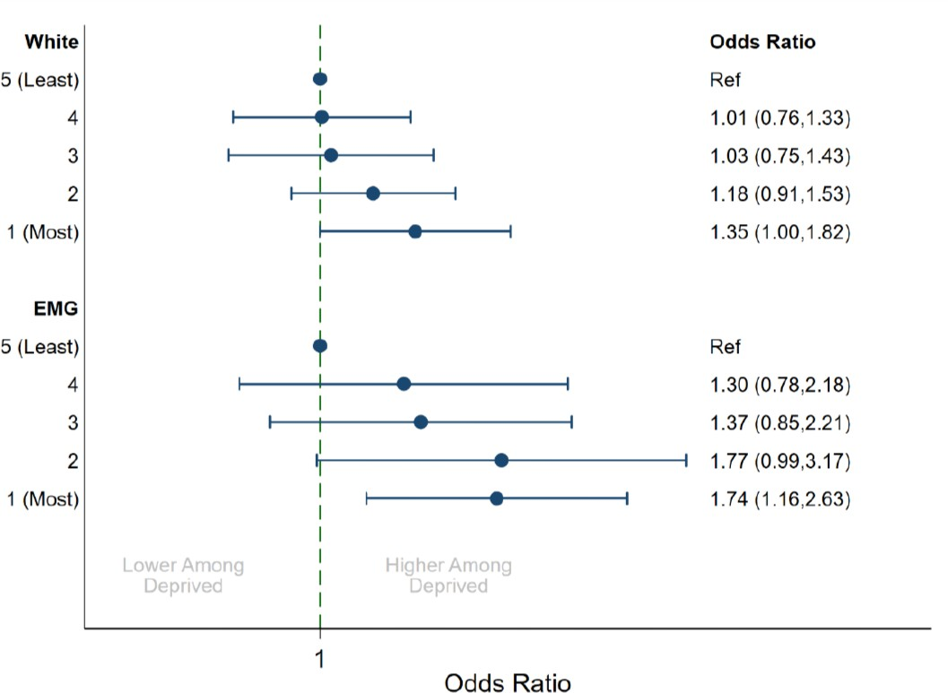
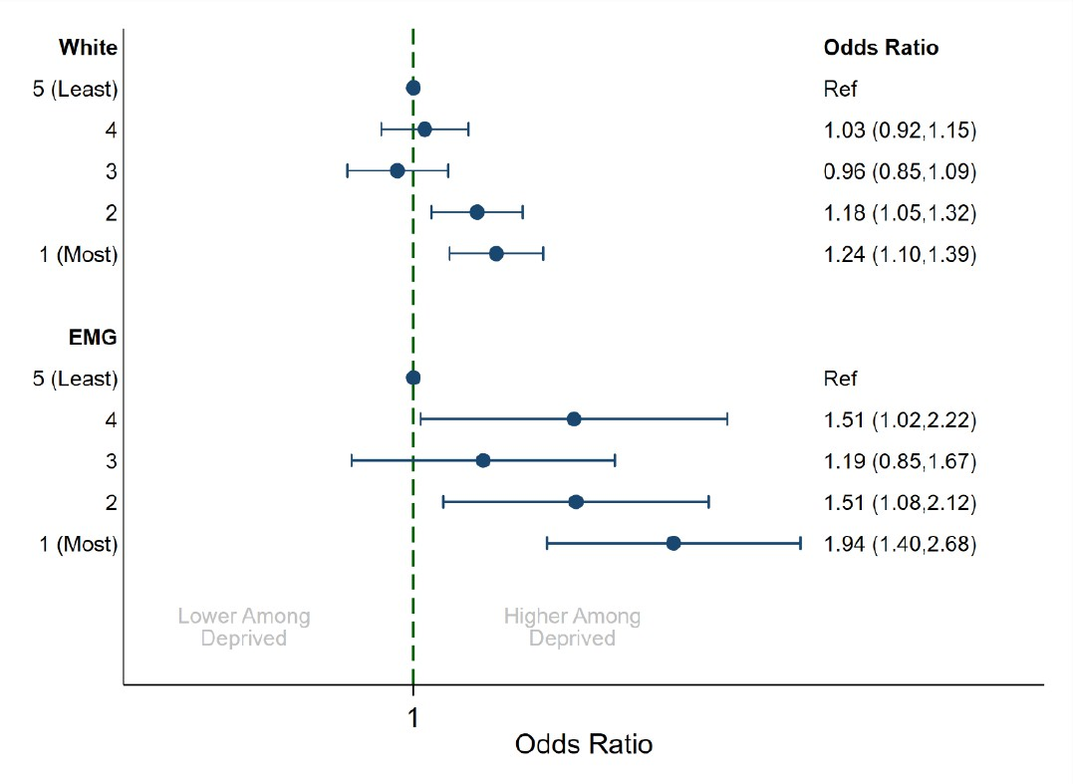
Ethnicity influences the magnitude of SES’s impact on asthma outcomes
Uncontrolled asthma
Any exacerbations
The impact of increased deprivation on asthma control and exacerbations was greater in ethnic minority groups than in White patients
EMG = Ethnic minority groups; SES = Socioeconomic status Busby J, Price D et al. J Asthma Allergy 2021;in press.

Slide 9
Conclusions
There was evidence of socioeconomic disparities in a UK primary care asthma cohort
Socioeconomic deprivation has an adverse effect on asthma outcomes
Most deprived patients were more likely to have worse peak flow, uncontrolled disease or an exacerbation during
follow-up than least deprived patients
Although more deprived patients had more uncontrolled disease, rates of respiratory referrals were similar to those of less deprived patients
More deprived patients may have greater need for specialist reviews and phenotype-targeted treatments like biologics
Age and ethnicity influence the magnitude of SES’s impact on asthma outcomes
The impact of increased deprivation on asthma control was more pronounced in older patients versus younger patients, and in ethnic minority groups versus White patients
Interventions to resolve socioeconomic disparities should be explored, both in the UK and globally, to improve overall asthma outcomes
SES = Socioeconomic status
Busby J, Price D et al. J Asthma Allergy 2021;in press.

Slide 10
Acknowledgements
We would like to thank all patients and collaborators who contributed to this academic
research study, which was prioritized by ISAR.
This research study was funded and delivered by the Observational and Pragmatic Research Institute Pte Ltd (OPRI). Optimum Patient Care Global received partial funding from AstraZeneca Ltd to support dataset creation.
OPCRD has been reviewed and ethically approved by the NHS Health Research Authority to hold and process anonymized data as part of service delivery (Research Ethics Committee reference: 15/EM/0150). Ethical approval for this research study was granted by the ADEPT committee (ADEPT0120). The study was designed, implemented and registered in accordance with the criteria of ENCePP (EUPAS32482).
ADEPT = Anonymised Data Ethics Protocols and Transparency; ENCePP = European Network of Centres for Pharmacoepidemiology and Pharmacovigilance; ISAR = International Severe Asthma Registry; NHS = National Health Service Busby J, Price D et al. J Asthma Allergy 2021;in press.

