Slide 1
Real World Biologic Use and Switch Patterns in Severe Asthma:
Data from the International Severe Asthma Registry
and the US CHRONICLE Study
Andrew N Menzies-Gow, Claire McBrien, Bindhu Unni, Celeste M Porsbjerg, Mona Al-Ahmad, Christopher S Ambrose, Karin Dahl Assing, Anna von Bülow, John Busby, Borja G Cosio, J Mark FitzGerald, Esther Garcia Gil, Susanne Hansen, Liam G Heaney, Mark Hew, David J Jackson, Maria Kallieri, Stelios Loukides, Njira L Lugogo, Andriana I Papaioannou, Désirée Larenas-Linnemann, Wendy C Moore, Luis A Perez-de-Llano, Linda M Rasmussen, Johannes M Schmid, Salman Siddiqui, Marianna Alacqua, Trung N Tran, Charlotte Suppli Ulrik, John W Upham, Eileen Wang, Lakmini Bulathsinhala, Victoria A Carter, Isha Chaudhry, Neva Eleangovan, Ruth B Murray, Chris A Price, David B Price

Slide 2
Real world biologic use and switch patterns in severe asthma
2
Inclusion criteria
 |  | ≥18 years old at biologic initiation Severe asthma (GINA Step 5 or uncontrolled asthma at GINA Step 4) Treated with a biologic ≥6 months of follow-up after biologic initiation
 |  | All subjects were treated in countries that had access to ≥2 biologics. Therefore continuation, stopping, or switching of biologics was feasible.
Analyses
Demographic and clinical characteristics pre-biologic initiation
CHRONICLE Study (USA)
Patterns of biologic use
Patterns of biologic stopping,
switching and continuations
Time to cessation of first biologic
Switch patterns by biologic class
Reasons for stopping or switching biologics
Historical cohort study
Sensitivity analyses
Prospective patients (n=2656)
Non-US (n=1404)
GINA = Global Initiative for Asthma; CHRONICLE = Observational Study of Characteristics, Treatment and Outcomes With Severe Asthma in the United States; USA = United States of America
Menzies-Gow AN, Price D et al. J Asthma Allergy 2022;15:63-78.

Slide 3
Demographic and clinical characteristics of severe asthma patients before
initiation of the first biologic
3
Pre-biologic initiation, stoppers and switchers were more likely to have poorer
lung function and greater healthcare resource utilization than continuers
100
93
*: p<0.05 for stoppers vs continuers Ɨ: p<0.05 for switchers vs continuers
89
85
87
85
80
75
Proportion of patients (%)
69
64 64
60
61
60
58
46
47
46
36
40
40
40
24
21
21
20
12
13
7
0
≥35 years of age
Female
CRS and/or NP*Ɨ
BEC ≥300 cells/µL (not on LTOCS)Ɨ
FeNO ≥50 ppbƗ
LTOCS use*
≥1
Hospitalizations*Ɨ
Post-bronchodilator FEV1:FVC <0.7
Continued Stopped Switched
CRS and/or NP refers to CRS with NP, eosinophilic CRS or CRS without nasal polyps.
BEC = Blood eosinophil count; CRS = Chronic rhinosinusitis; FeNO = Fractional exhaled nitric oxide; FEV1 = Forced expiratory volume in 1 second; FVC = Forced vital capacity; LTOCS = Long-term oral corticosteroids; NP = Nasal polyps
Menzies-Gow AN, Price D et al. J Asthma Allergy 2022;15:63-78.

Slide 4
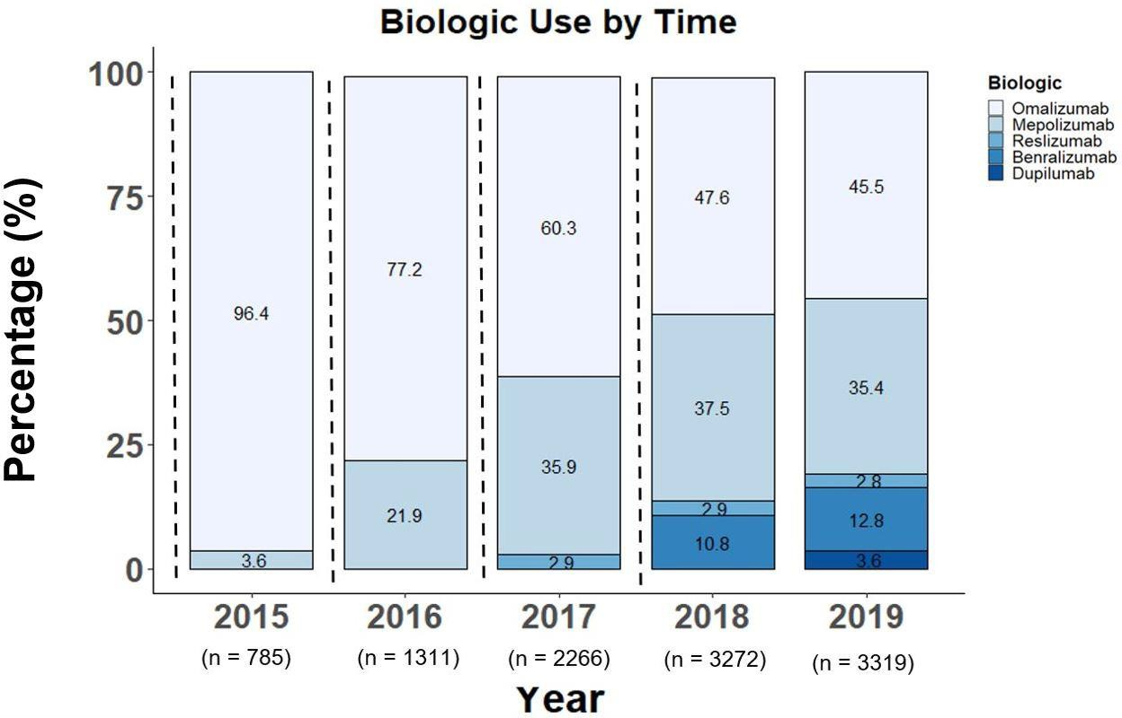
Patterns of biologic use over time by biologic class
4
Over time, the proportional use of Anti-IgE therapy ↓ while that of Anti-IL5/5R therapies ↑.
IgE = Immunoglobulin E; IL5/5R = Interleukin 5/5 receptor
Menzies-Gow AN, Price D et al. J Asthma Allergy 2022;15:63-78.

Slide 5
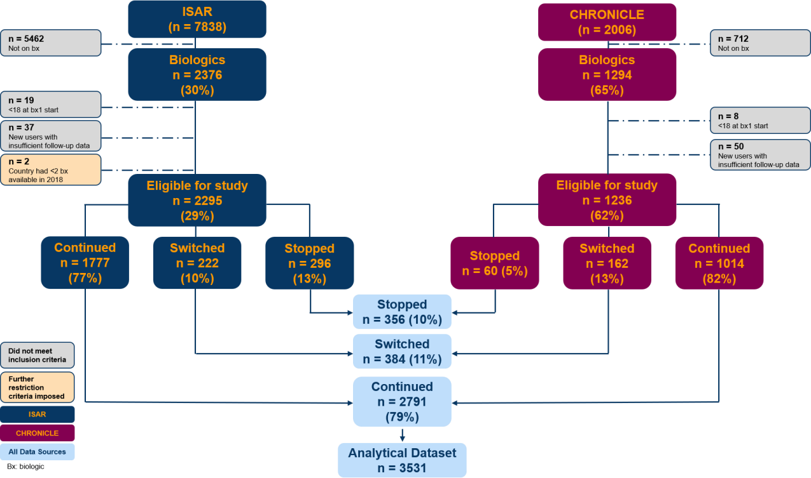
Patterns of biologic use in patients with severe asthma
5
79% of patients continued their first biologic for at least 6 months while 10.2% stopped and 10.8% switched during follow ups.
ISAR = International Severe Asthma Registry; CHRONICLE = Observational Study of Characteristics, Treatment and Outcomes With Severe Asthma in the United States Menzies-Gow AN, Price D et al. J Asthma Allergy 2022;15:63-78.

Slide 6
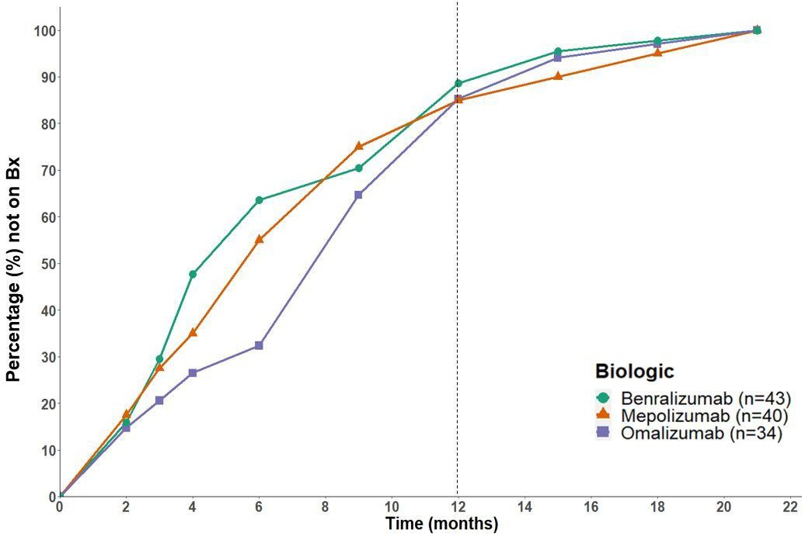
Time to biologic cessation in patients with severe asthma
6
Most patients stopped their first biologic within 12 months. The time
patients received their initial biologic varied for those who switched.
Bx = Biologic
Menzies-Gow AN, Price D et al. J Asthma Allergy 2022;15:63-78.

Slide 7
Patterns of biologic switches for patients with severe asthma
7
Of patients who stopped or switched their first biologic, the most common first switch was from omalizumab to (or, rarely, combined with) an anti–IL-5/5R.
Anti-IgE +│> Anti-IL5/5R
187
Anti-IL5/5R +│> Anti-IL5/5R
116
Anti-IL5/5R +│> Anti-IL4
29
Anti-IL5/5R +│>Anti-IgE
24
Anti-IgE <│+│> Anti-IL4
21
0 50 100 150
Number of Patients (n=377)
Patterns are mutually exclusive; │: or, < , >: sequence of switch; +: add-on use
200
IgE = Immunoglobulin E; IL4/13 = Interleukin 4/13; IL5/5R = Interleukin 5/5 receptor
Menzies-Gow AN, Price D et al. J Asthma Allergy 2022;15:63-78.

Slide 8
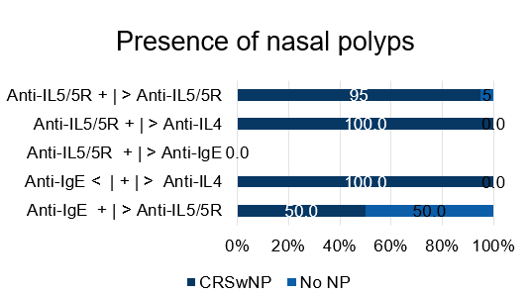
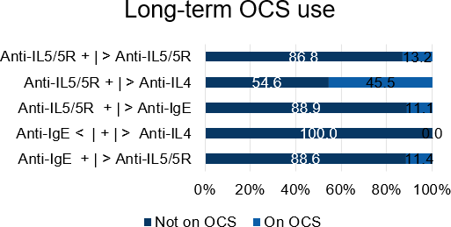
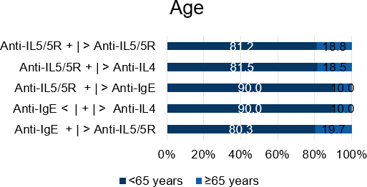
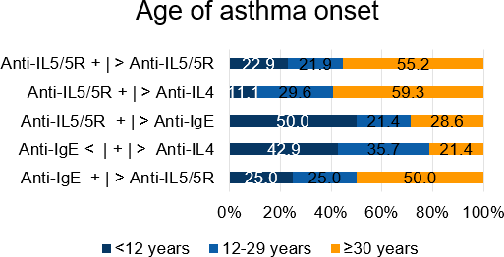
Patterns of biologic switches by age, LTOCS use, age of asthma onset and
presence of nasal polyps
8
n=76
n=20
n=5
n=0 n=3
n=11
n=18
n=8 n=140
n=70
n=69 n=27 n=20
n=20
n=132
n=96
n=27 n=14 n=14 n=104
CRSwNP = Chronic rhinosinusitis with nasal polyps; IgE = Immunoglobulin E; IL4 = Interleukin 4; IL5/5R = Interleukin 5/5 receptor; LTOCS = Long-term oral corticosteroid; NP = Nasal polyps; OCS = Oral corticosteroids
Menzies-Gow AN, Price D et al. J Asthma Allergy 2022;15:63-78.

Slide 9
Reasons a patient stopped or switched their first-prescribed biologic
9
The most commonly cited reasons for stopping or switching a biologic were insufficient clinical efficacy and adverse outcomes.
Reason | Stopped (n=139) | Switched (n=280)
Reason available n (%) | 113 | 183
Insufficient Clinical Efficacy | 72 (63.7%) | 158 (86.3%)
Potential Adverse Outcomes | 18 (15.9%) | 14 (7.7%)
Biologic Access Restriction | 8 (7.1%) | 5 (2.7%)
Patient Preference | 4 (3.5%) | 3 (1.6%)
Other | 12 (10.6%) | 11 (6.0%)
Menzies-Gow AN, Price D et al. J Asthma Allergy 2022;15:63-78.

Slide 10
Sensitivity analyses of prospective and non-US patients: Patterns of biologic use
10
100
90
84.2
86.6
80
79
74.1
Proportion of patients (%)
70
60
50
40
30
20
13.1
10.2
10.8
10.5
12.8
10
5.3
5.5
7.9
0
Total (n=3531)
eCRF (n=2656)
Continued Stopped Switched
USA only (n=2127)
Non-USA (n=1404)
eCRF = Electronic case report form; US = United States
Menzies-Gow AN, Price D et al. J Asthma Allergy 2022;15:63-78.

Slide 11
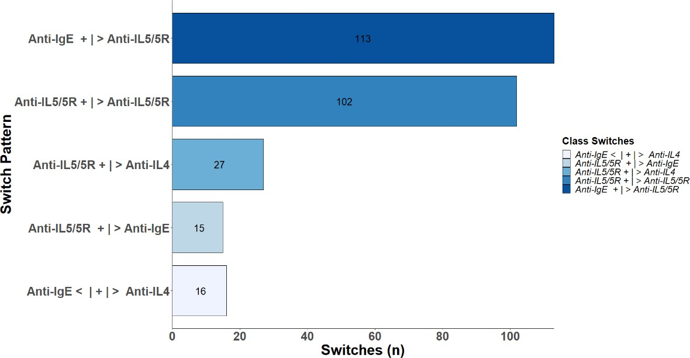
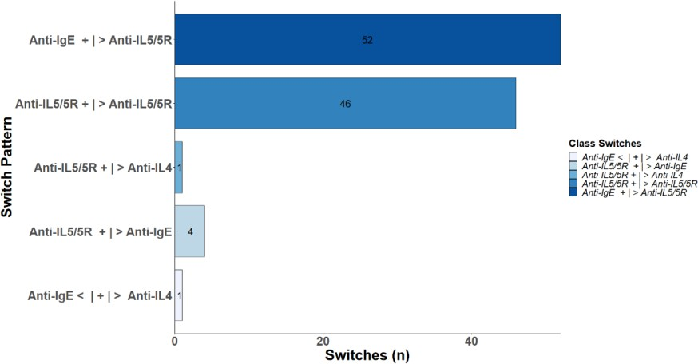
Sensitivity analyses of prospective and non-US patients: Patterns of first biologic switch
11
Like in the overall population, the most common first switch in prospective and non-US patients was from omalizumab to an anti-IL5/5R therapy.
eCRF data only (n=273)
Non-US data only (n=104)
eCRF = Electronic case report form; IgE = Immunoglobulin E; IL4 = Interleukin 4; IL5/5R = Interleukin 5/5 receptor; US = United States
Menzies-Gow AN, Price D et al. J Asthma Allergy 2022;15:63-78.

Slide 12
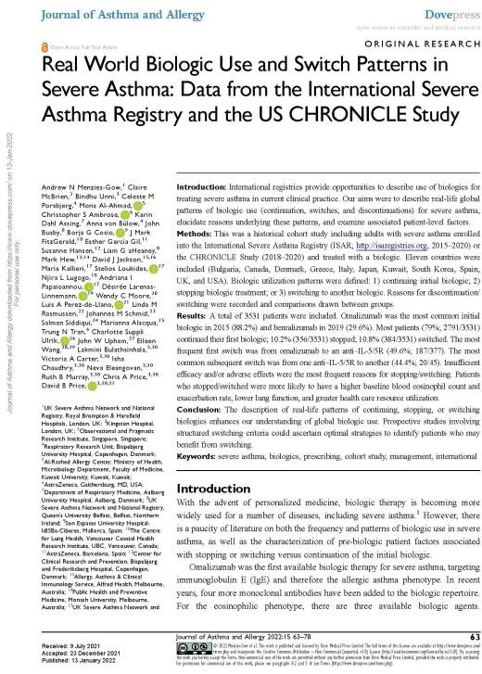
Conclusions
12
Our findings naturally trigger the question: Is the first biologic prescribed to a patient usually the best one for that individual, or are we under- switching?
ISAR = International Severe Asthma Registry
Menzies-Gow AN, Price D et al. J Asthma Allergy 2022;15:63-78.

Slide 13
Acknowledgements
We would like to thank all patients and collaborators who contributed to this research study.
This research study was funded and delivered by the Observational and Pragmatic Research Institute Pte Ltd (OPRI). The International Severe Asthma Registry (ISAR) is co- funded by Optimum Patient Care Global Limited and AstraZeneca.
Registration of the ISAR database with the European Union Electronic Register of Post-Authorization studies was also undertaken (ENCEPP/DSPP/23720). ISAR has ethical approval from the Anonymised Data Ethics Protocols and Transparency (ADEPT) committee (ADEPT0218). All data collection sites in the International Severe Asthma Registry (ISAR) have obtained regulatory agreement in compliance with specific data transfer laws, country- specific legislation, and relevant ethical boards and organizations.
ADEPT = Anonymised Data Ethics Protocols and Transparency; ENCePP = European Network of Centres for Pharmacoepidemiology and Pharmacovigilance; ISAR = International Severe Asthma Registry Menzies-Gow AN, Price D et al. J Asthma Allergy 2022;15:63-78.

