Slide 2
Aims and Methods
Aims
1. Describe the profile of adult patients with severe asthma eligible for
both anti-IgE and anti-IL5/5R
Adult severe asthma patients eligible eligible to receive both Anti-IgE and Anti-IL5/5R
2. Compare the effectiveness of both classes of treatment in real life.
Outcomes
1:1 matched cohort
Primary outcome: Exacerbation rate
Anti-IgE initiated (n=350)
Anti-IL5 initiated (n=350)
Secondary outcomes:
Long-term oral corticosteroid use
Emergency room visits
Hospitalizations
*OCS dependence is defined as being on long-term OCS upon initiation of biologic therapy. 1:1 matching by age, gender and LTOCS use
Bx: biologic; IgE = Immunoglobulin E; IL5 = IL5/5R = Interleukin 5/5-receptor; ISAR = International Severe Asthma Registry; LTOCS = Long-term oral corticosteroids; OCS = Oral corticosteroids Pfeffer P et al. Allergy. (2023). doi: 10.1111/all.15711

Slide 3
Associations between biologic therapy and outcomes at post-therapy
BMI= body mass index; IgE = Immunoglobulin E; IL5/5R = Interleukin 5/5-receptor; IRR = incidence rate ratio Pfeffer P et al. Allergy. (2023). doi: 10.1111/all.15711

Slide 4
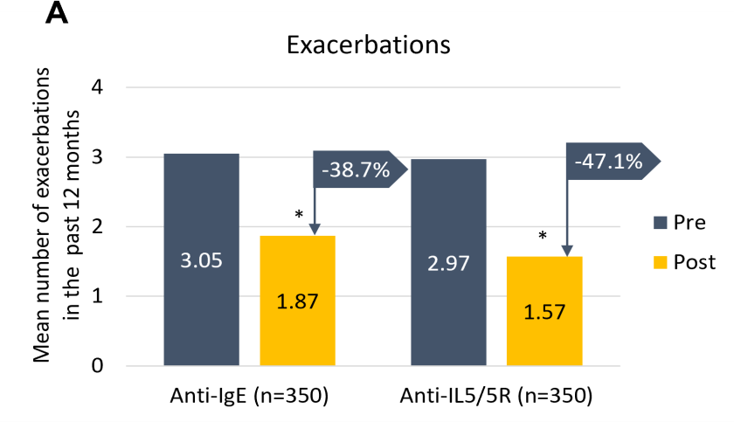
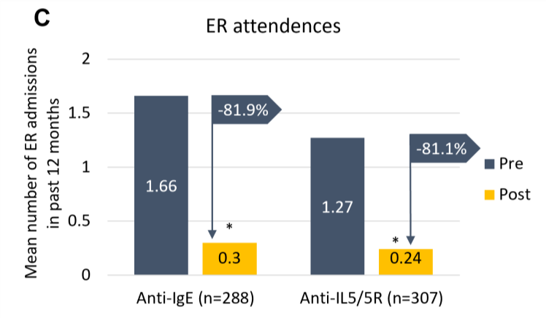
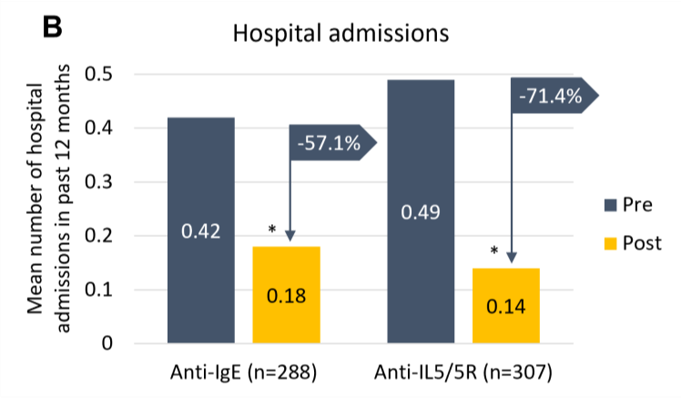
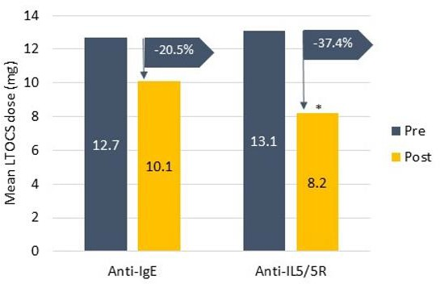
Determining the ‘right’ biologic when patients are eligible for
both Anti-IgE and Anti-IL5/5R – a matched analysis
LTOCS dose
(n = 49)
(n = 61)
ER = emergency room; IgE = Immunoglobulin E; IL5/5R = Interleukin 5/5-receptor; LTOCS = Long-term oral corticosteroids Pfeffer P et al. Allergy. (2023). doi: 10.1111/all.15711

Slide 5
Conclusions
In real-life, both anti-IgE and anti-IL5/5R improve asthma outcomes in patients eligible for both biologic classes.
Anti-IL5/5R was superior in reducing asthma exacerbations and LTOCS use.
These findings can assist treatment decisions and add to the growing body of
robust real-life data on biologics.
IgE = Immunoglobulin E; IL5/5R = Interleukin 5/5-receptor; LTOCS = Long-term oral corticosteroids Pfeffer P et al. Allergy. (2023). doi: 10.1111/all.15711

Slide 6
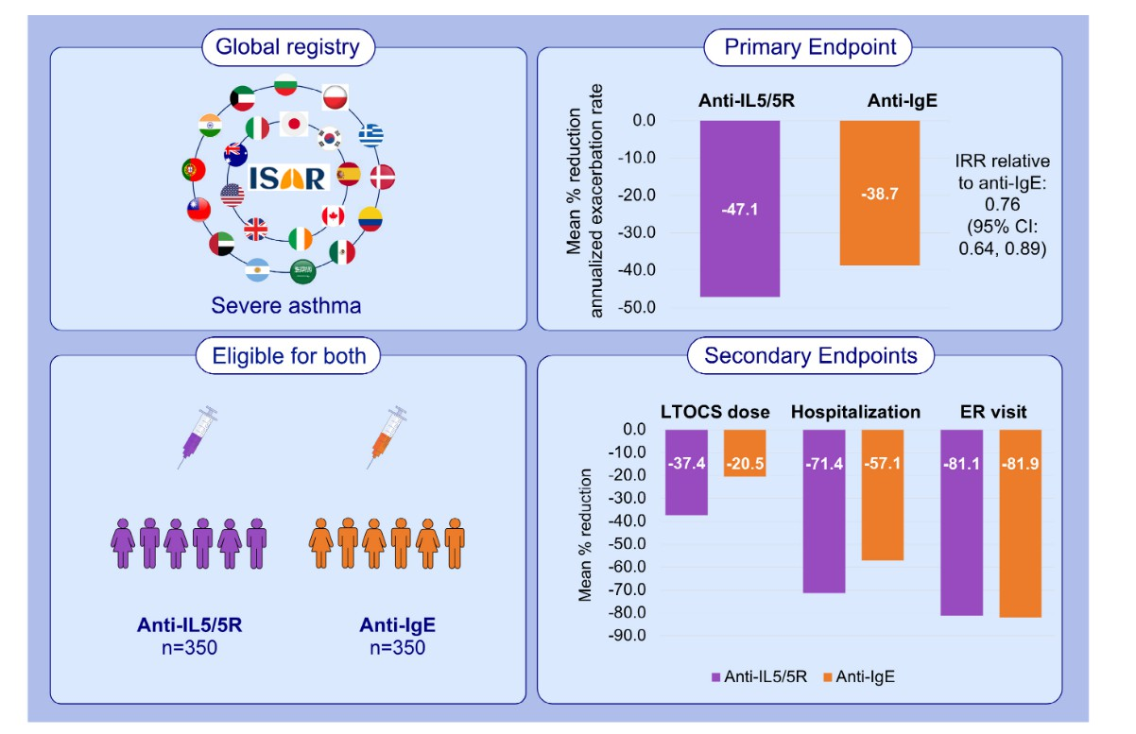
Recap
Thank you!

