Slide 1
Cluster Analysis of Inflammatory Biomarker Expression in the International Severe Asthma Registry
Eve Denton, David B. Price, Trung N. Tran, G. Walter Canonica, Andrew Menzies-Gow, J. Mark FitzGerald, Mohsen Sadatsafavi, Luis Perez de Llano, George Christoff, Anna Quinton, Chin Kook Rhee, Guy Brusselle, Charlotte Ulrik, Njira Lugogo, Fiona Hore-Lacy, Isha Chaudhry, Lakmini
Bulathsinhala, Ruth B. Murray, Victoria A. Carter, Mark Hew
Denton E., et al. JACI In Pract 2021:Article In press

Slide 2
The ISAR Initiative
Lack of non-drug specific registries
Lack of data interoperability across regional or country- specific registries due to non- standardised data collection
WHY
?
No clear guideline for SA referrals
Existing country registries are small
A large observational registry with pooled data from multiple countries has the statistical power to better understand severe asthma epidemiology, clinical management and outcomes across international populations.

Slide 3
The Broad Inclusion Criteria For Enrolment Captures a Diverse Patient Population Rarely Represented in RCTs
Inclusion
Adult ≥18 years old with severe asthma
Smokers ACO
Moderate-to- severe asthma
Undergoing GINA Step 5 treatment OR uncontrolled on GINA Step 4
treatment
Uncontrolled as defined by ERS/ATS guidelines
Poor symptom control where ACQ is consistently > 1.5, ACT <20
Airflow limitation where pre-bronchodilator FEV₁ <80% predicted, with reduced FEV₁/FVC
Serious exacerbations with ≥1 hospitalization, ICU stay or mechanical ventilation in the previous year
Frequent severe exacerbations with ≥2 bursts of SCS with each course >3 days in the previous
year
Exclusion
Lack of informed consent for participation
Fitzgerald JM, Price DB et al. BMC Med Res Methodol 2020;20:212

Slide 4
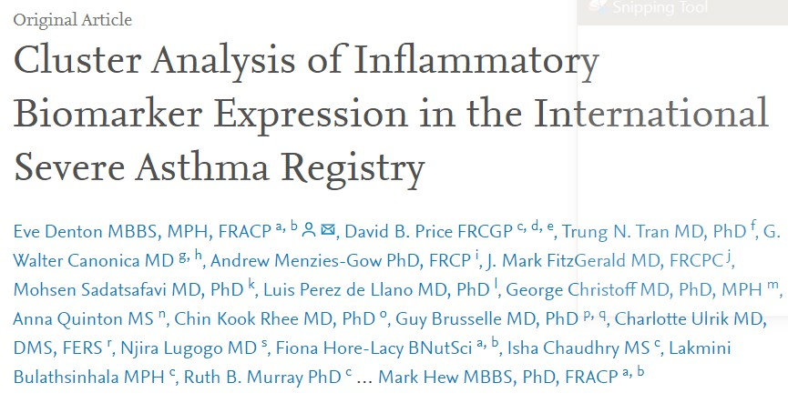
BRISAR: Background & Aim
Inflammatory pathway in severe asthma | Associated biomarker
Allergy | Serum IgE
Eosinophilic inflammation | Blood eosinophil count
Airway epithelial dysregulation | FeNO
Severe asthma is a heterogenous disease – a variety of cellular pathways are activated and differentially expressed
Inflammatory biomarkers are used to characterize severe asthma phenotypes and guide the delivery of precision medicine; however, little is known about the overlap and relatability of these biomarkers in severe asthma
The aim of this study is to therefore describe the interrelation between inflammatory biomarker expression in severe asthma to characterize the activation of underlying inflammatory pathways using a large, international cohort
Denton E., et al. JACI In Pract 2021:Article In press

Slide 5
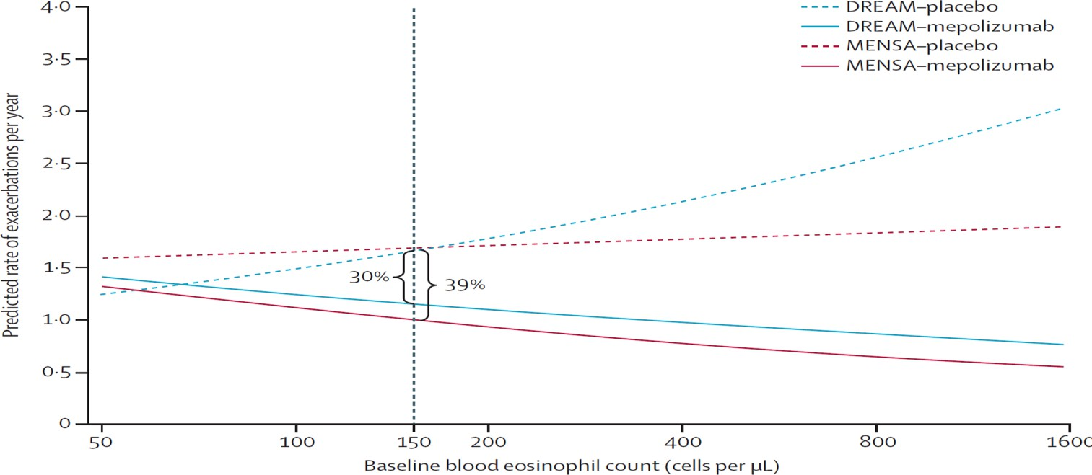
Differential Expression of Biomarkers Can Predict Treatment Response to Different Therapies
DREAM/MENSA: Increased blood eosinophil count associated with better response to Mepolizumab:
Patients with low eos and high FeNO respond to Dupilumab:
 | AER relative risk in dupilumab vs placebo
FeNO (ppb) |  | <25 | 25 to <50 | ≥50
Baseline Eos levels (cells/µL) | <150 | 1.154 | 0.643 | 0.551
 | 150 to <300 | 0.601 | 0.494 | 1.182
 | ≥300 | 0.564 | 0.347 | 0.194
Differential activation of
inflammatory pathways
Differential expression of
biomarkers
Manifestation of associated
clinical characteristics
Ortega HG, et al. Lancet Respir Med 2016;4(7):549-556
Pavord ID et al. Presented at AACI 2020
Denton E., et al. JACI In Pract 2021:Article In press

Slide 6
A Cross-Sectional Study: Design
Objective 1
To distinguish patient groups with different patterns of biomarker activation
Objective 2
To compare the clinical characteristics of the patient subgroups derived from these analyses
Categorized according to biomarker positivity*:
1
Eos count:
≥300cells/µL
Outcomes:
Demographics
Lung function
Asthma symptoms
Exacerbations
Allergic comorbidities
Asthma medications
Inclusion:
ISAR population
At least one measurement
of each biomarker
4
5
7
6
2
Serum IgE:
≥ 75kU/L
3
FeNO:
≥25ppb
8
Index date: Date of enrolment in ISAR
Biomarker levels measured pre-biologic initiation
*Biomarkers were measured at baseline; the highest measurement was used in cases of multiple baseline measurements
Denton E., et al. JACI In Pract 2021:Article In press

Slide 7
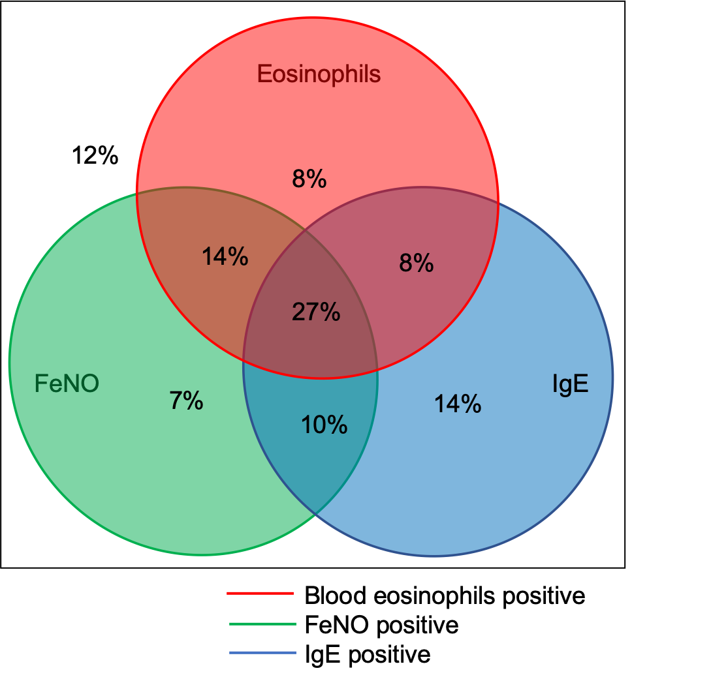
Triple Positivity Was The Most Common Biomarker Overlap Group
n=1175
There is substantial overlap between biomarker positivity groups
≥300cells/µL
A greater overlap was observed with eosinophils
and FeNO than with IgE
Overall:
57% were positive for eosinophils
58% were positive for FeNO
59% were positive for IgE
≥25ppb
≥ 75kU/L
Denton E., et al. JACI In Pract 2021:Article In press

Slide 8
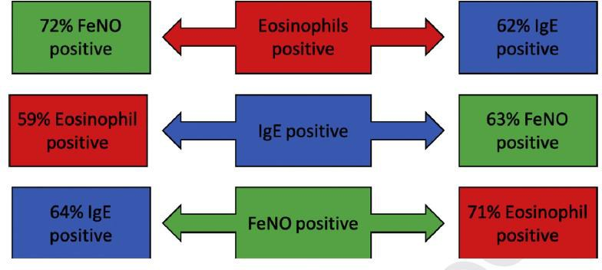
Likelihood of alternate biomarker positivity
Denton E., et al. JACI In Pract 2021:Article In press

Slide 9
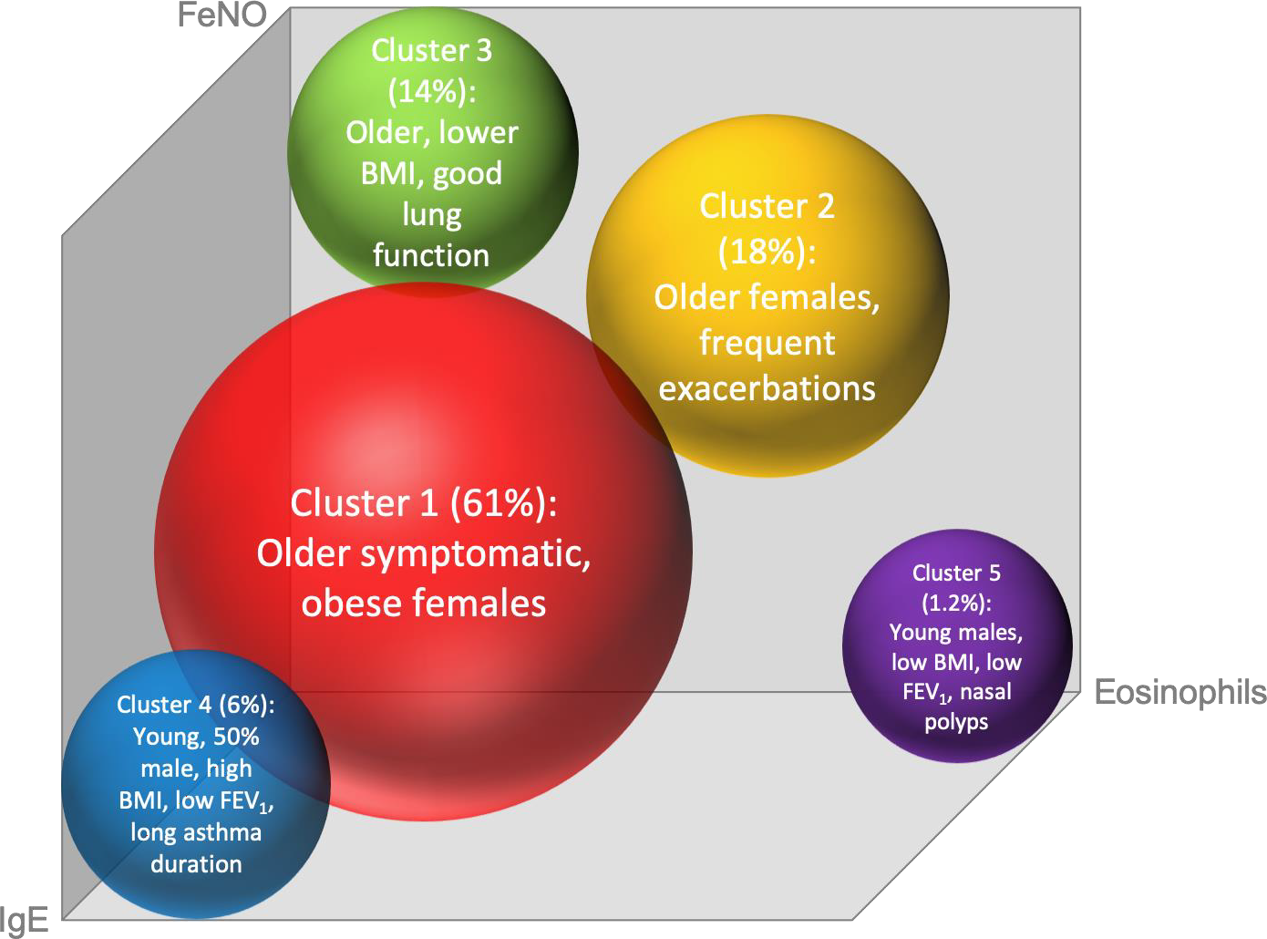
Five Distinct Clusters Based on Biomarker Profiles
High FeNO
Moderate IgE
Moderate eos
High eos
High FeNO
Low IgE
Low eos
Low FeNO
Low IgE
Very high eos
High FeNO
High eos
Very high IgE
Moderate eos
Moderate FeNO
Denton E., et al. JACI In Pract 2021:Article In press

Slide 10
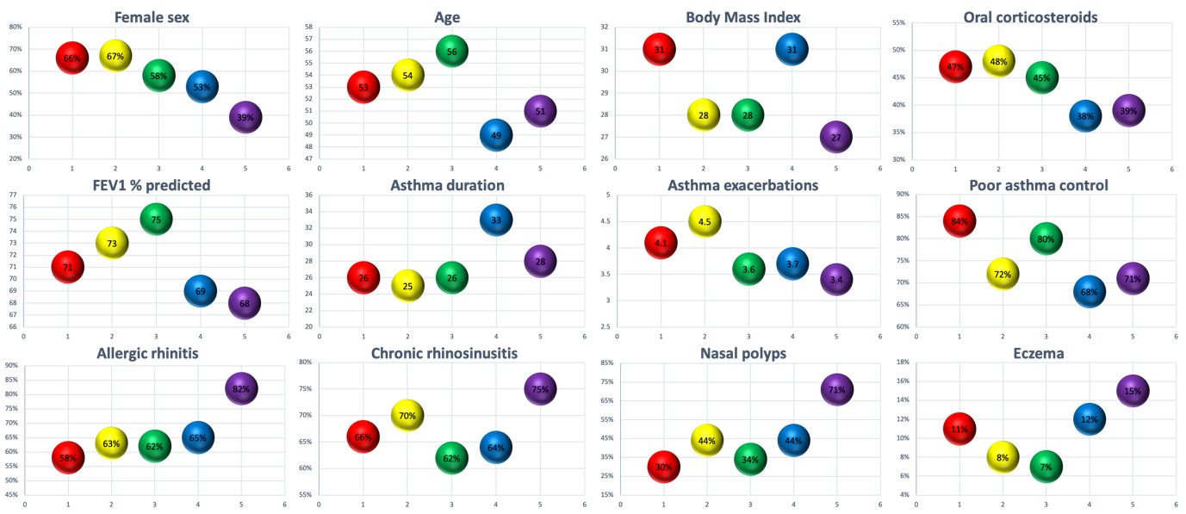
Clinical Characteristics Associated With Each Patient Subgroup
Cluster 1:
Low eos
Low FeNO
Low IgE
Cluster 2:
High eos
High FeNO
Low IgE
Cluster 3:
High FeNO
Moderate IgE
Moderate eos
Cluster 4:
Very high IgE
Moderate eos
Moderate FeNO
Cluster 5:
Very high eos
High FeNO
High eos
p=0.01
p=0.03
p=<0.001
p=0.003
p=0.01
Denton E., et al. JACI In Pract 2021:Article In press

Slide 11
Implications for Clinical Practice
New methods are required to determine the most appropriate choice of targeted therapy – simply relying on biomarker positivity is not appropriate due to the significant overlap groups
There is an urgent unmet need in severe asthma, where patients negative for all three biomarkers cannot be appropriately treated by currently available biologics
Discrete clusters of severe asthma phenotypes based on specific combinations of biomarker profiles can be identified – future research can use these patient sub-populations as a basis to better understand severe asthma disease mechanisms

Slide 12
Conclusion
Many patients have an overlap in biomarker positivity, which may assist in delivering precision medicine
Specific combinations of inflammatory pathway activation predominate in severe asthma
Distinct inflammatory endotypes underpin clinically recognizable phenotypes

