Slide 1
Asthma exacerbations are associated with a decline in lung
function: a longitudinal population-based study
Seyi Soremekun, Liam G Heaney, Derek Skinner , Lakmini Bulathsinhala, Victoria Carter, Isha Chaudhry, Naeimeh Hosseini, Neva Eleangovan, Ruth Murray, Trung N Tran, Benjamin Emmanuel, Esther Garcia Gil, Andrew Menzies-Gow, Matthew Peters, Njira Lugogo, Rupert Jones, David B Price

Slide 2
The role of exacerbations on lung function trajectory in a broad asthma population
2
Inclusion criteria
Aged ≥ years old
Asthma diagnosis
Active asthma during the baseline year
years of lung function data
valid lung function measurements of the same type
Primary outcome
Peak Expiratory Flow (PEF) rate – used to track lung function trajectories according to annual exacerbation rate
Historical cohort study
n=,
Exclusion criteria
Diagnosis of COPD or other chronic respiratory conditions
COPD = Chronic obstructive pulmonary disease
Soremekun S et al. Thorax 2022; 10.1136/thorax-2021-217032

Slide 3
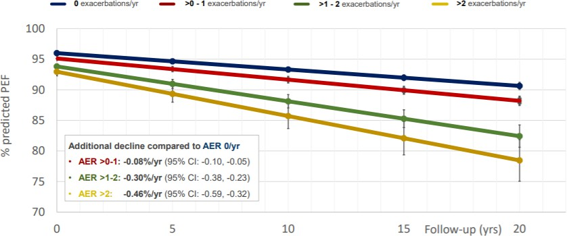
Exacerbations and lung function decline in asthma
3
AER = Annual exacerbation rate; PEF = Peak expiratory flow
Soremekun S et al. Thorax 2022; 10.1136/thorax-2021-217032

Slide 4
Age and lung function decline
4
Treating exacerbations may benefit lung function in the long term
AER = Annual exacerbation rate; PEF = Peak expiratory flow
Soremekun S et al. Thorax 2022; 10.1136/thorax-2021-217032

