Slide 1
Impact of pre-biologic impairment on meeting domain-specific biologic responder definitions in patients with severe asthma (BEAM)
Luis Perez-de-Llano, Ghislaine Scelo, G. Walter Canonica, Wenjia Chen, William Henley, Désirée Larenas-Linnemann, Matthew J Peters, Paul E. Pfeffer, Trung N. Tran, Charlotte Suppli Ulrik, Todor A. Popov, Mohsen Sadatsafavi, Mark Hew, Jorge Maspero, Peter G. Gibson, George C. Christoff, J. Mark Fitzgerald, Carlos A. Torres-Duque, Celeste M. Porsbjerg, Nikolaos G. Papadopoulos, Andriana I. Papaioannou, Enrico Heffler, Takashi Iwanaga, Mona Al-Ahmad, Piotr Kuna, João A Fonseca, Riyad Al-Lehebi, Chin Kook Rhee, Mariko Siyue Koh, Borja G. Cosio, Diahn-Warng Perng (Steve), Bassam Mahboub, Andrew N. Menzies-Gow, David J. Jackson, John Busby, Liam G. Heaney, Pujan H Patel, Eileen Wang, Michael E. Wechsler, Alan Altraja, Lauri Lehtimäki, Arnaud Bourdin, Leif Bjermer, Lakmini Bulathsinhala, Victoria Carter, Ruth Murray, Aaron Beastall, Eve Denton, David B. Price
Perez-de-Llano et al., Impact of pre-biologic impairment on meeting domain-specific biologic responder definitions in patients with severe asthma, Ann Allergy Asthma Immunol, published Dec 2023, in press, DOI :https://doi.org/10.1016/j.anai.2023.12.023

Slide 2
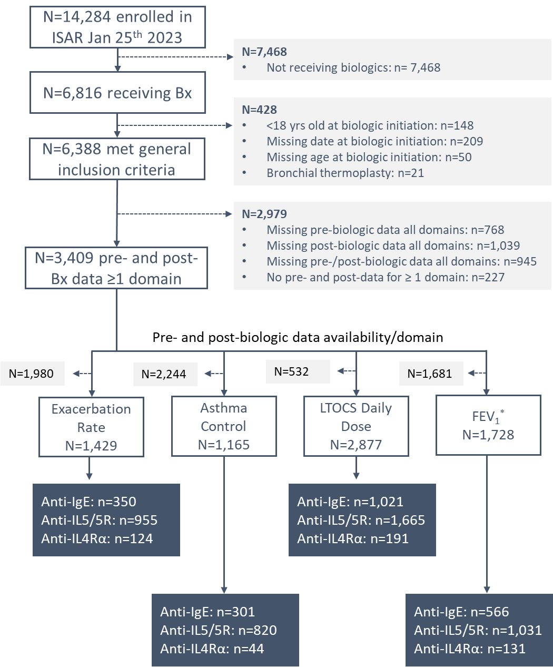
Aim and Methods
Rationale
There is little agreement on clinically useful criteria for identifying real-world responders to biologic treatments for asthma.
Objective
To investigate the impact of pre-biologic impairment on meeting domain-specific biologic responder definitions in adults with severe asthma.
Methods
Longitudinal cohort study across 22 countries participating in ISAR from May 2017 to January 2023.
Change in four asthma domains (exacerbation rate, asthma control, long-term oral corticosteroid [LTOCS] dose, and lung function) was assessed from biologic initiation to one year post-treatment (minimum 24 weeks)
Pre- to post-biologic changes for responders and non-responders were described along a categorical gradient for each domain derived from pre-biologic distributions (exacerbation rate: 0 to 6+/year; asthma control: well-controlled to uncontrolled; LTOCS: 0 to >30 mg/day; ppFEV1: <50 to ≥80%)
Perez-de-Llano et al., Impact of pre-biologic impairment on meeting domain-specific biologic responder definitions in patients with severe asthma, Ann Allergy Asthma Immunol, published Dec 2023, in press, DOI :https://doi.org/10.1016/j.anai.2023.12.023
ISAR: International Severe Asthma Registry, Bx: biologic, Anti-IgE: Anti-Immunoglobulin E, Anti-IL5/5R: Anti-Interleukin 5/5R, Anti-IL4: Anti-Interleukin 4, FEV1: Forced Expiratory Volume 1 second, *both percent predicted and absolute.

Slide 3
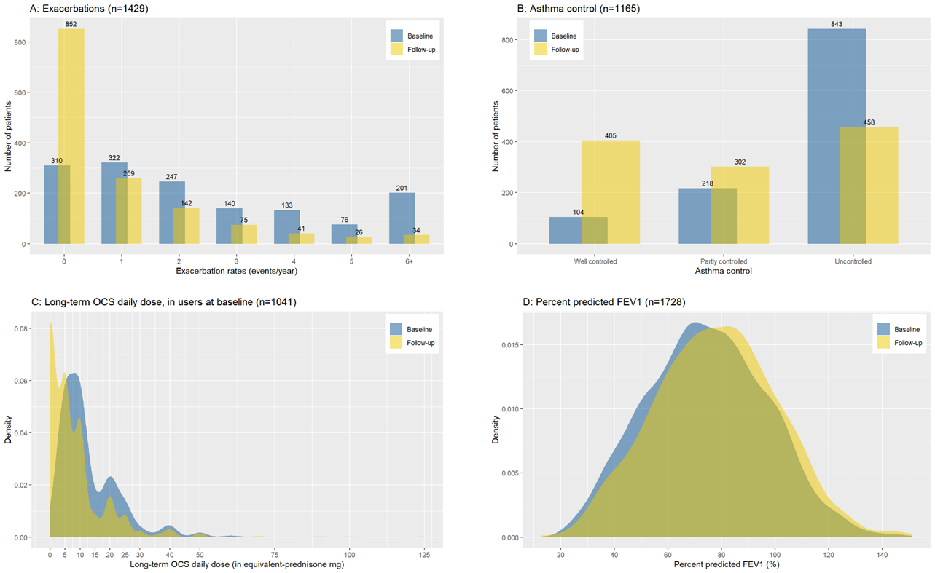
Statistically significant improvements were observed from pre- to post-biologic initiation for all asthma outcome domains assessed
p<0.001
p<0.001
p<0.001
p<0.001
FEV1: forced expiratory volume in one second; OCS: oral corticosteroid
Perez-de-Llano et al., Impact of pre-biologic impairment on meeting domain-specific biologic responder definitions in patients with severe asthma, Ann Allergy Asthma Immunol, published Dec 2023, in press, DOI:https://doi.org/10.1016/j.anai.2023.12.023

Slide 4
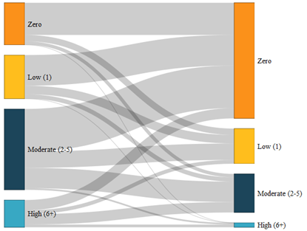
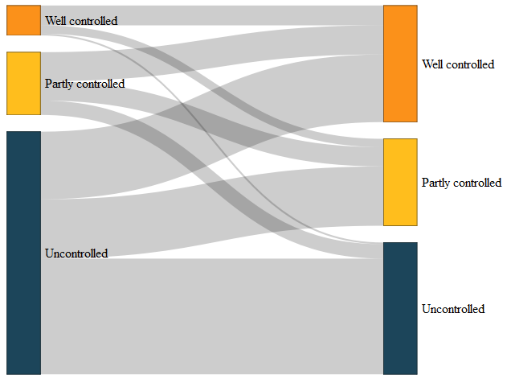
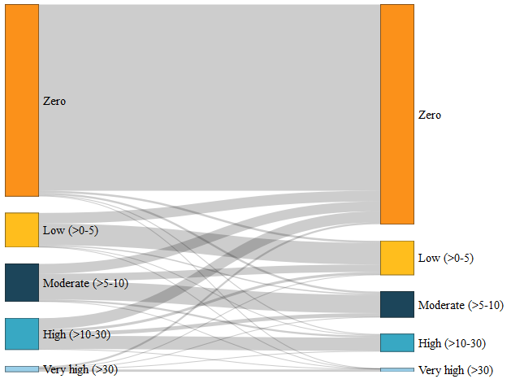
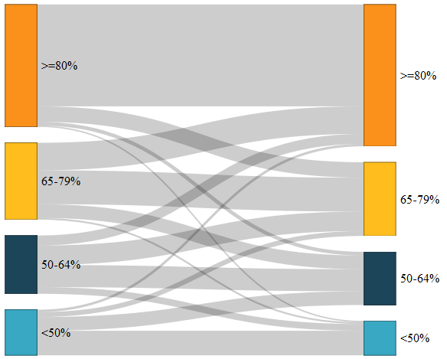
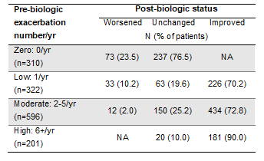
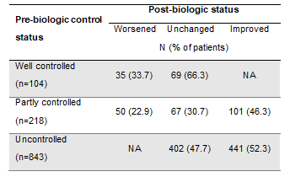
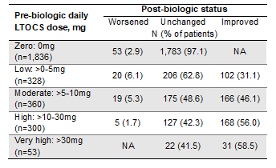
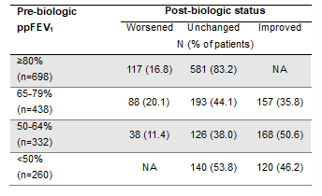
Responders to biologics increased with greater pre-biologic impairment: Increasing from 70.2 to 90.0% for exacerbation rate, 46.3 to 52.3% for asthma control, 31.1 to 58.5% for LTOCS daily dose, and 35.8 to 50.6% for ppFEV1
Exacerbations
Asthma Control
LTOCS daily dose
% predicted FEV1
Pre-bx Post-bx
Pre-bx Post-bx
Pre-bx Post-bx
Pre-bx Post-bx
Perez-de-Llano et al., Impact of pre-biologic impairment on meeting domain-specific biologic responder definitions in patients with severe asthma, Ann Allergy Asthma Immunol, published Dec 2023, in press, DOI :https://doi.org/10.1016/j.anai.2023.12.023
Bx: biologic, ppFEV1: percent predicted Forced Expiratory Volume 1 second, LTOCS: Long-term Oral Corticosteroid, NA: Not Applicable

Slide 5
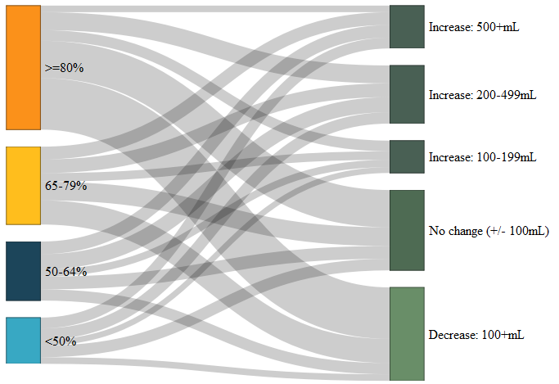
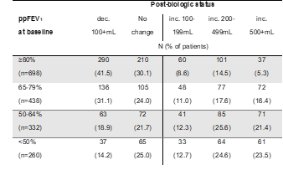
Even those with low pre-biologic impairment, who would be actively excluded from RCTs investigating biologic efficacy, exhibited clinically meaningful post-biologic improvement
Exacerbations
Change in absolute ppFEV1
Absolute FEV1
70% of patients with only 1 exacerbation per year improved to zero exacerbations
28% of patients with ppFEV1≥80% improved by ≥100mL FEV1
Pre-bx Post-bx
Pre-bx Post-bx
Perez-de-Llano et al., Impact of pre-biologic impairment on meeting domain-specific biologic responder definitions in patients with severe asthma, Ann Allergy Asthma Immunol, published Dec 2023, in press, DOI :https://doi.org/10.1016/j.anai.2023.12.023 Bx: biologic, ppFEV1: percent predicted Forced Expiratory Volume 1 second, RCT: Randomised Controlled Trial

Slide 6
Proportion of patients showing improvement post-biologic tended to be greater for anti–IL-5/5R compared to anti-IgE, irrespective of the degree of pre-biologic impairment
Post-biologic status (worsened, unchanged, improved) according to pre-biologic impairment and biologic class for the asthma outcome domains exacerbation rate and asthma control
Perez-de-Llano et al., Impact of pre-biologic impairment on meeting domain-specific biologic responder definitions in patients with severe asthma, Ann Allergy Asthma Immunol, published Dec 2023, in press, DOI :https://doi.org/10.1016/j.anai.2023.12.023
Anti-IgE: Anti-Immunoglobulin E, Anti-IL5/5R: Anti-Interleukin 5/5R

Slide 7
Summary BEAM: Improvement across all domains, with greater pre-biologic disease, but meaningful change even with pre-biologic impairment
Statistically significant improvements were observed from pre- to post-biologic treatment for all asthma outcome domains assessed
The proportion of patients showing improvement post-biologic tended to be greater for anti–IL-5/5R compared to anti-IgE for exacerbation, asthma control, and ppFEV1 domains irrespective of pre-biologic impairment
Those with greater disease burden pre-biologic therapy tended to have a greater magnitude of effect for each domain assessed
Even those with low pre-biologic impairment, who would be actively excluded from RCTs investigating the efficacy of biologics, exhibited clinically meaningful post-biologic improvement
A multi-dimensional approach to define and assess biologic responders and response needed
Perez-de-Llano et al., Impact of pre-biologic impairment on meeting domain-specific biologic responder definitions in patients with severe asthma, Ann Allergy Asthma Immunol, published Dec 2023, in press, DOI :https://doi.org/10.1016/j.anai.2023.12.023
Anti-IgE: Anti-Immunoglobulin E, Anti-IL5/5R: Anti-Interleukin 5/5R, RCT: Randomized Controlled Trial, ppFEV1: percent predicted Forced Expiratory Volume 1 second,

